Slide 1
ECON 205
Chapter 1
Prof. Dr. Dilek TEMİZ
Lecture Notes

Slide 2
INTRODUCTION
In these first two chapters we review material from the introductory microeconomics course.
Chapter 1 applies the principles of cost-benefit analysis to a variety of choices familiar from experience. Its goal is to give you a natural feel for what it means to “think like an economist.”
Chapter 2 develops basic supply and demand analysis, our analytical tool for explaining the prices and quantities of goods traded in markets.

Slide 3
All economic questions and problems arise because human wants exceed the resources available to satisfy them.
Scarcity
Scarcity is the condition that arises because wants exceeds the ability of resources to satisfy them.
Faced with scarcity, we must make choices—we must choose among the available alternatives.
The choices we make depend on the incentives we face.

Slide 4
Economics Defined
Economics is the social science that studies the choices that individuals, businesses, governments, and entire societies make as they cope with scarcity, the incentives that influence those choices, and the arrangements that coordinate them.

Slide 5
Economics divides into two parts:
Microeconomics: The study of the choices that individuals and businesses make and the way these choices interact and are influenced by governments.
Macroeconomics: The study of the aggregate (or total) effects on the national economy and the global economy of the choices that individuals, businesses, and governments make.

Slide 6
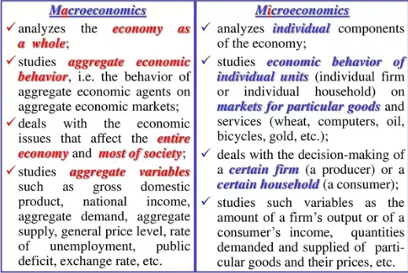

Slide 7
Two big economic questions:
How do choices determine what, how, and for whom goods and services get produced?
When do choices made in self-interest also promote the social interest?

Slide 8
What, How, and For Whom?
Goods and services are the objects (goods) and actions (services) that people value and produce to satisfy human wants.
What goods and services get produced and in what quantities?
How are goods and services produced?
For Whom are the various goods and services produced?

Slide 9
Economic Ideas
Six ideas define the economic way of thinking:
Choice is a tradeoff
Cost is what you must give up to get something
Benefit is what you gain from something
People make rational choices by comparing benefits and costs
Most choices are “how much” choices made at the margin
Choices respond to incentives (dürtü)

Slide 10
A Choice Is a Tradeoff
Because we face scarcity we must make choices.
To make a choice we select from alternatives.
Whatever choice you make, you could have chosen something else.
You can think about your choices as tradeoffs.
A tradeoff is an exchange—giving up one thing to get something else.

Slide 11
Cost: What You Must Give Up
Opportunity cost is the best thing that you must give up to get something—the highest-valued alternative forgone.
Benefit: What You Gain
Benefit is the gain or pleasure that something brings.
Benefit is measured by what you are willing to give up.

Slide 12
Rational Choice
A rational choice is a choice that uses the available resources to best achieve the objective of the person making the choice.
We make rational choices by comparing costs and benefits.

Slide 13
Marginal cost is the opportunity cost of a one-unit increase in an activity.
The marginal cost of something is what you must give up to get one additional unit of it.
Marginal benefit is what you gain when you get one more unit of something.
The marginal benefit of something is measured by what you are willing to give up to get one additional unit of it.

Slide 14
Making a Rational Choice
You make a rational choice when you take those actions for which marginal benefit exceeds or equals marginal cost.
Choices Respond to Incentives
An incentive is a reward or a penalty that encourages or discourages an action.

Slide 15
Common Pitfalls (Tuzak) in Decision Making
Ignoring Implicit Costs (örtülü maliyetleri yok saymak)
Failing to Ignore Sunk Costs (Batık Maliyetleri Gözardı Etmemek)
Measuring Costs and Benefits as Proportions Rather than Absolute Dollar Amounts (Maliyetlerin ve Faydaların Mutlak Dolar Tutarları Yerine Orantılı Olarak Ölçülmesi)
Failure to Understand the Average-Marginal Distinction (Ortalama-Marjinal Ayrımını Anlayamama)

Slide 16
Pitfall #1: Ignoring Implicit Costs
Implicit costs are a specific type of opportunity cost.
If doing activity x means not being able to do activity y, then the value to you of doing y is an opportunity cost of doing x.
In other words, the opportunity cost is the value of all that must be sacrificed to do the activity.

Slide 17
Pitfall #2: Failing to Ignore Sunk Costs Batık Maliyetleri Gözardı Etmemek
An opportunity cost may not seem to be a relevant cost when in reality it is.
On the other hand, sometimes an expenditure may seem relevant when in reality it is not.
Sunk costs: A sunk cost refers to money that has already been spent and which cannot be recovered.
These costs should be ignored.

Slide 18
For example, your rent, marketing campaign expenses or money spent on new equipment can be considered sunk costs.
A sunk cost can also be referred to as a past cost. Businesses don't typically consider sunk costs in their financial analysis for the future because these costs have already happened, they can't be recovered and they won't change.

Slide 19
Example 1:
Let's say you own a store and you spend $30,000 training your staff on how to use the new software you've installed on your company's computers.
After a while, the software is no longer up to par and you discern that need to use a different software. This would require you to train your employees yet again.
The $30,000 you spent training your employees for the first software is considered a sunk cost because it will never be recovered. As a business owner, you'll likely spend money on the research and development of your upcoming or current products.

Slide 20
Example 2:
Let's say you spend $10,000 on the development of a new cell phone.
Once the product is released, however, no consumers display an interest in purchasing your company's new cell phone.
The $10,000 you spent on the cell phone's development is considered a sunk cost since it was a failed investment, you won't be recovering it and, therefore, shouldn't be considered in your decisions on the fate of the cell phone.

Slide 21
Pitfall #3: Measuring Costs and Benefits as Proportions Rather Than Absolute Dollar Amounts
When comparing costs and benefits, always use absolute dollar amounts, not proportions.

Slide 22
Pitfall #4: Failure to Understand the Average-Marginal Distinction
Compare the benefit and cost of an additional unit of activity.
Marginal cost: the increase in total cost that results from carrying out one additional unit of activity
Marginal benefit: the increase in total benefit that results from carrying out one additional unit of activity
Keep increasing the level of an activity as long as its marginal benefit exceeds its marginal cost.

Slide 23
Positive Questions and Normative Questions
Normative question: a question about what policies or institutional arrangements lead to the best outcomes.
Positive question: a question about the consequences of specific policies or institutional arrangements.

Slide 24
A positive statement can be tested by checking it against facts. A normative statement expresses an opinion and cannot be tested.
Positive economics is the study of what is. Normative economics is the study of what should be.

Slide 25
Positive economics deals with objective explanation and the testing and rejection of theories. For example:
A fall in incomes will lead to a rise in demand for own-label supermarket foods.
The rising price of crude oil on world markets will lead to an increase in cycling to work.
A reduction in income tax will improve the incentives of the unemployed to find work.
A rise in average temperatures will increase the demand for sun screen products.
Higher interest rates will reduce house prices.

Slide 26
Normative statements are subjective statements – i.e. they carry value judgments. For example:
Pollution is the most serious economic problem
Unemployment is more harmful than inflation
The government should increase the minimum wage to £7 per hour to reduce poverty.
The retirement age should be raised to 70 to combat the effects of our ageing population.
Resources are best allocated by allowing the market mechanism to work freely

Slide 27
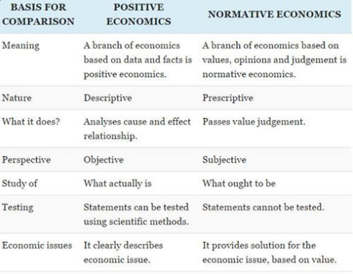

Slide 28
Microeconomics and Macroeconomics
Microeconomics: the study of individual choices and the study of group behavior in individual markets
Macroeconomics: the study of broader aggregations of markets

Slide 30
Microeconomics is the study of how households and firms make choices, how they interact in markets, and how the government attempts to influence their choices.
In contrast, macroeconomics is the study of the economy as a whole, including topics such as inflation, unemployment, and economic growth.
When we want to study the overall economy-level actions of people and governments, the models and tools of macroeconomics become very useful.

Slide 31
Economists are much better at predicting and explaining what happens in individual markets than in the economy as a whole.
When prominent economists disagree in the press or on television, the issue is more likely to be from macroeconomics than from microeconomics.
But even though economists still have trouble with macroeconomic questions, macroeconomic analysis is undeniably important. After all, recessions and inflation disrupt millions of lives.

Slide 32
Economists increasingly believe that the key to progress in macroeconomics lies in more careful analysis of the individual markets that make up broader aggregates.
As a result, the distinction between micro and macro has become less clear in recent years.
The graduate training of all economists, micro and macro alike, is increasingly focused on microeconomic analysis.

Slide 33
Q1. Cemil has a flexible summer job. He can work every day but is allowed to take a day off anytime he wants. His friend Ahmet suggests they go to the amusement (game) park on Tuesday. The admission charge for the park is $15 per person, and it will cost them $5 each for gasoline and parking. Cemil loves amusement parks and a day at the park is worth $45 to him. However, Cemil
also enjoys his job so much that he would actually be willing to pay $10 per day to do it.
If Cemil earns $10 if he works, should he go to the amusement park?
b. If Cemil earns $15 . . . ?
c. If Cemil earns $20 . . . ?

Slide 34
A1. Let $X be the amount Cemil earns in a day on his job. The cost to Cemil of going to the park is then $15 (admission fee) + $5 (gas & parking) + $10 (the lost satisfaction from not working) + $X (lost salary) = $30 + $X.
The benefit of going to the park is $45.
He should go to the park if his salary is $10/day,
and shouldn't go if his salary is $20/day.
At a salary of $15/day, he is indifferent between going and not going.

Slide 35
Q2. Which of the following sentences is a positive claim and which is a normative claim?
1. We need a higher minimum wage.
2. Working people at minimum wage are not above the poverty level.
3. That is not fair.
4. But a higher minimum wage will mean that some low wage workers will be laid off and have no job.
The first and third sentences are normative and the other two are positive statements.

Slide 36
The production possibility frontier (PPF)
The production possibility frontier (PPF) illustrates the trade-offs facing an economy that produces only two goods. It shows the maximum quantity of one good that can be produced for any given production of the other.

Slide 37
Production possibilities frontier: The boundary between the combinations of goods and services that can be produced and the combinations that cannot be produced, given the available factors of production and the state of technology.
The PPF is a valuable tool for illustrating the effects of scarcity and its consequences.

Slide 38
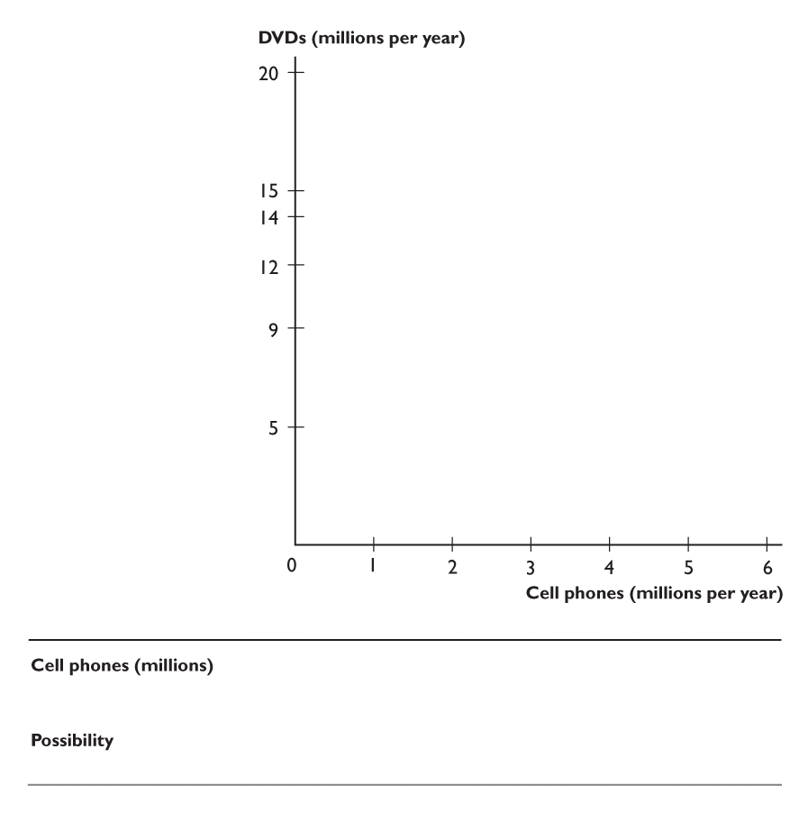
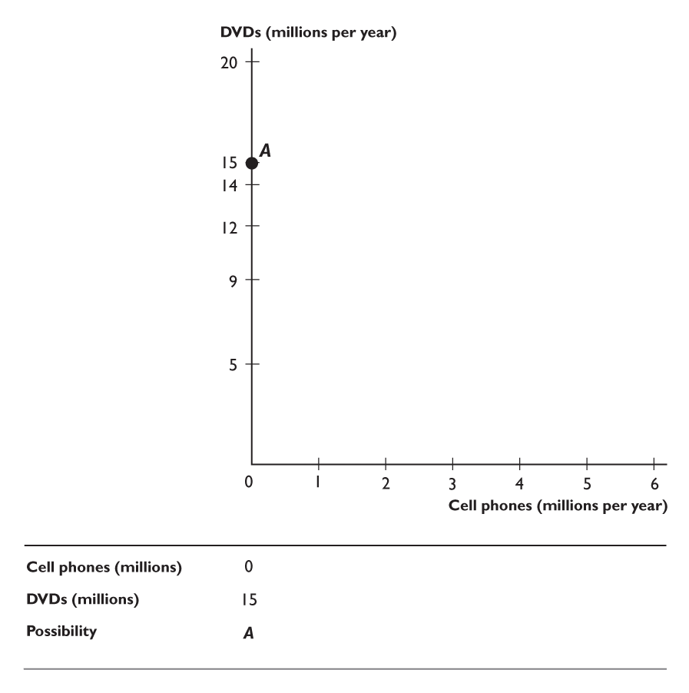
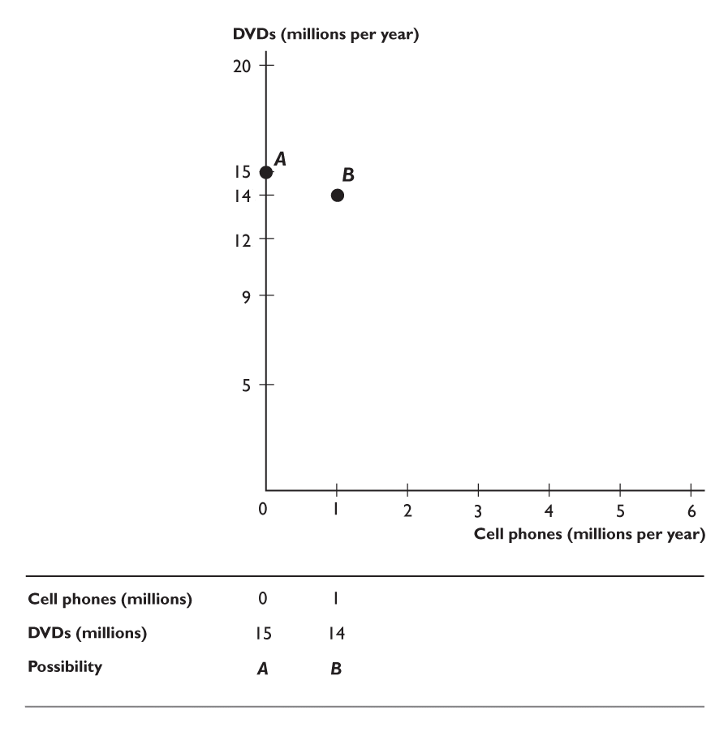
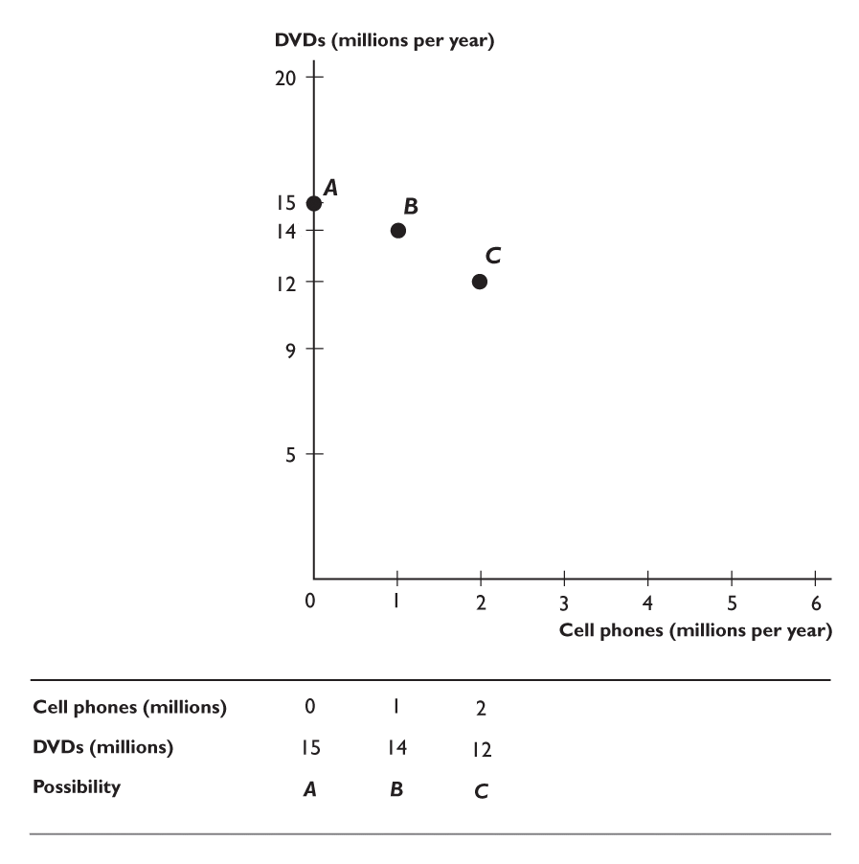
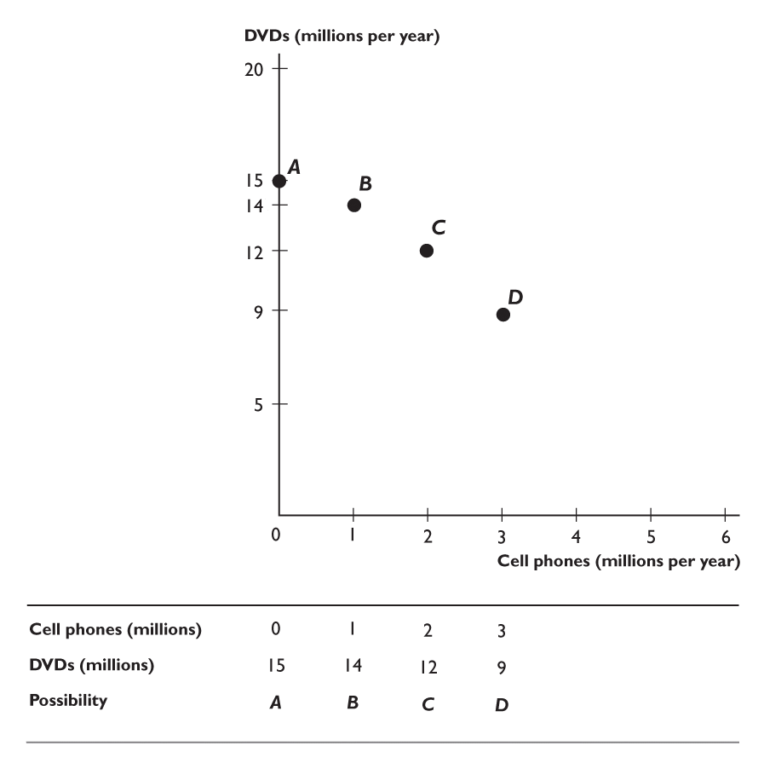
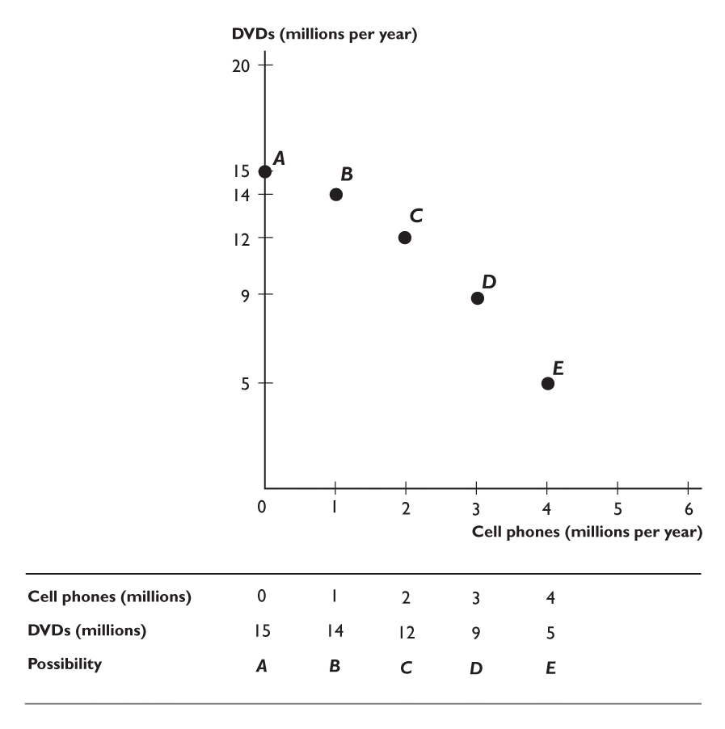
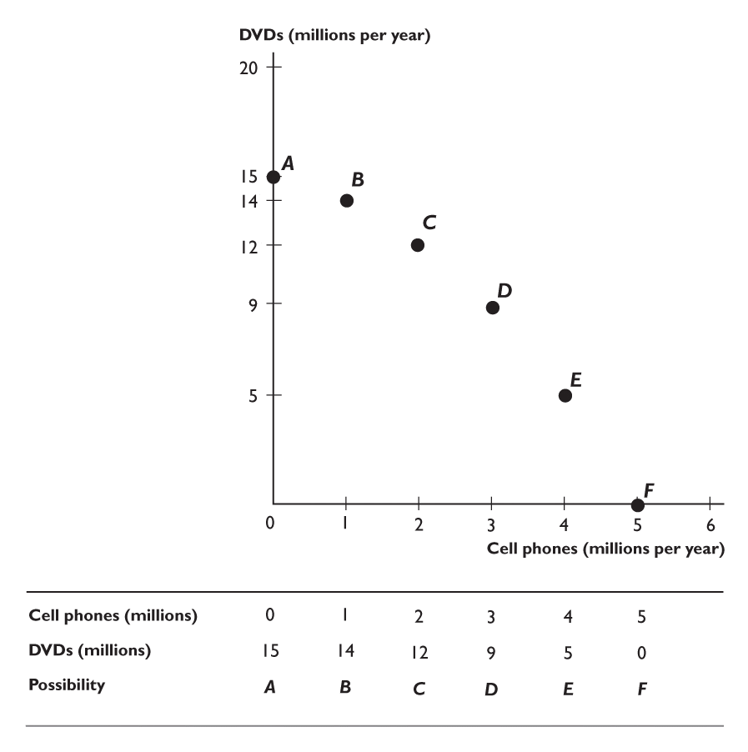
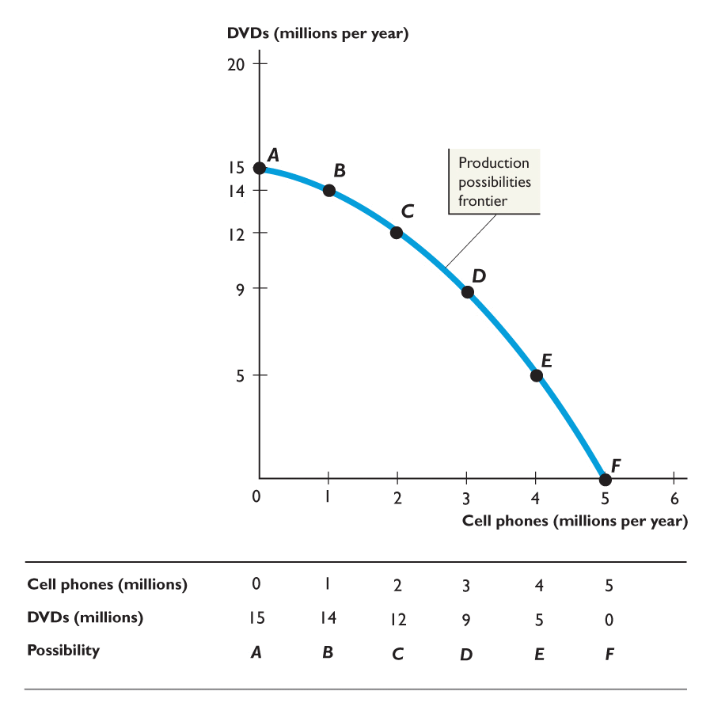
PRODUCTION POSSIBILITIES
Figure 1 shows the PPF for cell phones and DVDs.
Each point on the graph represents a column of the table.
The line through the points is the PPF.

Slide 40
The PPF puts three features of production possibilities in sharp focus:
Attainable and unattainable combinations
Efficient and inefficient production
Tradeoffs and free lunches

Slide 41
Attainable and Unattainable Combinations
Because the PPF shows the limits to production, it separates attainable combinations from unattainable ones.
Figure 2 on the next slide illustrates the attainable and unattainable combinations.

Slide 42
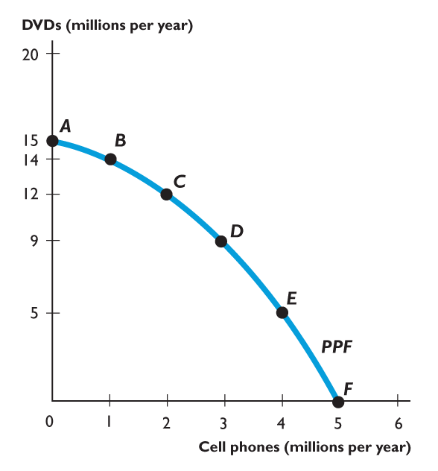
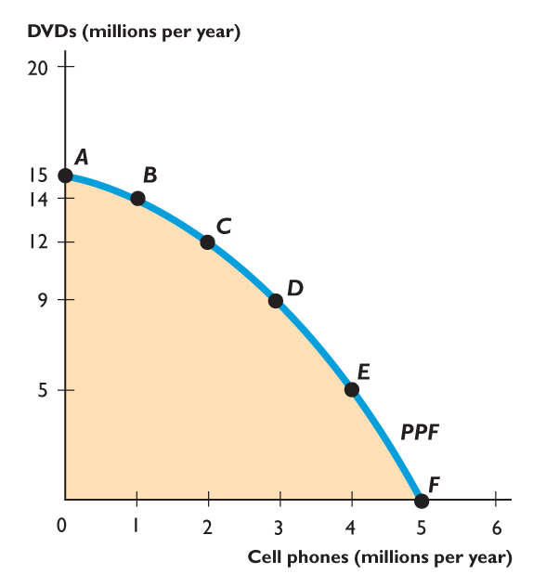
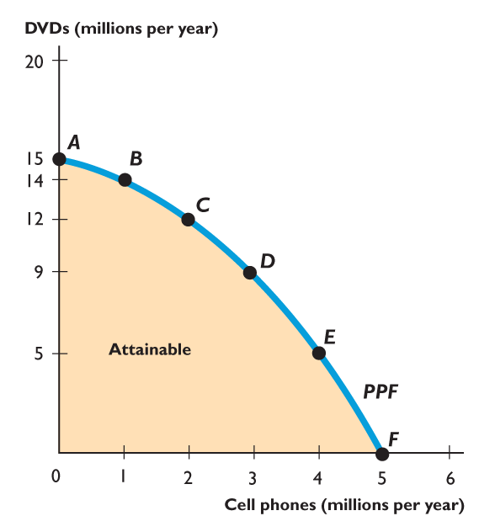
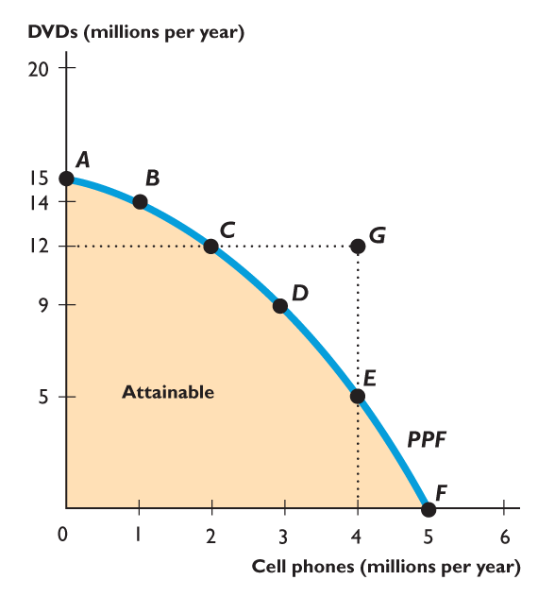
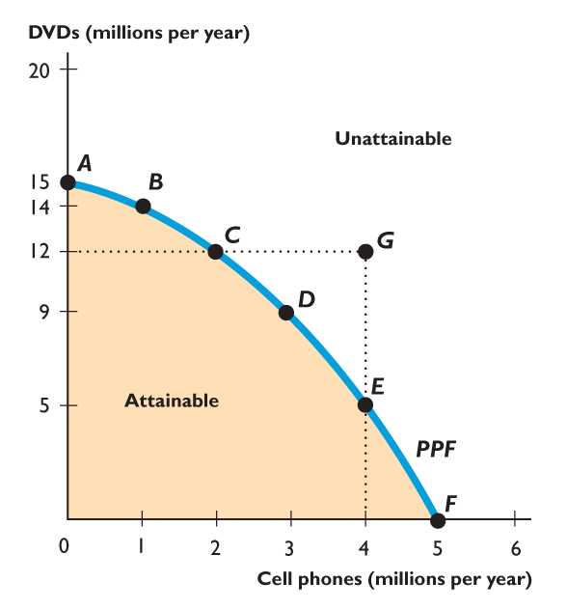
PRODUCTION POSSIBILITIES
We can produce at any point inside the PPF or on the frontier.
We cannot produce at any point outside the PPF such as point G.
The PPF separates attainable combinations from unattainable combinations.

Slide 44
Efficient and Inefficient Production
Production efficiency is a situation in which we cannot produce more of one good or service without producing less of something else.
Figure 3 on the next slide illustrates the distinction between efficient and inefficient production.

Slide 45
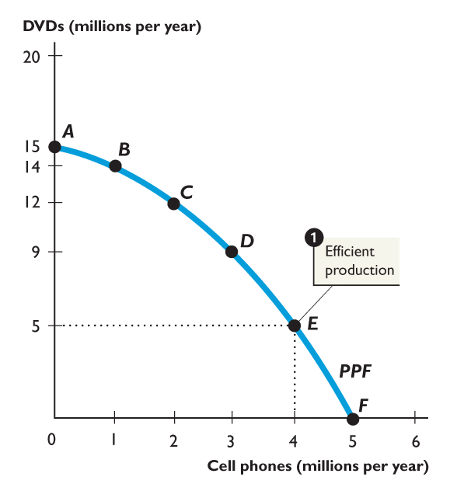
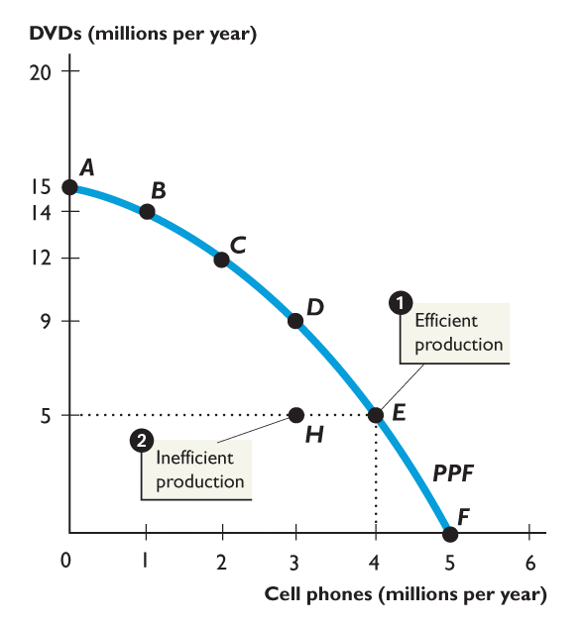
PRODUCTION POSSIBILITIES
1. When production is on the PPF, such as at point E or D, production is efficient.
2. If production were inside the PPF, such as at point H, more could be produced of both goods without forgoing either good.
Production is inefficient.

Slide 46
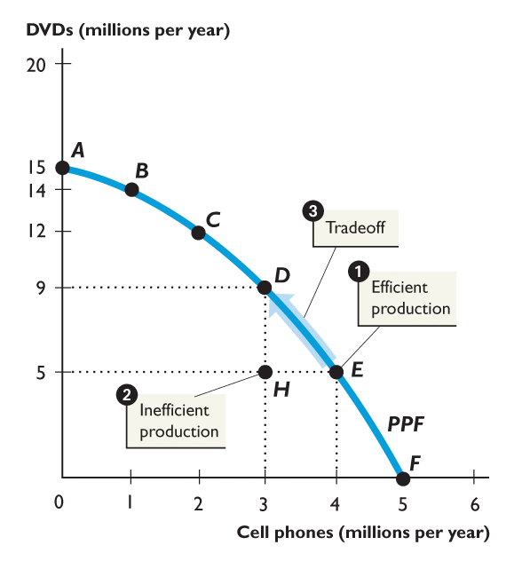
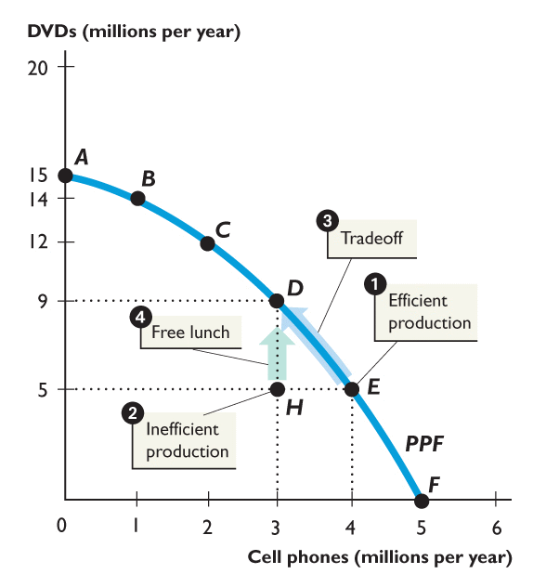

Slide 47
Tradeoffs and Free Lunches
A tradeoff is an exchange—giving up one thing to get something else.
A free lunch is a gift—getting something without giving up something else.
Figure 3 on the next slide illustrates the distinction between a tradeoff and a free lunch.

Slide 48
PRODUCTION POSSIBILITIES
3. When production is on the PPF, we face a tradeoff.
4. If production were inside the PPF, there would be a free lunch.
Moving from point H to point D does not involve a tradeoff.

Slide 49
OPPORTUNITY COST
The Opportunity Cost of a Cell Phone
The opportunity cost of a cell phone is the decrease in the quantity of DVDs divided by the increase in the number of cell phones as we move along the PPF.
Figure 4 illustrates the calculation of the opportunity cost of a cell phone.

Slide 50
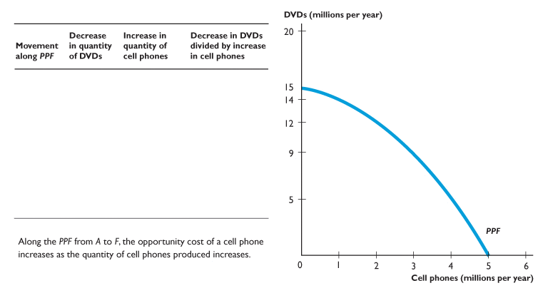
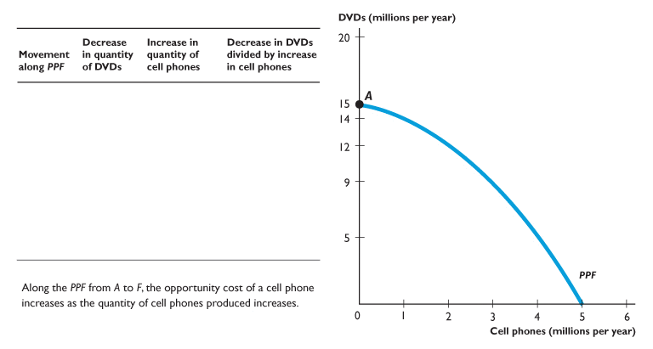
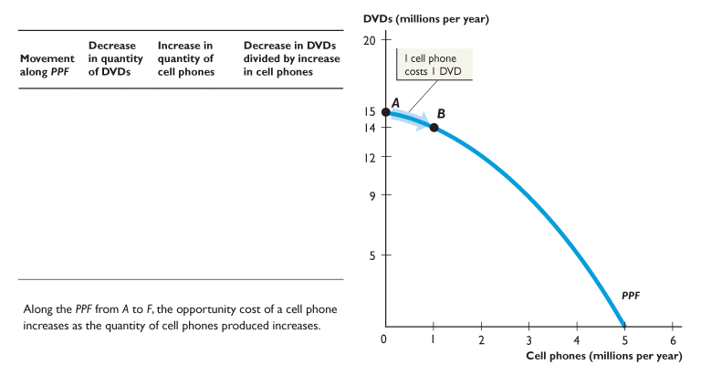
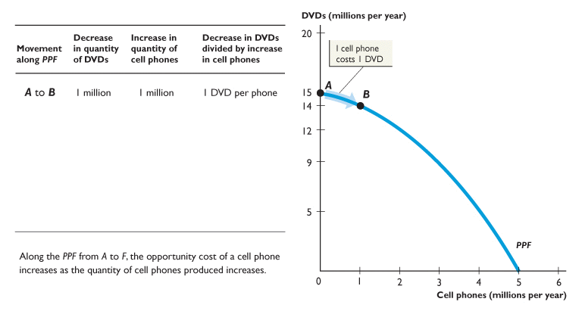
OPPORTUNITY COST
Moving from A to B, 1 cell phone costs 1 DVD.

Slide 51
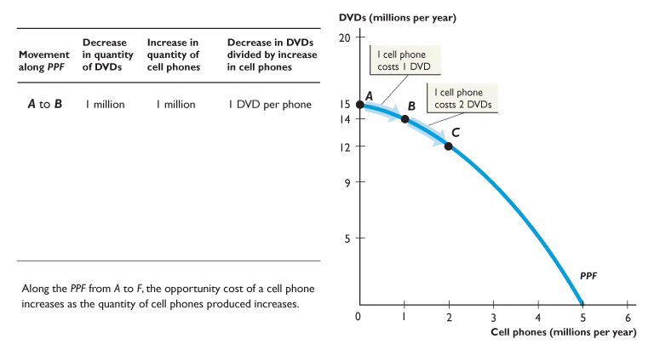
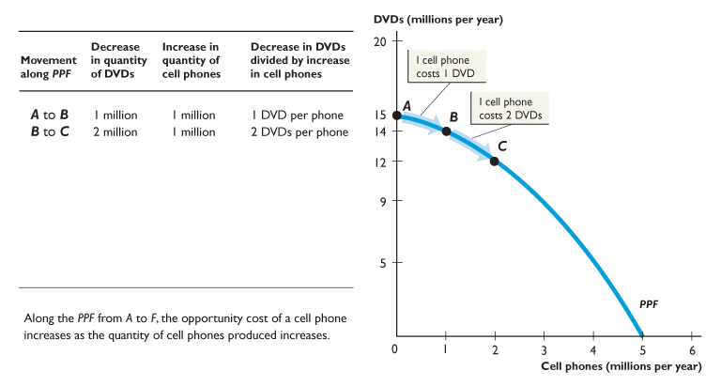
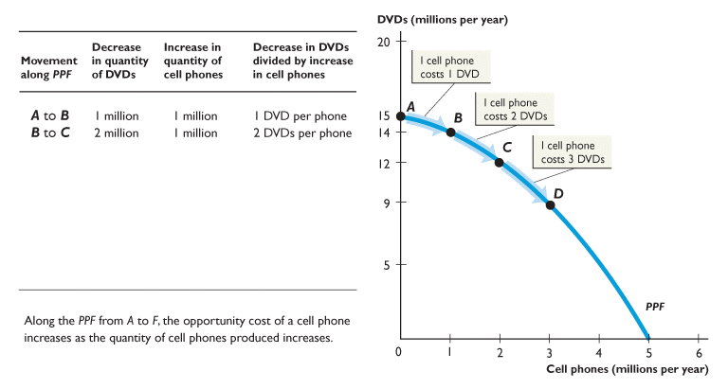
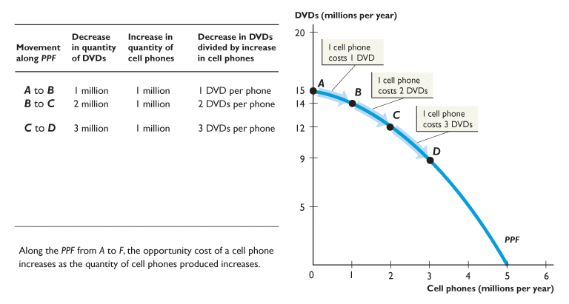
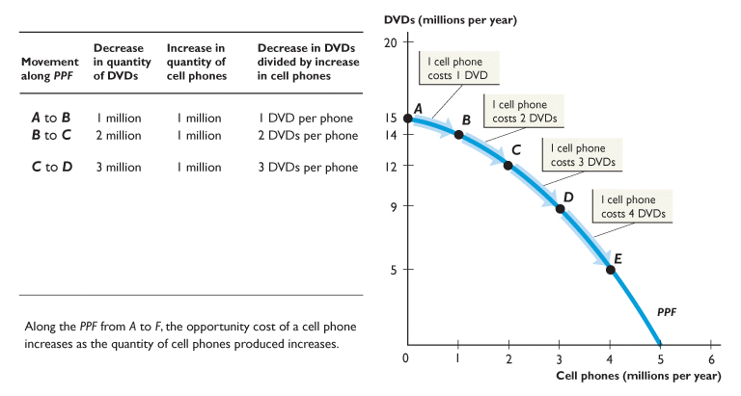
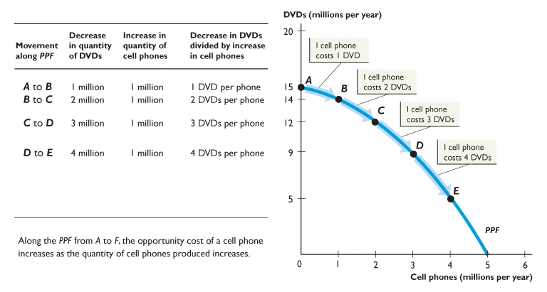
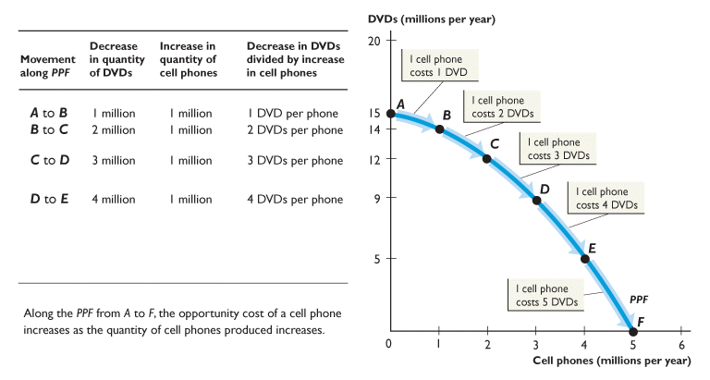
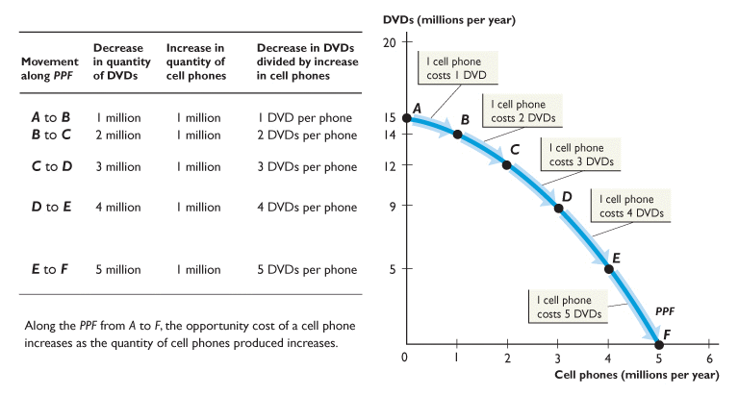

Slide 52
OPPORTUNITY COST
Moving from B to C, 1 cell phone costs 2 DVDs.

Slide 53
OPPORTUNITY COST
Moving from C to D, 1 cell phone costs 3 DVDs.

Slide 54
OPPORTUNITY COST
Moving from D to E, 1 cell phone costs 4 DVDs.

Slide 55
OPPORTUNITY COST
Moving from E to F, 1 cell phone costs 5 DVDs.

Slide 56
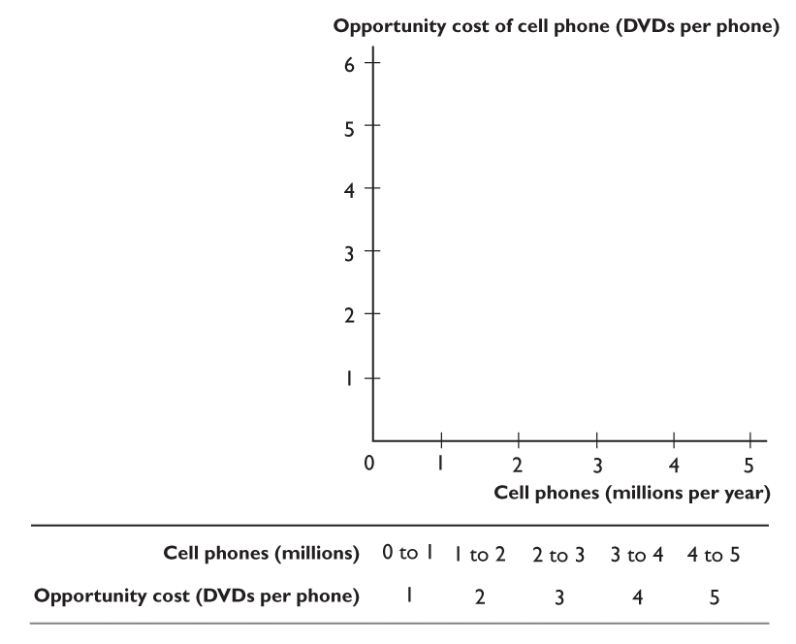
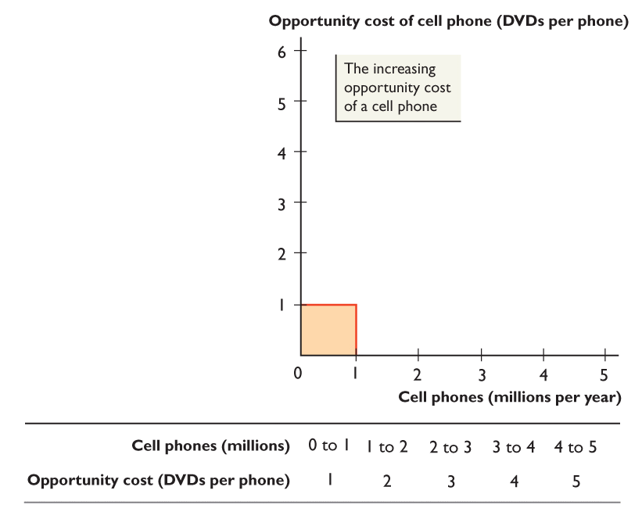
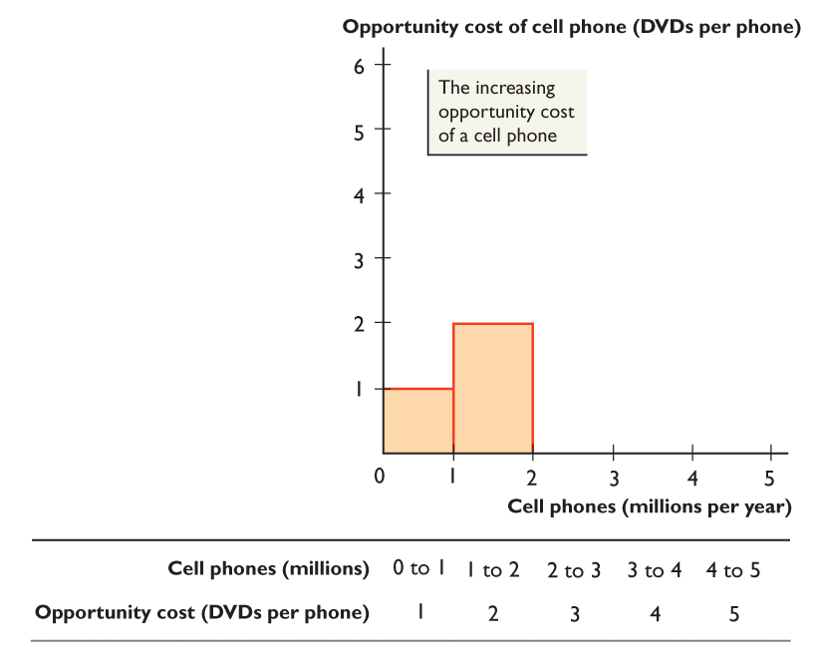
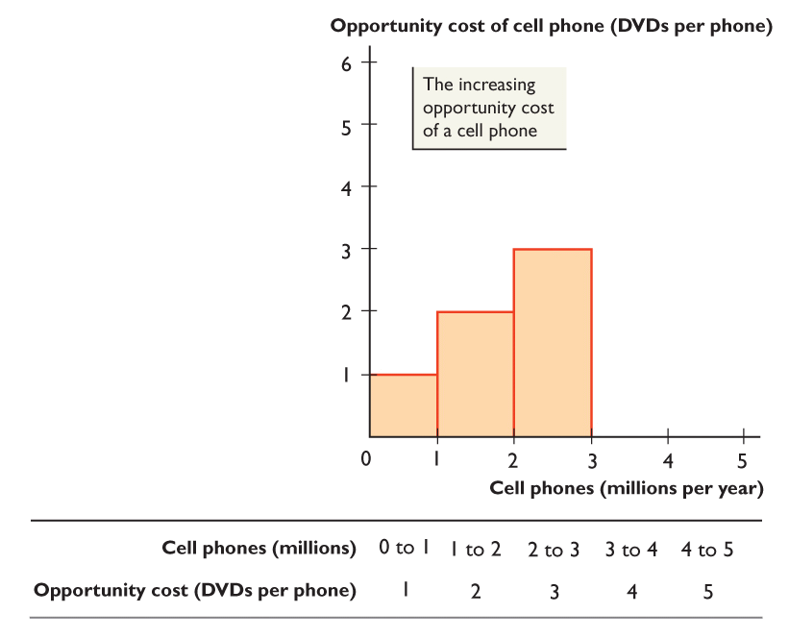
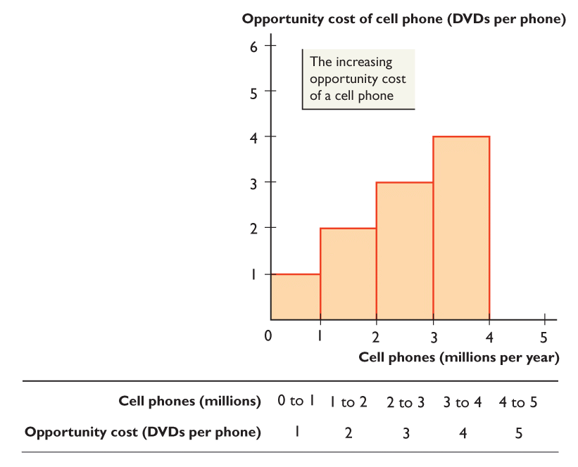
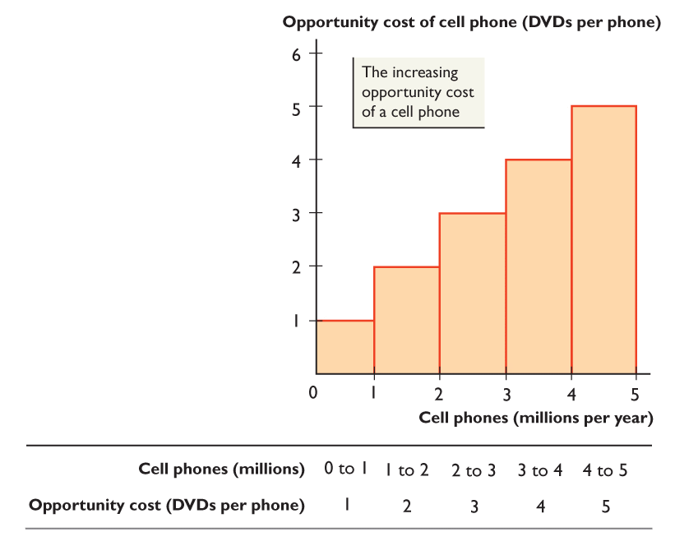
OPPORTUNITY COST
Increasing Opportunity Cost
The opportunity cost of a cell phone increases as more cell phones are produced.

Slide 58
OPPORTUNITY COST
Opportunity Cost and the Slope of the PPF
The magnitude of the slope of the PPF measures opportunity cost.
The slope of the PPF in Figure 4 measures the opportunity cost of a cell phone.
The PPF is bowed outward. As more cell phones are produced, the PPF becomes steeper and the opportunity cost of a cell phone increases.

Slide 59
OPPORTUNITY COST
Opportunity Cost Is a Ratio
The opportunity cost of a cell phone is the quantity of DVDs forgone divided by the increase in the quantity of cell phones gained.
The opportunity cost of a DVD is the quantity of cell phones forgone divided by the increase in the quantity of DVDs gained.
When the opportunity cost of a cell phone is x DVDs, the opportunity cost of a DVD is 1/x cell phones.

Slide 60
OPPORTUNITY COST
Increasing Opportunity Costs Are Everywhere
Just about every activity has an increasing opportunity cost.

Slide 61
ECONOMIC GROWTH
Economic growth is the sustained expansion of production possibilities.
An economy grows when it develops better technology, improves the quality of labor, or increases the quantity of capital.
When an economy’s resources increase, its production possibilities expand and its PPF shifts outward.
To study economic growth, we begin at the PPF with consumption goods on one axis and a capital good on the other.

Slide 62
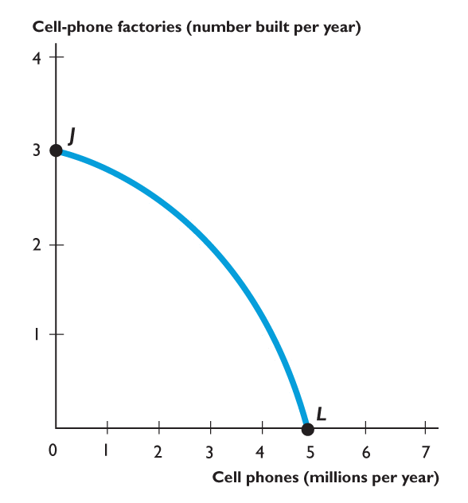
ECONOMIC GROWTH
If we produce at point J, we produce only cell-phone factories and no cell phones.
If we produce at point L, we produce cell phones and no cell-phone factories.
At L, consumption remains at 5 million cell phones every year.

Slide 63
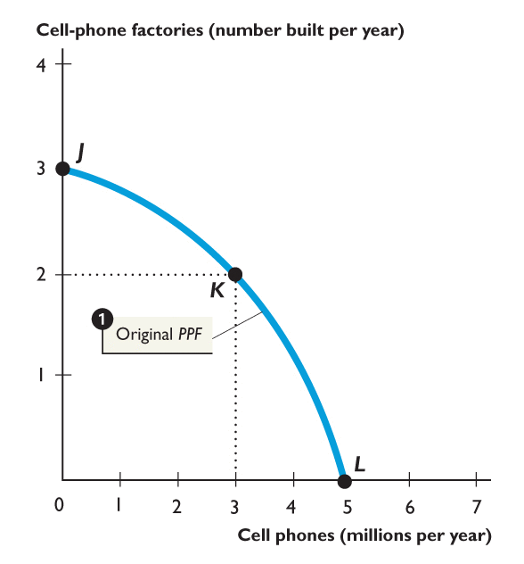
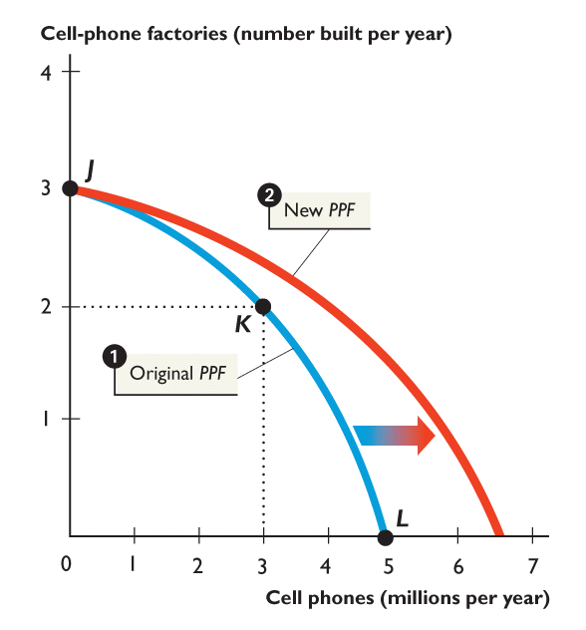

Slide 64
ECONOMIC GROWTH
1. But if we cut production of cell phones to 3 million this year, we can produce 2 cell-phone factories at point K.
2. Then next year, our PPF shifts outward because we have more capital.
We can consume at a point outside our original PPF, such as K'.

Slide 65
Economic Growth and the PPF
With additional resources or an improvement in technology, the economy can produce more computers,
Economic growth shifts the PPF outward.
more wheat,
or any combination in between.
Notes:
65

Slide 66
Economic Growth
10
c
Figure 2.5
Pizzas ovens
8
b
b'
6
4
2
PPF₀
PPF₁
a
a'
Pizzas (millions)
1
2
3
4 5 6 7

Slide 67
Economic Growth in Australia and Hong Kong
Since 1960, Hong Kong has grown more rapidly than Australia.
Differences in economic growth rates reflect differences in the proportion of resources devoted to capital accumulation versus consumption.

Slide 68
Economic Growth in Australia and Hong Kong
Figure 2.6
Australia
in 1960
Australia
in 2005
Capital goods ( per person)
Hong Kong
in 2005
B
Hong Kong
in 1960
C
D
A
A
Consumption goods (per person)

Slide 69
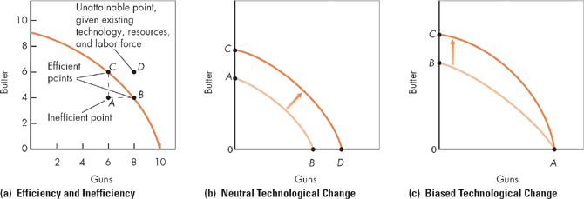
Efficiency and Technological Change

