Slide 1
Chapter 10
Perfect Competition

Slide 2
In this chapter our first step will be to characterize the competitive firm’s objective as that of earning the highest possible profit. This is clearly not the only goal a firm might pursue, but we’ll see several reasons why firms might often behave as if profit were all they cared about. We’ll then consider the four conditions that define a perfectly competitive market:
the existence of a standardized product,
price-taking behavior on the part of firms,
perfect long-run mobility of factors of production, and
perfect information on the part of consumers and firms.

Slide 3
In studying not only perfect competition but also a variety of other market structures, economists traditionally assume that the firm’s central objective is to maximize profit. Two things must be said about this assumption. The first is to clarify just what is meant by the term “profit,” and the second is to explain why it often makes sense to assume that firms try to maximize it.

Slide 4
Profit—or, more precisely, economic profit—is defined as the difference between total revenue and total cost, where total cost includes all costs—both explicit and implicit—associated with resources used by the firm.
This definition is significantly different from the one used by accountants and many other noneconomists, which does not subtract opportunity or implicit costs from total revenue. Accounting profit is simply total revenue less all explicit costs incurred.

Slide 5
Economic profit: the difference between total revenue and total cost, where total cost includes all costs—both explicit and implicit—associated with resources used by the firm.
Accounting profit is simply total revenue less all explicit costs incurred.
does not subtract the implicit costs.
Economists assume that the goal of firms is to maximize economic profit.

Slide 6
EXAMPLE: Suppose a firm produces 100 units of output per week by using 10 units of capital and 10 units of labor.
Suppose the weekly price of each factor is $10/unit, and the firm owns its 10 units of capital.
If output sells for $2.50/unit, the firm’s total revenue will be $250/wk.
To calculate the week’s economic profit, we subtract from $250 the $100 spent on labor (an explicit cost) and the $100 opportunity cost of capital (an implicit cost), which leaves $50. (Under the assumption that the firm could have rented its capital to some other firm at the weekly rate of $10/unit, the $100 opportunity cost is simply the earnings forgone by using the capital in its own operation.)
The week’s accounting profit for this firm, by contrast, is $150, the difference between the $250 total revenue and the $100 out-of-pocket expenditure for labor.

Slide 7
Accounting profit may be thought of as the sum of two components:
normal profit, which is the opportunity cost of the resources owned by the firm (in this example, $100), and
economic profit, as defined above (here, $50).
Economic profit is profit over and above the normal profit level.

Slide 8
The Four Conditions For Perfect Competition
To predict how much output a competitive firm will produce, economists have developed the theory of perfect competition. Four conditions define the existence of a perfectly competitive market. Let us consider each of them in turn.

Slide 9
Firms Sell a Standardized Product:
In a perfectly competitive market, the product sold by one firm is assumed to be a perfect substitute for the product sold by any other. Interpreted literally, this is a condition that is rarely if ever satisfied. It is difficult to speak of a market for even such a simple commodity as shirts, because shirts come in so many different styles and quality levels. If we define the market sufficiently narrowly, however, it is sometimes possible to achieve a reasonable degree of similarity among the products produced by competing firms.

Slide 10
2. Firms Are Price Takers:
This means that the individual firm gives the market price of the product as given. More specifically, it must believe that the market price will not be affected by how much output it produces. This condition is likely to be satisfied when the market is served by a large number of firms, each one of which produces an unimportant fraction of total industry output. But a large number of firms are not always necessary for price-taking behavior. Even with only two firms in the market, for example, each may behave as a price taker if it believes that other firms stand ready to enter its market at a moment’s notice.

Slide 11
3. Free Entry and Exit, with Perfectly Mobile Factors of Production in the Long Run:
One implication of this condition is that if a firm perceives a profitable business opportunity at a given time and location, it will be able to hire the factors of production required to take advantage of it. Similarly, if its current project no longer appears attractive in relation to alternative business Project, it is free to discharge its factors of production, which will then move to industries in which opportunities are stronger.

Slide 12
Of course, no one believes that resources are perfectly mobile. Labor, in particular, is not likely to satisfy this condition. People buy homes, make friends, enroll their children in schools, and establish a host of other commitments that make it difficult to move from one place to another.
Nonetheless, the perfect mobility assumption is often reasonably well satisfied in practice, especially if we take into account that it is not always necessary for labor to move geographically in order for it to be mobile in an economic sense.
Indeed, the firm can often move to the worker, as happened when New England shoe and textile factories relocated in the South in order to employ the less expensive labor available there.

Slide 13
4. Firms and Consumers Have Perfect Information:
A firm has no reason to leave its current industry if it has no way of knowing about the existence of more profitable opportunities elsewhere. Similarly, a consumer has no motive to switch from a high-priced product to a lower-priced one of identical quality unless she knows about the existence of the latter.
Here too the required condition is never satisfied in a literal sense. The world is sufficiently complex that there will inevitably be relevant features of it hidden from view. As a practical matter, the assumption of perfect information is usually interpreted to mean that people can gain most of the information that is most relevant to their choices without great difficulty.

Slide 14
The Four Conditions For Perfect Competition
Firms Sell a Standardized Product
Firms Are Price Takers
Free Entry and Exit
Firms and Consumers Have Perfect Information

Slide 15
The Short-Run Condition For Profit Maximization
The first question we want our model of competitive firm behavior to be able to answer is, “How does a firm choose its output level in the short run?” Under the assumption that the firm’s goal is to maximize economic profit, it will choose that level of output for which the difference between total revenue and total cost is largest.

Slide 16
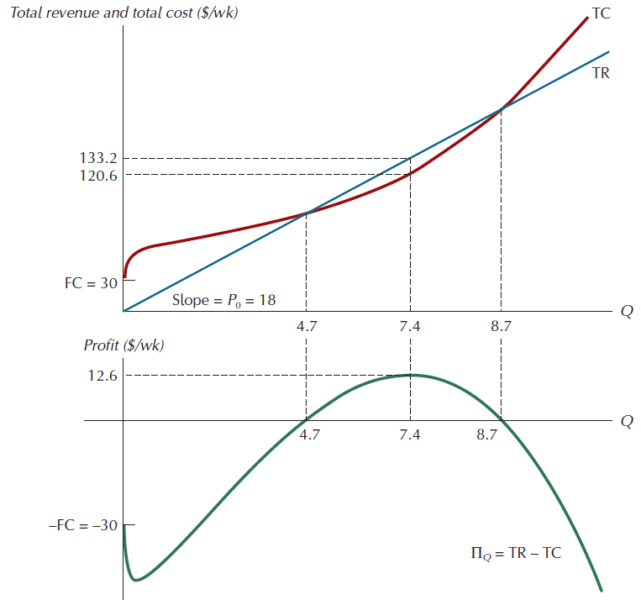
Figure 10.2: Revenue, Cost, and Economic Profit
FIGURE 10.2
Revenue, Cost, and Economic Profit
The total revenue curve is the ray labeled TR in the top panel. The difference between it and total cost (TC in the top panel) is economic profit
(∏_{Q} in the bottom panel). At
Q = 0, ∏Q = - FC = - 30.
Economic profit reaches a
maximum ($12.60/wk) for
Q = 7.4.

Slide 17
The maximum profit point can also be characterized in terms of the relationship between output price and short-run marginal cost. Output price, which is equal to the slope of the total revenue curve, is also called marginal revenue (MR).
Marginal revenue is formally defined as the change in revenue that occurs when the sale of output changes by 1 unit.
MR is the benefit to the firm of selling an additional unit of output. If the firm wants to maximize its profit, it must weigh this benefit against the cost of selling an extra unit of output, which is its marginal cost.

Slide 18
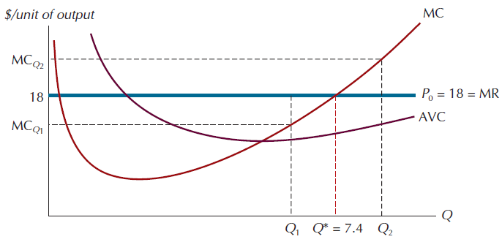
Figure 10.3: The Profit-Maximizing Output Level in the Short Run
FIGURE 10.3
The Profit-Maximizing
Output Level in the
Short Run
A necessary condition for
profit maximization is that
price equal marginal cost on
the rising portion of the
marginal cost curve. Here,
this happens at the output
level Q* = 7.4.

Slide 19
THE SHUTDOWN CONDITION
Recall that the rule for short-run profit maximization is to set price equal to marginal cost, provided price exceeds the minimum value of average variable cost.
Why must price be greater than the minimum point of the AVC curve? The answer is that unless this condition is met, the firm will do better to shut down—that is, to produce no output—in the short run.

Slide 20
To see why, note that the firm’s average revenue (AR) per unit of output sold is simply the price at which it sells its product. (When price is constant for all levels of output, average revenue and marginal revenue are the same.) If average revenue is less than average variable cost, the firm is taking a loss on each unit of output it sells.
The firm’s total revenue (average revenue times quantity) will be less than its total variable cost (AVC times quantity), and this means that it would do better by not producing any output at all. Shutting down in this context means simply to produce zero output in the short run. The firm will restart production if price again rises above the minimum value of AVC, the initiate point for its shutdown condition.

Slide 21
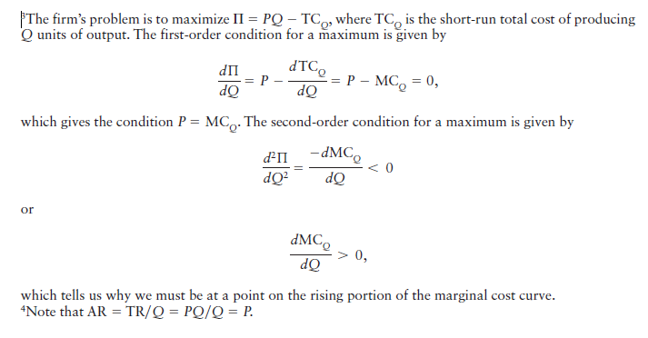

Slide 22
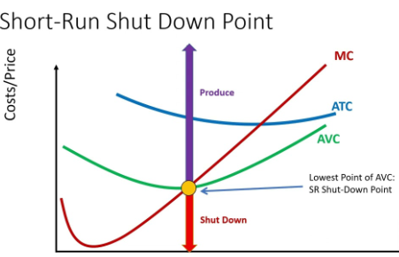
Shutdown condition: if price falls below the minimum of average variable cost, the firm should shut down in the short run.
Quantity

Slide 23
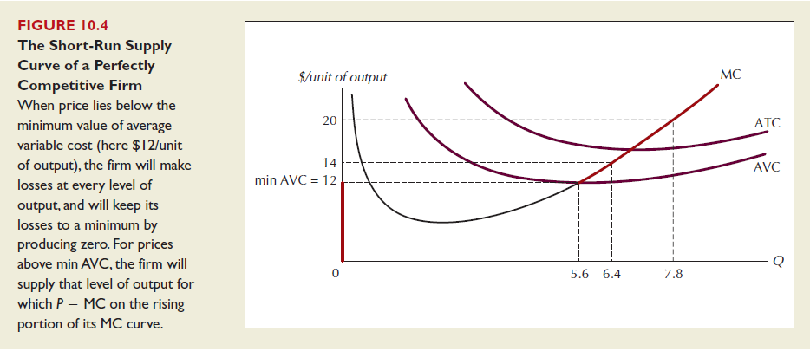
Figure 10.4: The Short-Run Supply Curve of a Perfectly Competitive Firm

Slide 24
The two rules—
that price must equal marginal cost on a rising portion of the marginal cost curve and
that price must exceed the minimum value of the average variable cost curve—together define the short-run supply curve of the perfectly competitive firm.

Slide 26
THE SHORT-RUN COMPETITIVE INDUSTRY SUPPLY
The short-run supply curve for a competitive industry is generated in a manner analogous to the one we used to generate the market demand curve.
In this case we simply announce a price and then add together the amounts each firm wishes to supply at that price. The resulting sum is industry supply at that price.
Additional points on the industry supply curve are generated by pairing other prices with the sums of individual firm supplies at those prices.

Slide 27
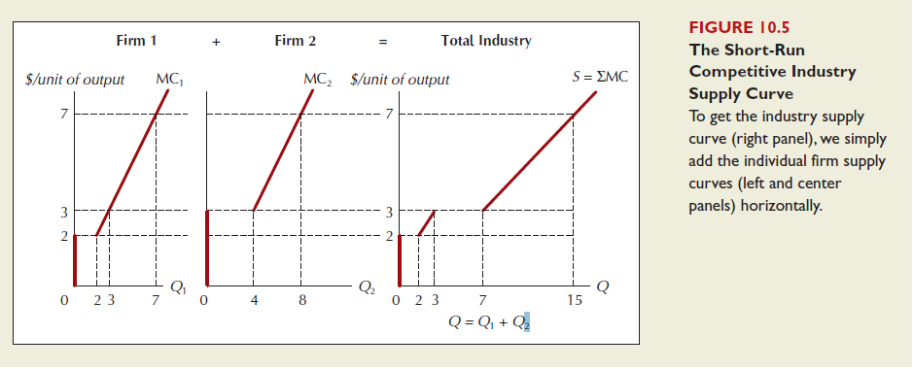

Slide 28
Example: Suppose an industry has 200 firms, each with supply curve P = 100 + 1000Q_{i}. What is the industry supply curve?

Slide 29
SHORT-RUN COMPETITIVE EQUILIBRIUM
The individual competitive firm must choose the most profitable level of output to produce in response to a given price. But where does that price come from?
As we saw in Chapter 2, it comes from the intersection of the supply and demand curves for the product. Recall that at the equilibrium price sellers are selling the quantity they wish to sell, and buyers are buying the quantity they wish to buy.

Slide 30
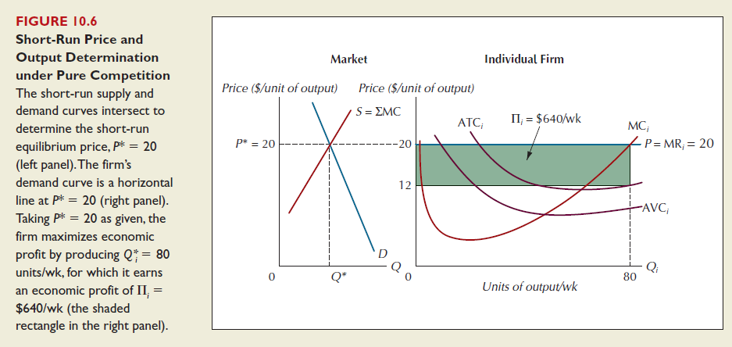

Slide 31
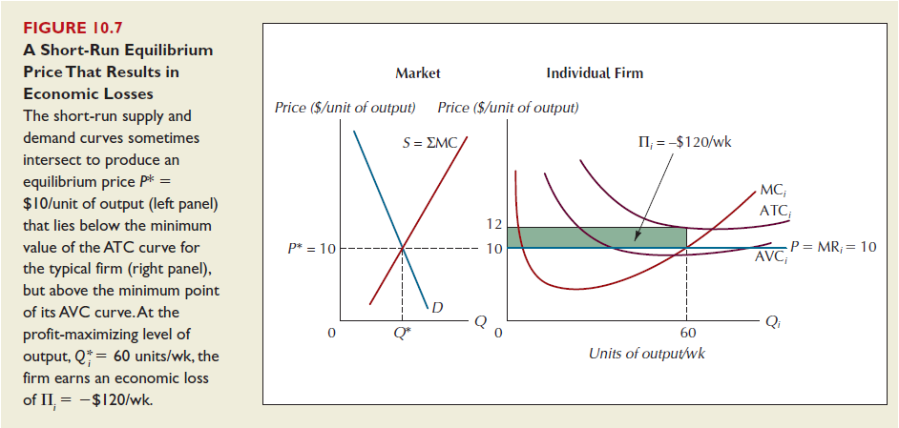

Slide 32
Short-Run Competitive Equilibrium
Even though the market demand curve is downward sloping, the demand curve facing the individual firm is perfectly elastic.
Breakeven point: the point at which price equal to the minimum of average total cost.
The lowest price at which the firm will not suffer negative profits in the short run.

Slide 33
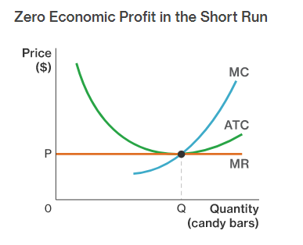
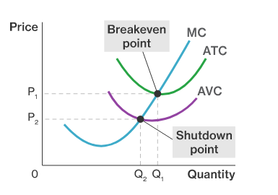

Slide 34
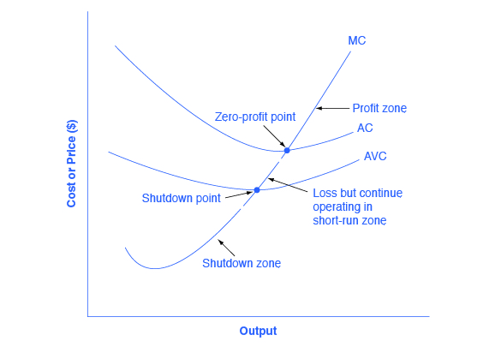

Slide 35
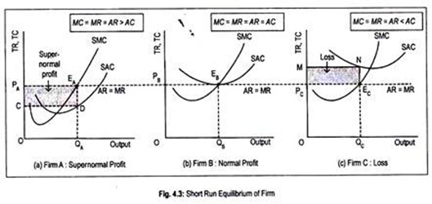

Slide 36
Profit Maximization in the Long-run
The long-run is defined as: The period of time over which firms can adjust their plant size in response to changes in the level of demand for their product.
New firms can enter a market and existing firms can exit a market in the long-run.
The long-run is the variable-plant period.
In perfectly competitive markets, firms can enter or exit the market in the long-run.

Slide 37
If economic profits are being earned, firms will be attracted to the profits and will want to enter the market.
If economic losses are being earned, some firms will wish to minimize their losses by shutting down and leaving the market.
Due to the entry and exit of firms in perfectly competitive markets, economic profits and losses will be eliminated in the long-run and firms will only BREAK EVEN.
When all the firms in a perfectly competitive market are breaking even, a market is in its long-run equilibrium state. No firms will with to enter OR exit a market in which firms are breaking even!

Slide 38
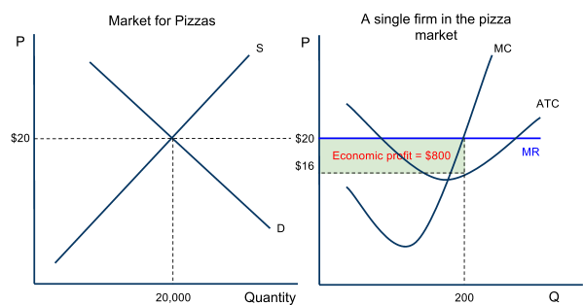
Profit Maximization in the Long-run – Entry Eliminates Profits
When individual firms are earning economic profits in a perfectly competitive market, new firms will be attracted to the market, leading to an increase in market supply and a fall in the price.
Consider the pizza market:
At the current level of demand and supply, the price ($20) per pizza is greater than the typical firm’s ATC ($16).
Pizza shops are making 200 pizzas each at a profit of $4 per pizza for a total profit of $800.
Due to the low entry barriers, sellers of other products will be attracted to the pizza market, where easy profits can be earned.

Slide 39
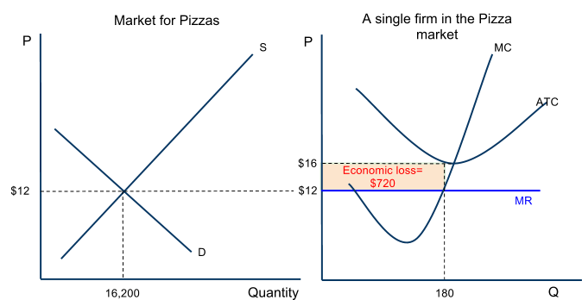
Profit Maximization in the Long-run – Exit Eliminates Losses
When individual firms are earning losses in a perfectly competitive market, certain firms will choose to leave the market to avoid losses and to seek profits elsewhere.
Consider the pizza market:
At the current level for demand and supply the market price ($12) is lower than the typical firm’s ATC ($16)
Pizza shops are making 180 pizzas each at a loss of $4 per pizza, for a total loss of $720
Due to the fact that it is easy to exit the market, some pizza shops will chose to shut down and seek profits elsewhere.

Slide 40
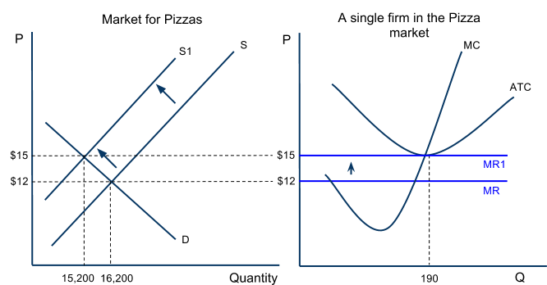
The experience of earning losses will make some firms wish to leave the market
The number of sellers is a determinant of supply, so the market supply will decrease The decreased competition in the pizza market causes the price of pizzas to rise and the market quantity to decrease
For the individual firm that remains in the market:
The price of pizza rises from $12 to $15
MR rises, causing the firm to increase its output to maintain its MR=MC level
Losses are eliminated, as the price rises to the firm’s minimum ATC
The firm’s output increases as it now faces less competition
The market is in equilibrium again when the individual firm is only breaking even

Slide 41
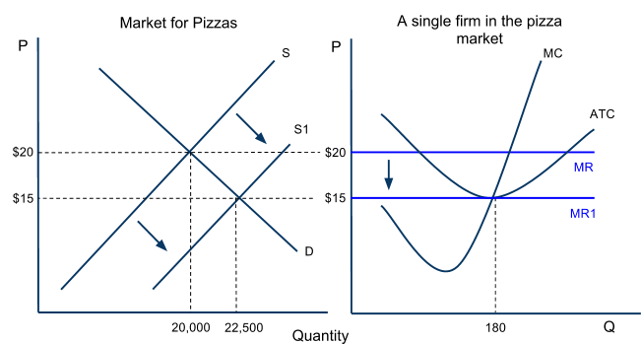
The existence of economic profits will attract new sellers to the pizza market.
The number of sellers is a determinant of supply, so the market supply will increase
The increased competition in the pizza market causes the price of pizzas to fall and the market quantity to increase
For the individual firm in the market:
The price of pizza falls from $20 to $15.
MR falls, causing the firm to reduce its output to maintain its MR=MC level
Economic profit is eliminated, as the price falls to the firm’s minimum ATC
The firm output is reduced as it now faces more competition
The market is in equilibrium again when the individual firm is only breaking even

Slide 42
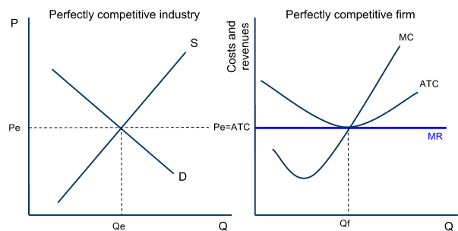
Long-run Equilibrium in Perfect Competition
A perfectly competitive market is in its long-run equilibrium ONLY when the typical firm is breaking even.
Equilibrium is defined as “a state of balance”
If any profits or losses are being earned, a PC market is out of balance, and firms will enter or exit the market until equilibrium is restored.

Slide 43
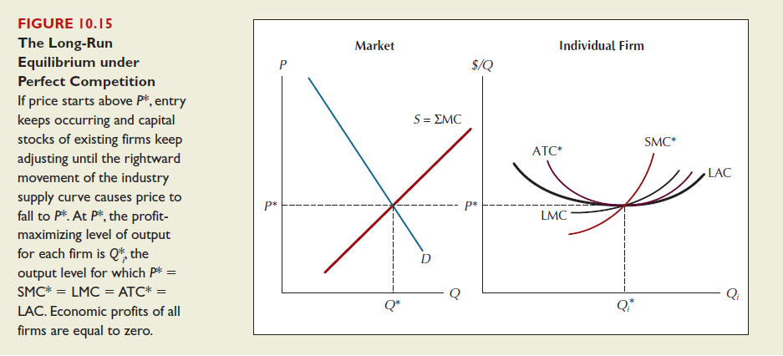

Slide 44
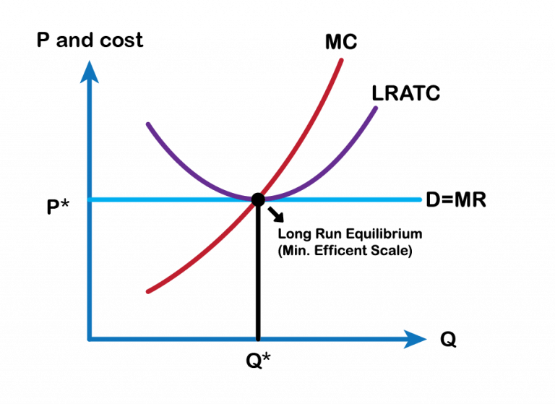

Slide 45
Efficiency in Perfectly Competitive Markets
In long-run equilibrium, purely competitive firms will produce the efficient level of output and price. Efficiency in economics is measured in two ways: Firms can be productively efficient, and an industry can be allocatively efficient.
Productive Efficiency is achieved if firms produce at their minimum average total cost:
Interpretation: Firms are using resources to their maximum efficiency by producing their output at the lowest possible average total cost. Competition forces firms to use resources as efficiently as possible.

Slide 46
Allocative Efficiency is achieved if a market produces at the quantity where marginal benefit equals marginal cost (where Price = Marginal Cost)
Interpretation: The right amount of output is being produced. There is neither under nor over-allocation of resources towards a good in a purely competitive industry.
If the price were higher than the marginal cost, this is a signal that marginal benefit exceeds marginal cost and more output is desired,
If price were lower than marginal cost, the signal from buyers to sellers is that marginal cost exceeds marginal benefit, and less output is desired.
Only when P = MC is the right amount of output being produced.

Slide 47
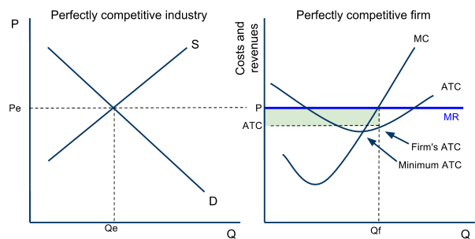
Efficiency in Perfectly Competitive Markets – Productive Efficiency
Price acts as a signal in competitive markets of the demands (and therefore the marginal benefit) of consumers. Price will always equal firms’ minimum ATC in the long-run, assuring that perfectly competitive sellers will be productively efficient.
If price is high enough that firms are earning profits, then the signal from buyers to sellers is WE WANT MORE
If price is low enough that firms are earning losses, then the signal from buyers to sellers is WE WANT LESS
Consider the market and firm here:
Price is higher than the firm’s ATC.
The firm’s are earning economic profits
The signal from buyers is “we want more”, so more firms will enter the market to satisfy demand.
As new firms enter, price will fall to minimum ATC, and firms will be more productively efficient!

Slide 48
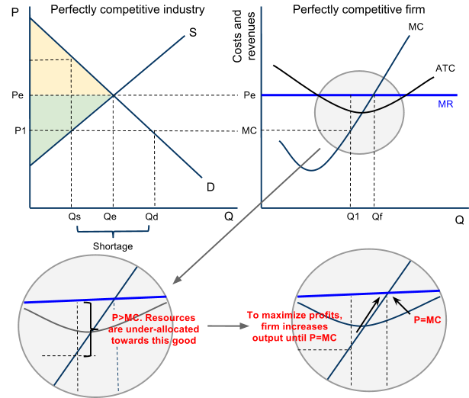
Efficiency in Perfectly Competitive Markets – Allocative Efficiency
Assume the firm (which represents all firms in this market) produces at Q1.
Market quantity supplied will be only Qs. At Qs, the demand (MB) is greater than the supply (MC) of the good. Resources are under-allocated.
The profit-maximizing firm will increase its production to Qf to achieve the MR=MC point.
As all firms do so, market quantity increases to Qe.
When all firms produce where P=MC, the shortage that existed at Qs is eliminated and resources are efficiently allocated toward this good!

