Slide 1
Chapter 11
Monopoly

Slide 2
Defining Monopoly
Monopoly: a market structure in which a single seller of a product with no close substitutes serves the entire market.
The key feature that differentiates the monopoly from the competitive firm is the price elasticity of demand facing the firm. For the perfectly competitive firm, recall, price elasticity is infinite. If a competitive firm raises its price only slightly, it will lose all its sales. A monopoly, by contrast, has significant control over the price it charges.
The important distinction between monopoly and competition is that the demand curve facing the individual competitive firm is horizontal (irrespective of the price elasticity of the corresponding market demand curve), while the monopolist’s demand curve is simply the downward-sloping demand curve for the entire market.

Slide 3
Very stringent requirements for pure monopoly:
Only one firm in industry.
No close substitutes for the good firm produces.
Some reason why entry and survival of a competing firm is unlikely.
Pure monopolies are rare in real world because most firms face competition from firms producing substitutes.
  E.g., sole provider of natural gas in a city is not a pure monopoly, since other firms provide substitutes like heating oil and electricity.
  E.g., if there is only one railroad, it still competes with bus lines, trucking companies, and airlines.

Slide 4
The key difference:
A monopoly firm has market power, the ability to influence the market price of the product it sells. A competitive firm has no market power.

Slide 5
Five Sources Of Monopoly
The main cause of monopolies is barriers
to entry – other firms cannot enter the market.
Five sources of barriers to entry:
Exclusive Control over Important Inputs
Economies of Scale
Patents
Network Economies
Government Licenses or Franchises

Slide 6
Exclusive Control over Important Inputs:
The Perrier Corporation of France sells bottled mineral water. It spends millions of dollars each year advertising the unique properties of this water, which are the result, it says, of a once-in-eternity union of geological factors that created their mineral spring.
In New York State, the Adirondack Soft Drink Company offers a product that is essentially tap water saturated with carbon dioxide gas. I am unable to tell the difference between Adirondack Seltzer and Perrier.
But others feel differently, and for many of them there is simply no satisfactory substitute for Perrier.
Perrier’s monopoly position with respect to these buyers is the result of its exclusive control over an input that can not easily be duplicated.

Slide 7
A similar monopoly position has resulted from the deBeers Diamond Mines’ exclusive control over most of the world’s supply of raw diamonds.
Synthetic diamonds have now risen in quality to the point where they can occasionally fool even an experienced jeweler. But for many buyers, the preference for a stone that was mined from the earth is not a simple matter of greater hardness and refractive brilliance.
They want real diamonds, and deBeers is the company that has them.

Slide 8
Exclusive control of key inputs is not a guarantee of permanent monopoly power. The preference for having a real diamond, for example, is based largely on the fact that mined diamonds have historically been honestly superior to synthetic ones.
But assuming that synthetic diamonds eventually do become completely indistinguishable from real ones, there will no longer be any basis for this preference.
And as a result, deBeers’ control over the supply of mined diamonds will cease to confer monopoly power.
New ways are constantly being devised of producing existing products, and the exclusive input that generates today’s monopoly is likely to become obsolete tomorrow.

Slide 9
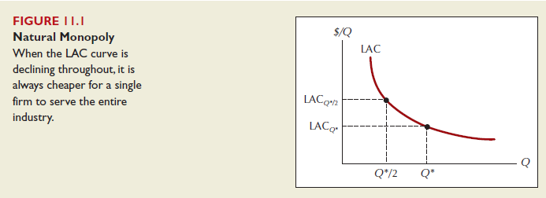
2. Economies of Scale When the long-run average cost curve (given fixed input prices) is downward sloping, the least costly way to serve the market is to concentrate production in the hands of a single firm. In Figure 11.1, for example, note that a single firm can produce an industry output of Q* at an average cost of LACQ*, while with two firms sharing the same market, average cost rises to LACQ*/2. A market that is most cheaply served by a single firm is called a natural monopoly. A frequently cited example is the provision of local telephone landlines.

Slide 10
3. Patents:
Most countries protect inventions through some sort of patent system. A patent typically talks the right to exclusive benefit from all exchanges involving the invention to which it applies.
There are costs as well as benefits to patents. On the cost side, the monopoly it creates usually leads, as we will see, to higher prices for consumers. On the benefit side, the patent makes possible a great many inventions that would not otherwise occur.
Although some inventions are unforeseen, most are the result of long effort and expense in sophisticated research laboratories. If a firm were unable to sell its product for a sufficiently high price to earn these outlays, it would have no economic reason to undertake research and development in the first place.

Slide 11
Without a patent, competition would force price down to marginal cost, and the pace of innovation would be slowed dramatically.
The protection from competition afforded by a patent is what makes it possible for the firm to recover its costs of innovation.
In the United States, the life of a patent is 17 years, a compromise figure that is too long for many inventions, too short for many others.
In particular, there is a winning argument that the patent life should be extended in the prescription drug industry, where the testing and approval process often consumes all but a few years of the current patent period

Slide 12
4. Network Economies:
On the demand side of many markets, a product becomes more valuable as greater numbers of consumers use it. In extreme cases, such network economies function like economies of scale as a source of natural monopoly.
Microsoft’s Windows operating system, for example, achieved its dominant market position on the strength of powerful network economies. Because Microsoft’s initial sales advantage gave software developers a strong incentive to write for the Windows format, the inventory of available software in the Windows format quickly became vastly larger than for any competing operating system.
And although general-purpose software such as word processors and spreadsheets continued to be available for multiple operating systems, specialized professional software and games usually appeared first in the Windows format and often only in that format.

Slide 13
This software gap gave many people a good reason for choosing Windows, even if, as in the case of many Apple Macintosh users, they believed a competing system was otherwise superior.
The end result was that at one point, more than 90 percent of the world’s personal computers ran the Microsoft’s Windows operating system. If that wasn’t a pure monopoly, it came extremely close.

Slide 14
5. Government Licenses or Franchises:
In many markets, the law prevents anyone but a government-licensed firm from doing business. At rest areas on the Turnpike, for example, not just any fast-food restaurant is free to set up operations.
The Turnpike Authority negotiates with several companies, chooses one, and then grants it an exclusive license to serve a particular area. As someone who likes Whoppers better than Big Macs, I am happy that the MassPike chose Burger King over McDonald’s. But their choice is bound to disappoint many other buyers.

Slide 15
The Turnpike’s purpose in restricting access in the first place is that there is simply not room for more than one establishment in these locations.
In such cases, the government license as a source of monopoly is really a scale economy acting in another form.
But government licenses are also required in a variety of other markets, such as the one for taxis, where scale economies do not seem to be an important factor. To raise revenues, many college campuses (such as Ohio State) sell exclusive rights to vending machine sales (such as only Coke or only Pepsi).

Slide 16
THE PROFIT-MAXIMIZING MONOPOLIST
As in the competitive case, we assume that the monopolist’s goal is to maximize economic profit. And again, as before, in the short run this means to choose the level of output for which the difference between total revenue and short-run total cost is greatest. The case for this motive is less forcing than in the case of perfect competition.
After all, the monopolist’s survival is less under restriction than the competitors, and so the evolutionary argument for profit maximization applies with less force in the monopoly case. Nonetheless, we will explore just what behaviors follow from the monopolist’s goal of profit maximization.

Slide 17
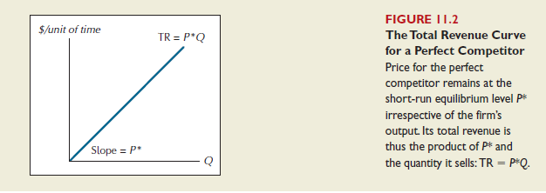
THE MONOPOLIST’S TOTAL REVENUE CURVE
The key difference between the monopolist and the perfect competitor is the way in which total, and hence marginal, revenue varies with output. The demand curve facing the perfect competitor is simply a horizontal line at the short-run equilibrium market price—call it P*. The competitive firm is a price taker, typically because its own output is too small to have any obvious influence on the market price. Under these circumstances, the perfectly competitive firm’s total revenue curve is a ray with slope P*, as shown in Figure 11.2.

Slide 18
As price falls, total revenue for the monopolist does not rise linearly with output.
  Instead, it reaches a maximum value at the quantity corresponding to the midpoint of the demand curve after which it again begins to fall.
  Total revenue reaches its maximum value when the price elasticity of demand is unity.

Slide 19
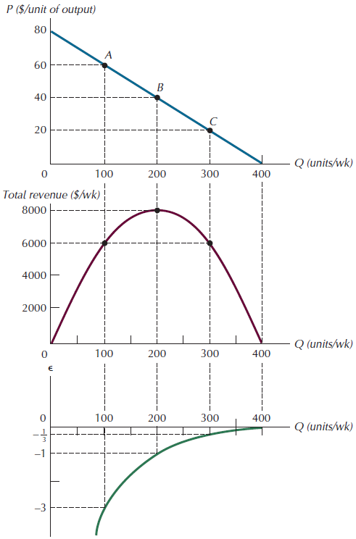
Figure 11.3 Demand, Total Revenue, and Elasticity
FIGURE 11.3
Demand, Total Revenue,
and Elasticity
For the monopolist to
increase sales, it is necessary
to cut price (top panel). Total
revenue rises with quantity,
reaches a maximum value,
and then declines (middle
panel). The quantity level for
which the price elasticity of
demand is unity corresponds
to the midpoint of the
demand curve, and at that
value total revenue is
maximized.

Slide 20
Monopoly vs. Competition: Demand Curves
In a competitive market, the market demand curve slopes downward.
But the demand curve
for any individual firm’s product is horizontal
at the market price.
The firm can increase Q without lowering P,
so MR = P for the competitive firm.
A competitive firm’s demand curve
P
D
Q
Notes:
20

Slide 21
Monopoly vs. Competition: Demand Curves
A monopolist is the only seller, so it faces the market demand curve.
To sell a larger Q,
the firm must reduce P.
Thus, MR ≠ P.
A monopolist’s demand curve
P
D
Q
Notes:
21

Slide 22

MARGINAL REVENUE
The slope of the total cost curve at any level of output is by definition equal to marginal cost at that output level. By the same token, the slope of the total revenue curve is the definition of marginal revenue.
As in the case of the perfectly competitive firm, we can think of marginal revenue as the change in total revenue when the sale of output changes by 1 unit. More precisely, suppose ∆TR_{Q} is the change in total revenue that occurs in response to a small change in output, ∆Q. Marginal revenue, denoted MR_{Q}, is then given by

Slide 23

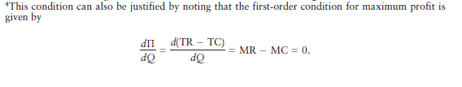
provided marginal revenue intersects marginal cost from above. Equation 11.2 defines the optimality condition for a monopolist. The monopolist wants to sell all
units for which marginal revenue exceeds marginal cost, so marginal revenue should lie above marginal cost prior to the intersection.

Slide 24
Recall that the similar condition for the perfectly competitive firm is to choose the output level for which price and marginal cost are equal. Recalling that marginal revenue and price (P) are exactly the same for the competitive firm, we see that the profit-maximizing condition for the perfectly competitive firm is simply a special case of Equation 11.2.
In the case of the monopoly firm, marginal revenue will always be less than price.
Like a competitive firm, a monopolist maximizes profit by producing the quantity where MR = MC. Once the monopolist identifies this quantity, it sets the highest price consumers are willing to pay for that quantity. It finds this price from the D curve.

Slide 25
Understanding the Monopolist’s MR
Increasing Q has two effects on revenue:
  Output effect: higher output raises revenue
  Price effect: lower price reduces revenue
To sell a larger Q, the monopolist must reduce the price on all the units it sells.
Hence, MR < P
MR could even be negative if the price effect exceeds the output effect.
Note that a competitive firm has the output effect but not the price effect: the competitive firm does not need to reduce its price in order to sell a larger quantity, so, for the competitive firm, MR = P.
Notes:
25

Slide 26




Marginal Revenue And Elasticity
Yet another useful relationship links marginal revenue to the price elasticity of demand at the corresponding point on the demand curve. Recall from Chapter 5 that the price elasticity of demand at a point (Q, P) is given by

Slide 27
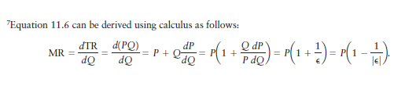
Equation 11.6 tells us that the less elastic demand is with respect to price, the more price will exceed marginal revenue.7 It also tells us that in the limiting case of infinite price elasticity, marginal revenue and price are exactly the same. (Recall from Chapter 10 that price and marginal revenue are the same for the competitive firm, which faces a horizontal, or infinitely elastic, demand curve.)

Slide 28
GRAPHING MARGINAL REVENUE
Equation 11.6 also provides a convenient way to plot the marginal revenue values that correspond to different points along a demand curve. To illustrate, consider the straight-line demand curve in Figure 11.7, which intersects the vertical axis at a price value of P = 80. The elasticity of demand is infinite at that point, which means that MR₀ = 80(1 – 1/ │e│ ) = 80. Although marginal revenue will generally be less than price for a monopolist, the two are exactly the same when quantity is zero. The reason is that at zero output there are no existing sales for a price cut to affect.

Slide 29
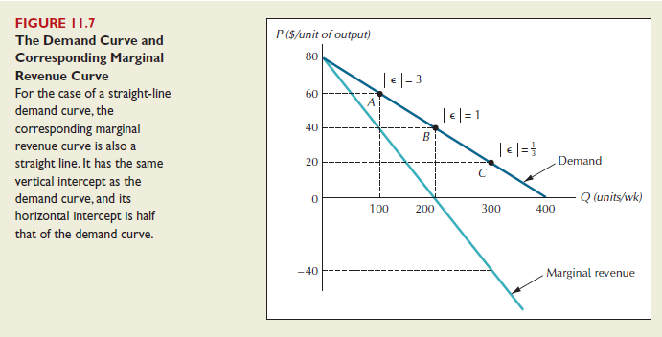

Slide 30

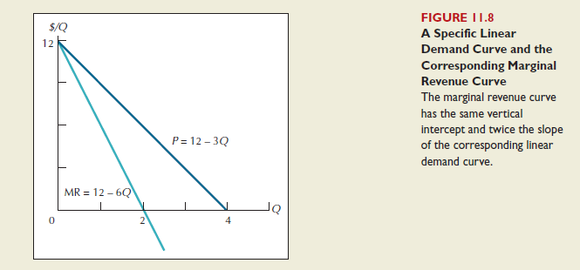
Find the marginal revenue curve that corresponds to the demand curve P = 12 - 3Q.

Slide 31
200
150
200
50
Elastic
Unit Elasticity
Dollars
Inelastic
MR
D
0 1 2 3 4 5 6 7 8 9 10 11 12 13 14 15 16 17 18
Q
750
500
250
Dollars
TR
0 1 2 3 4 5 6 7 8 9 10 11 12 13 14 15 16 17 18
Q

Slide 32
Profit-Maximization
Costs and Revenue
1. The profit-maximizing Q
is where
MR = MC.
2. Find P from
the demand curve at this Q.
MC
P
D
MR
Q
Quantity
Profit-maximizing output
Notes:
32

Slide 33
The Monopolist’s Profit
Costs and Revenue
MC
As with a competitive firm,
the monopolist’s
profit equals
(P – ATC) x Q
P
ATC
ATC
D
MR
Q
Quantity
Notes:
33

Slide 34
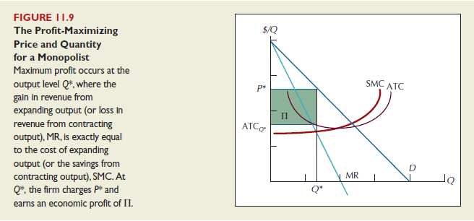

Slide 35
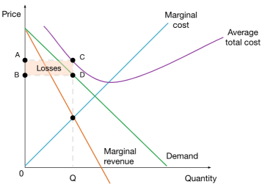
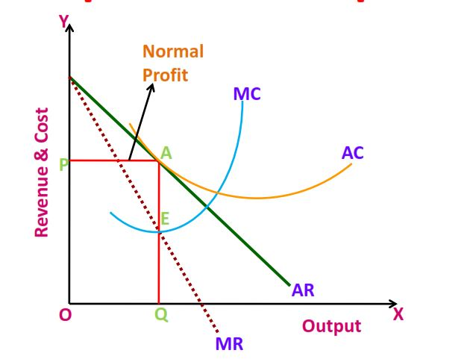

Slide 36
A PROFIT-MAXIMIZING MONOPOLIST WILL NEVER PRODUCE
ON THE INELASTIC PORTION OF THE DEMAND CURVE
If a monopolist’s goal is to maximize profits, it follows directly that she will never produce an output level on the inelastic portion of her demand curve.
If she were to increase her price at such an output level, the effect would be to increase total revenue. The price increase would also reduce the quantity demanded, which, in turn, would reduce the monopolist’s total cost.

Slide 37
Since economic profit is the difference between total revenue and total cost, profit would necessarily increase in response to a price increase from an initial position on the inelastic portion of the demand curve.
The profit-maximizing level of output must therefore lie on the elastic portion of the demand curve, where further price increases would cause both revenue and costs to go down.

Slide 38
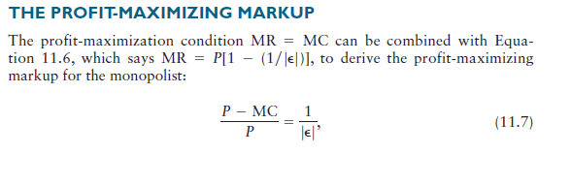
which is the difference between price and marginal cost, expressed as a fraction of the profit-maximizing price. For example, if the price elasticity of demand facing a monopolist were equal to -2, the profit-maximizing markup would be 1/2, which implies that the profit-maximizing price is twice marginal cost. Equation 11.7 tells us that the profit-maximizing markup grows smaller as demand grows more elastic. In the limiting case of infinitely elastic demand, the profit-maximizing markup is zero (which implies P = MC), the same as in the perfectly competitive case.

Slide 39
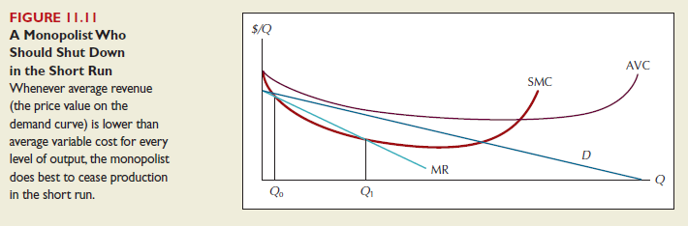
When Should a Monopolist Shutdown
Shutdown condition for a monopolist: cease production whenever average revenue is less than average variable cost at every level of output.

Slide 40
A Monopoly Does Not Have an S Curve
A competitive firm
  takes P as given
  has a supply curve that shows how its Q depends on P.
A monopoly firm
  is a “price-maker,” not a “price-taker”
  Q does not depend on P;
  rather, Q and P are jointly determined by
  MC, MR, and the demand curve.
So there is no supply curve for monopoly.
Notes:
40

Slide 41
The Welfare Cost of Monopoly
Recall: In a competitive market equilibrium,
P = MC and total surplus is maximized.
In the monopoly eq’m, P > MR = MC
  The value to buyers of an additional unit (P)
  exceeds the cost of the resources needed to produce that unit (MC).
  The monopoly Q is too low –
  could increase total surplus with a larger Q.
  Thus, monopoly results in a deadweight loss. Deadweight loss from monopoly: the loss of efficiency due to the presence of a Monopoly.
Notes:
41

Slide 42
The Welfare Cost of Monopoly
Competitive eq’m:
  quantity = Q_{C}
  P = MC
  total surplus is maximized
Monopoly eq’m:
  quantity = Q_{M}
  P > MC
  deadweight loss
Price
Deadweight
loss
MC
P
P = MC
MC
D
MR
Q_{M}
Q_{C}
Quantity
Notes:
42
It’s worth mentioning the following:
Most people know that monopoly changes the way the economic “pie” is divided: by charging higher prices, the monopoly gets more surplus and consumers get less surplus.
The analysis on this slide shows that the monopoly also reduces the size of the economic pie – by producing less than the socially efficient quantity and causing a deadweight loss.

Slide 43
The inefficiency of monopoly
Price
Deadweight
Marginal cost
loss
Monopoly
price
Marginal
revenue
Demand
0
Monopoly
Efficient
Quantity
quantity
quantity
Copyright © 2004 South-Western

Slide 44
Does monopoly reduce
economic efficiency?
The effects of monopoly can be summarized as follows:
  Monopoly causes a reduction in consumer surplus.
  Monopoly causes an increase in producer surplus.
  Monopoly causes a deadweight loss, which represents a reduction in economic efficiency; (allocative inefficiency occurs).

Slide 45
What happens if a perfectly competitive industry becomes a monopoly?
Price and cost per unit
Price and cost per unit
If the industry is perfectly competitive, the intersection of the demand and supply curves determines equilibrium price and quantity.
1. If the industry becomes a monopoly, the supply curve becomes the monopolist’s marginal cost curve.
Supply
MC
3. …and charges a higher price.
2. The monopolist reduces output to the level where MR = MC, …
Pm
Pc
Pc
Demand
MR
Demand
0
Qc
Quantity
0
Qm
Qc
Quantity
(a) Perfect competition
(b) Monopoly
Hubbard, Garnett, Lewis and O’Brien: Essentials of Economics © 2010 Pearson Australia
Notes:
45

Slide 46
PRICE DISCRIMINATION
Our discussion thus far has assumed that the monopolist sells all its output at a single price. In reality, however, monopolists often charge different prices to different buyers, a practice that is known as price discrimination. In the following sections, we analyze how the profit-maximizing monopolist behaves when it is possible to charge different prices to different buyers. When price discrimination is possible, a monopolist can transfer some of the gains from consumers into its own profits. However, we will see that not all the higher profits under price discrimination come at the expense of consumers. Efficiency is enhanced as the monopolist expands output toward the level at which demand intersects marginal cost.

Slide 47
Examples of Price Discrimination
Movie tickets
Discounts for seniors, students, and people
who can attend during weekday afternoons.
They are all more likely to have lower WTP (willingness to pay ) than people who pay full price on Friday night.
Airline prices
Discounts for Saturday-night stayovers help distinguish business travelers, who usually have higher WTP, from more price-sensitive leisure travelers.
Notes:
47

Slide 48
Examples of Price Discrimination
Discount coupons
People who have time to clip and organize coupons are more likely to have lower income and lower WTP than others.
Need-based financial aid
Low income families have lower WTP for
their children’s college education.
Schools price-discriminate by offering
need-based aid to low income families.
Notes:
48

Slide 49
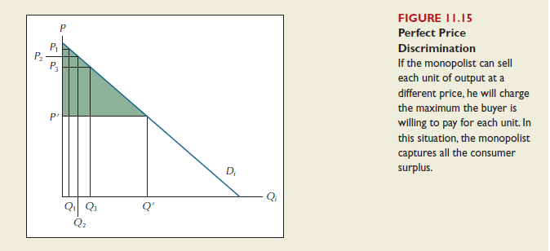
THE PERFECTLY DISCRIMINATING MONOPOLIST
First-degree price discrimination is the term used to describe the largest possible extent of market segmentation.

Slide 50
Perfect price discrimination.
Here, the monopolist produces the competitive quantity, but charges each buyer his or her WTP.
This is called perfect price discrimination.
The monopolist captures all consumer surplus
as profit.
But there’s no DWL.
Price
Monopoly profit
MC
D
MR
Quantity
Q
Notes:
50

Slide 51
Single Price Monopoly
Here, the monopolist charges the same price (P_{M}) to all buyers.
A deadweight loss results.
Consumer surplus
Price
Deadweight
loss
P_{M}
MC
Monopoly profit
D
MR
To keep the graph simple, this example assumes constant marginal cost.
Q_{M}
Quantity
Notes:
51

Slide 52
CS with monopoly: A
PS with monopoly:B+D
MC=S
A
P^{M}
B
DWL = C+E
C
P^{C}
E
D
Demand
Q^{M}
Q^{C}
MR

Slide 53
CS with 1st Degree Price Dis.: 0
PS with 1ST Degree PD: A+B+C+D+E
MC=S
A
P^{M}
DWL = ZERO!
B
C
P^{C}
E
D
Demand
Q^{M}
Q^{C}
MR

Slide 54
First Degree Price Discrimination ELIMINATES consumer surplus (each consumer pays their maximum amount)
First Degree Price Discrimination ELIMINATES deadweight loss (monopolists are able to provide goods to more consumers)
FDPD is hard to achieve and VERY weak to resale

Slide 55
Second degree price discrimination
Second degree price discrimination deals with price discounts:
-Selling at a discount price after a certain number of goods are purchased
Second degree price discrimination also involves offering separate membership and per unit price plans that consumers CHOOSE between
-ie: Cell phones, club memberships, bus pass

Slide 56
Block Pricing
In block pricing the first “block” of goods is sold at a given price, and the next “block” of goods is sold at a lower price
A consumer pays P₁ for the first Q₁ good, then P₂ for any goods above Q₁
There can be more than 2 different blocks of prices

Slide 57
Block Pricing
P
Here a price of 70 applies to the first 30 goods, followed by a price of 40 for the next 30 goods
Note: P=100-Q^{d}
100
Demand
70
40
10
MC
0
30 60 100
Q

Slide 58
Block Pricing and Surplus
P
Consumer Surplus (Red) = 900
Producer Surplus (Blue) = 2700
Deadweight Loss (Gold) = 450
100
Demand
450
70
900
450
40
900
900
450
10
MC
0
30 60 100
Q

Slide 59
Normal Monopoly Surplus
P
Consumer Surplus (Red) = 1012.5
Producer Surplus (Blue) = 2025
Deadweight Loss (Gold) = 1012.5
100
Demand
1012.5
55
2025
1012.5
MC
0
45
100
Q
MR

Slide 60
In this example quantity discounts increased producer surplus
Since the quantity sold on the market also increased, DWL decreased compared to the typical monopoly
Note that if prices decrease due to a decreasing MC, this is not considered price discrimination

Slide 61
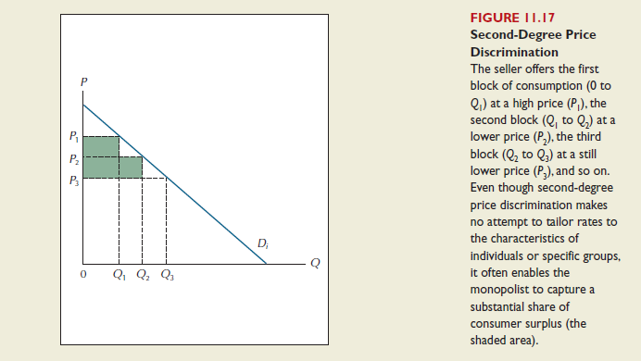

Slide 62
Third degree price discrimination
Third degree price discrimination charges different prices to different consumer groups, or segments of society (each with different demand schedules)
Examples:
-Student and seniors movie prices
-Regular and farm gasoline
-Bus passes
-Tuesday deals at restaurants

Slide 63
PRICE DISCRIMINATION
First Degree
-Each consumer pays their maximum willingness to pay
Second Degree
-Consumers sort themselves into different price categories (quantity discounts or plans)
Third Degree
-Firms sort consumers into different price categories

Slide 64
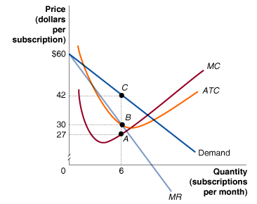
Refer to the figure below. How much is the amount of profit when the firm serves six subscribers per month?
a. (42 – 27) x 6
b. (42 – 30) x 6
c. (30 – 27) x 6
d. $42.

Slide 65
Refer to the figure below. How much is the amount of profit when the firm serves six subscribers per month?
a. (42 – 27) x 6
b. (42 – 30) x 6
c. (30 – 27) x 6
d. $42.

Slide 66
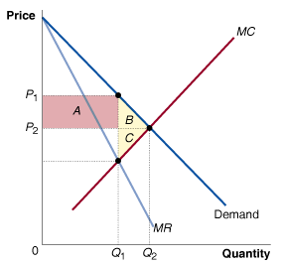
Refer to the figure below. Which area shows the reduction in consumer surplus from the existence of monopoly?
a. Area A.
b. Area B + C.
c. Area A + B.
d. None of the areas
indicated on the graph.

Slide 67
Refer to the figure below. Which area shows the reduction in consumer surplus from the existence of monopoly?
a. Area A.
b. Area B + C.
c. Area A + B.
d. None of the areas
indicated on the graph.

