Slide 1
Chapter 2
Supply and Demand
Prof. Dr. Dilek TEMİZ
Lecture Notes

Slide 2
The basic model of supply and demand is the pillar of microeconomics. It helps us understand why and how prices change, and what happens when the government intervenes in a market.
The supply-demand model combines two important concepts: a supply curve and a demand curve. It is important to understand precisely what these curves represent.

Slide 3
The Demand Curve
The demand curve shows how much of a good consumers are willing to buy as the price per unit changes. We can write this relationship between quantity demanded and price as an equation:
QD = QD(P)
The demand curve slopes downward: Consumers are usually ready to buy more if the price is lower. For example, a lower price may encourage consumers who have already been buying the good to consume larger quantities. Likewise, it may allow other consumers who were previously unable to afford the good to begin buying it.

Slide 4
quantity demanded: the amount of a good that consumers are willing to buy at a given price, holding constant the other factors that influence purchases
demand curve: the quantity demanded at each possible price, holding constant the other factors that influence purchases
  Quantity demanded is the amount of a good, service, or resource that people are willing and able to buy during a specified period at a specified price. The quantity demanded is an amount per unit of time. For example, the amount per day or per month.

Slide 5
DEMAND
The Law of Demand
  Other things remaining the same,
    If the price of the good rises, the quantity demanded of that good decreases.
    If the price of the good falls, the quantity demanded of that good increases.

Slide 6
DEMAND
Demand Schedule and Demand Curve
  Demand is the relationship between the quantity demanded and the price of a good when all other influences on buying plans remain the same.
  Demand is illustrated by a demand schedule and a demand curve.

Slide 7
DEMAND
  Demand schedule is a list of the quantities demanded at each different price when all the other influences on buying plans remain the same.
  Demand curve is a graph of the relationship between the quantity demanded of a good and its price when all other influences on buying plans remain the same.

Slide 8
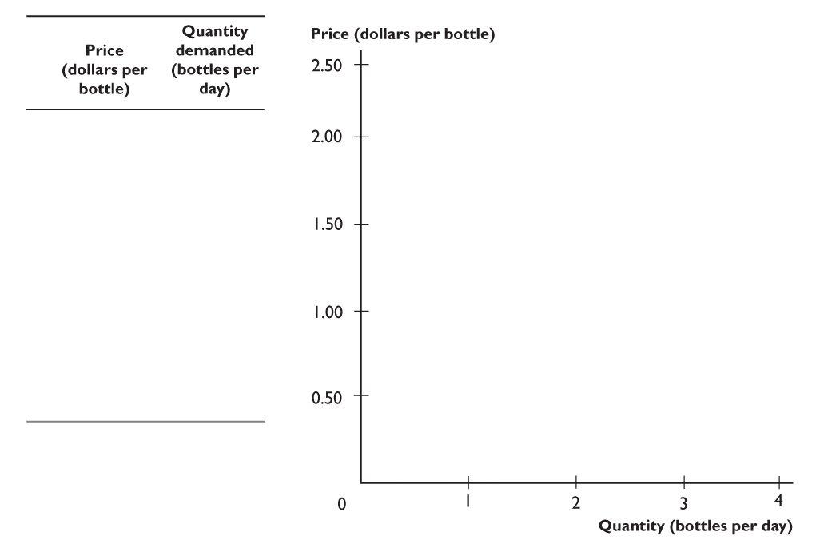
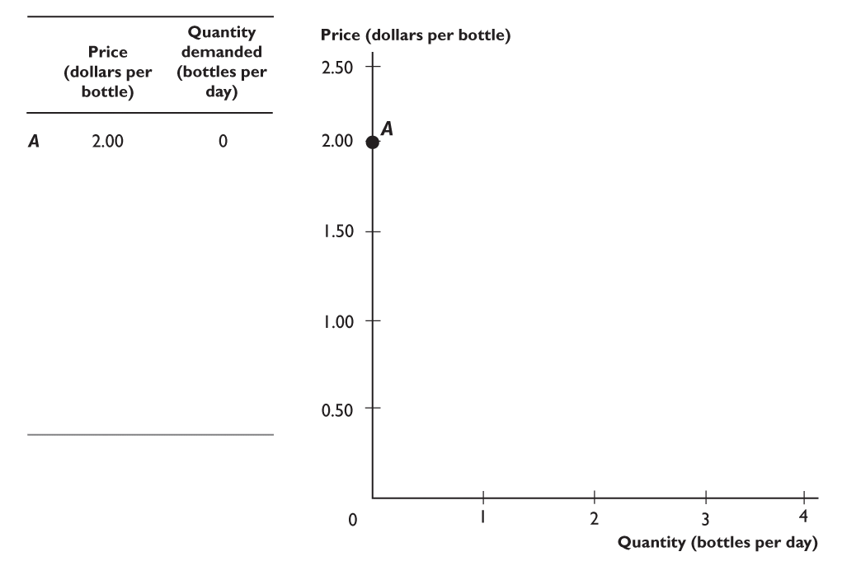
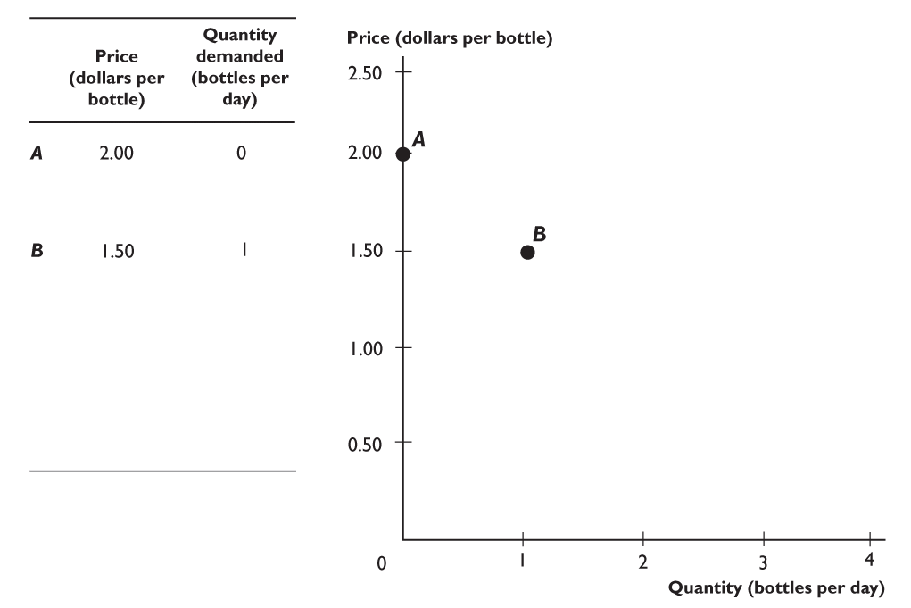
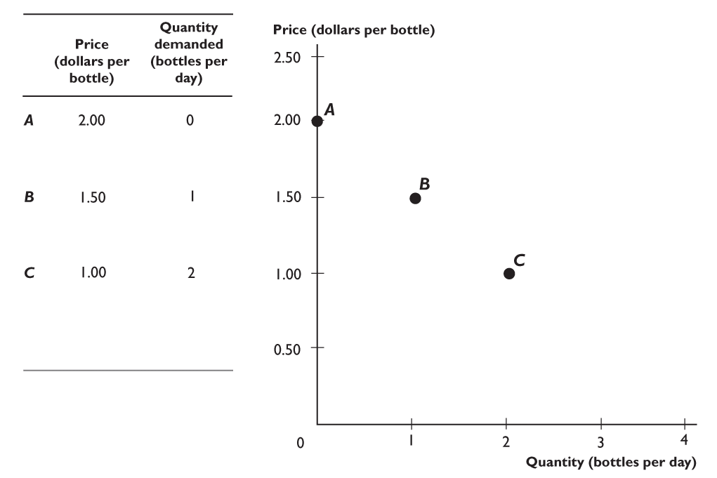
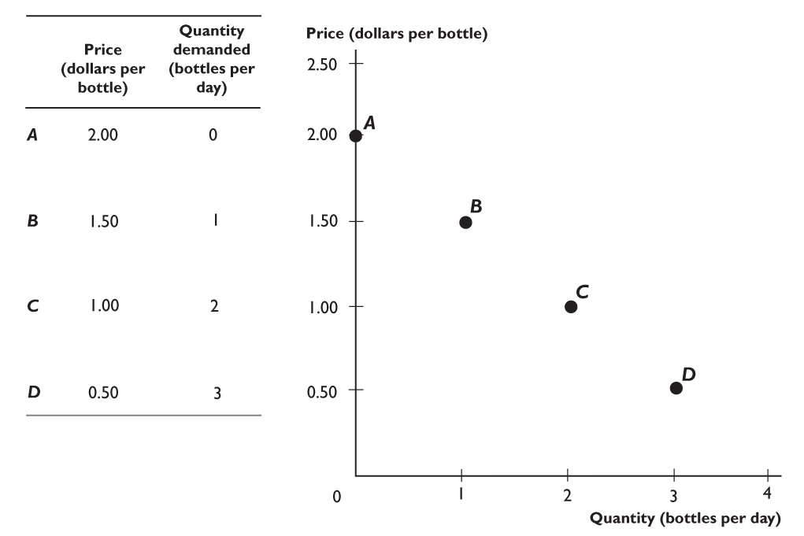
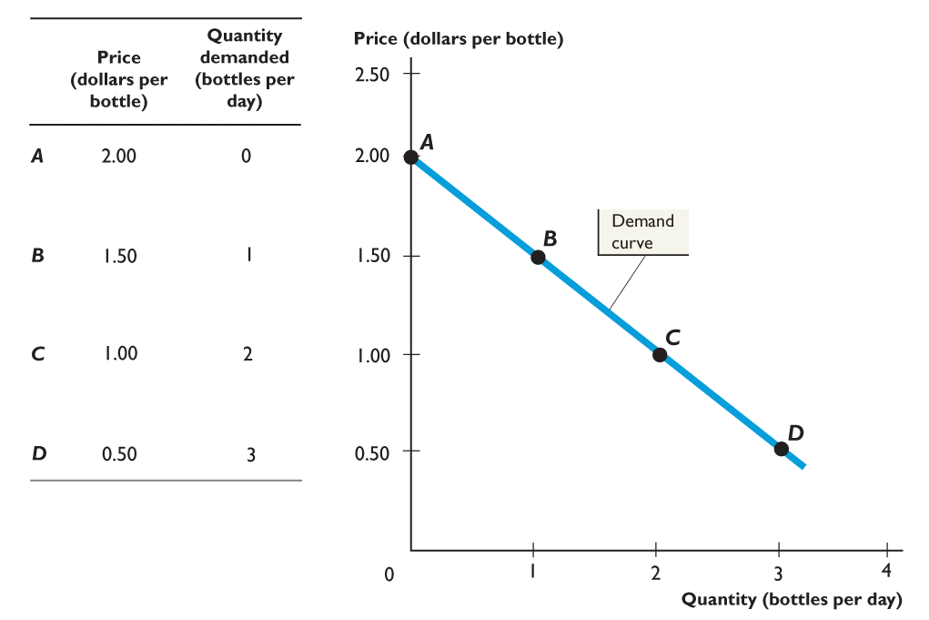
DEMAND

Slide 9
DEMAND
Individual Demand and Market Demand
  Market demand is the sum of the demands of all the buyers in a market.
  The market demand curve is the horizontal sum of the demand curves of all buyers in the market.

Slide 10
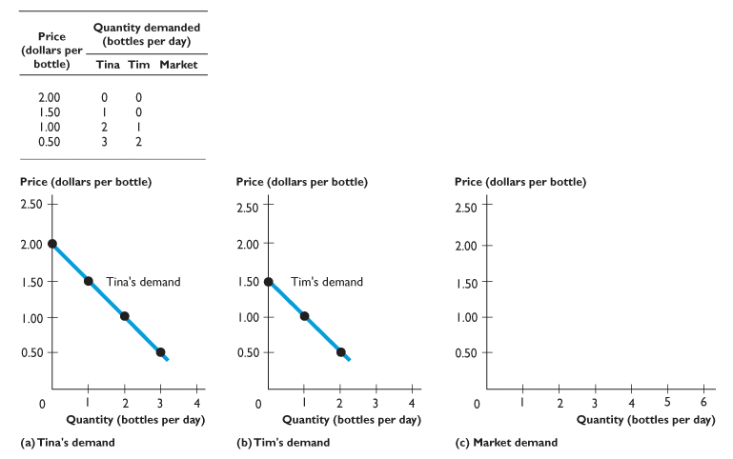
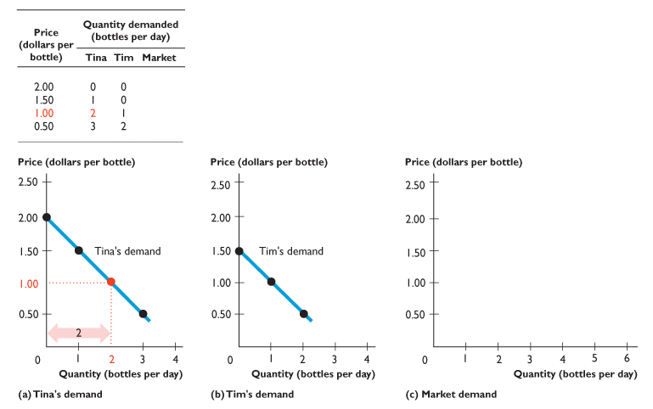
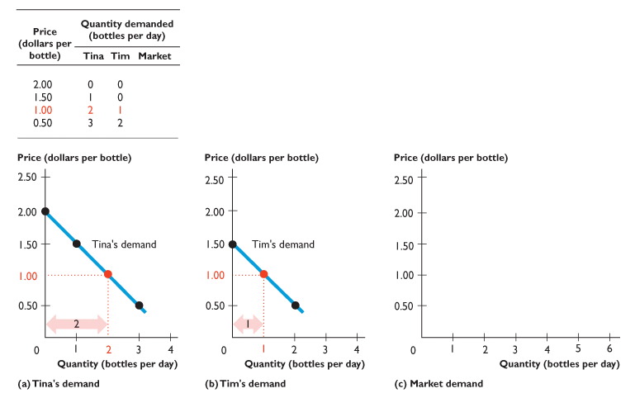
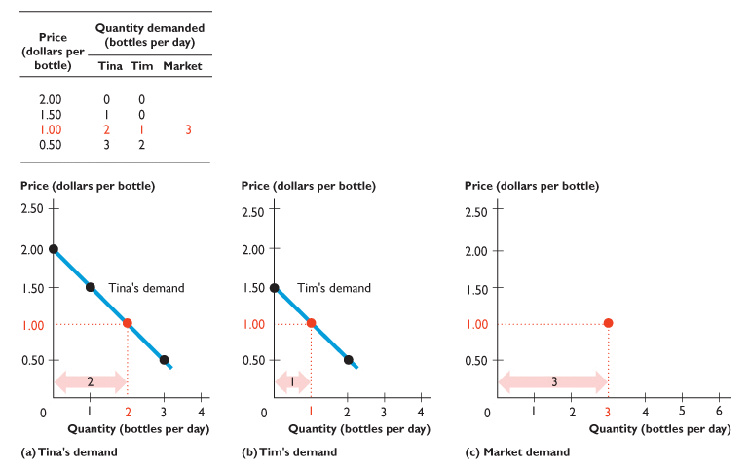
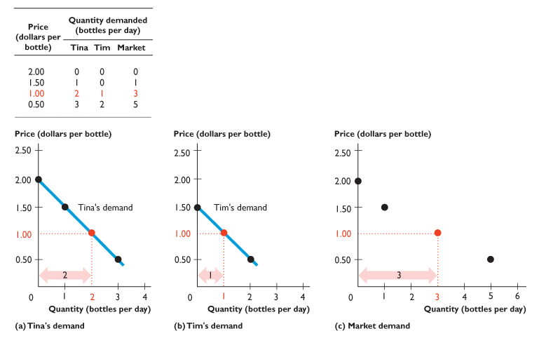
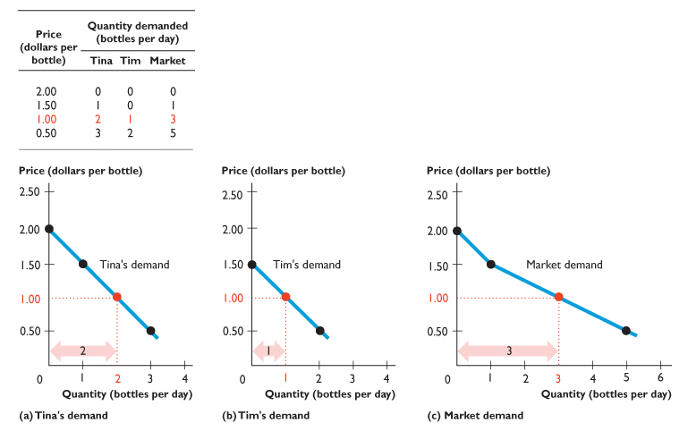
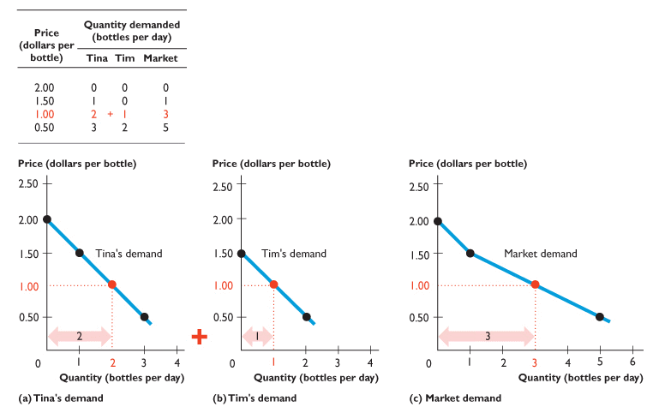
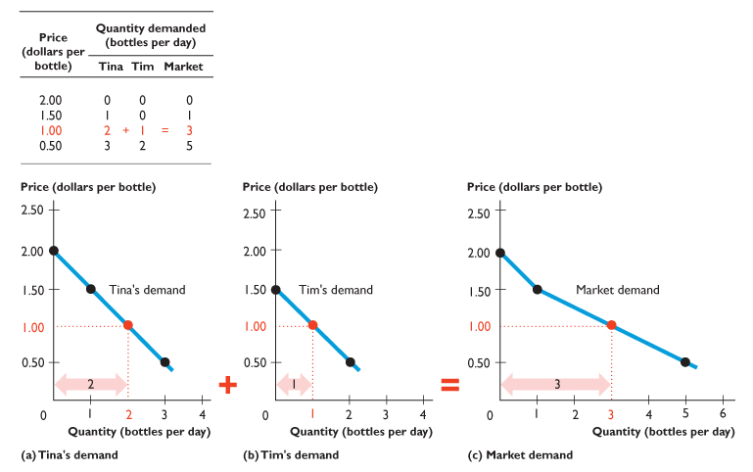
DEMAND

Slide 11
DEMAND
Changes in Demand
  Change in demand is a change in the quantity that people plan to buy when any influence other than the price of the good changes.
  A change in demand means that there is a new demand schedule and a new demand curve.

Slide 12
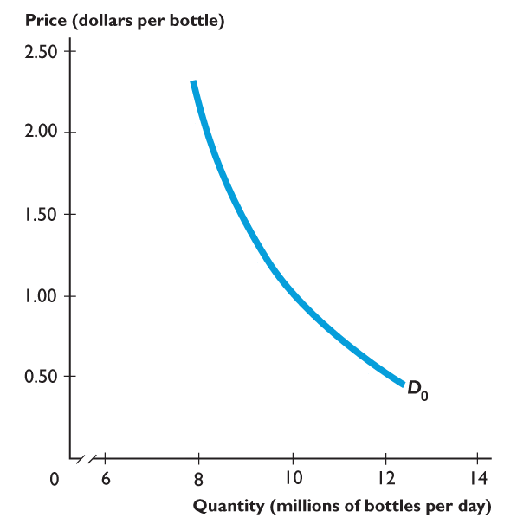
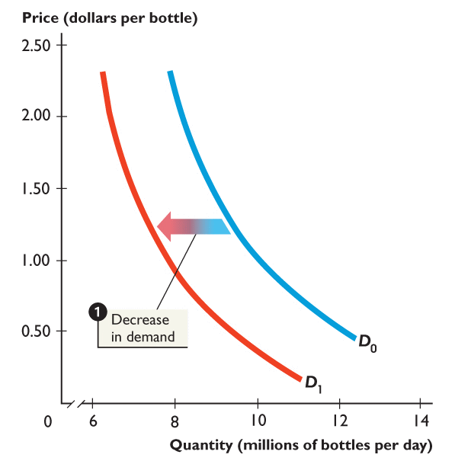
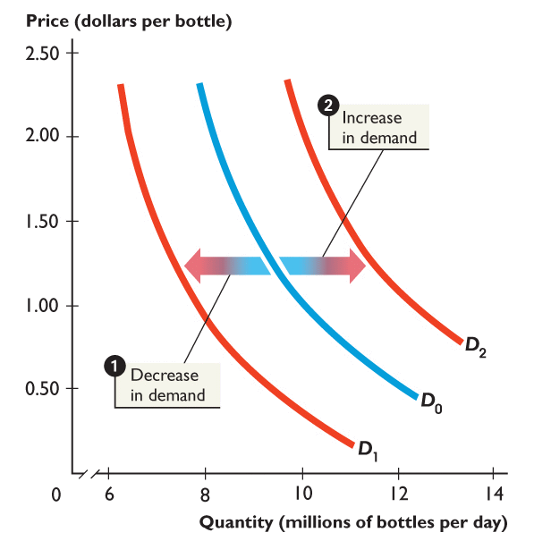
DEMAND
Figure 1 shows
changes in demand.
1. When demand decreases, the demand curve shifts leftward from D₀ to D₁.
2. When demand increases, the demand curve shifts rightward from D₀ to D₂.

Slide 14
SUPPLY
Quantity supplied is the amount of a good, service, or resource that people are willing and able to sell during a specified period at a specified price.
Supply curve is the relationship between the quantity of a good
that producers are willing to sell and the price of the good.
The Law of Supply
Other things remaining the same,
    If the price of a good rises, the quantity supplied of that good increases.
    If the price of a good falls, the quantity supplied of that good decreases.

Slide 15
SUPPLY
Supply Schedule and Supply Curve
  Supply is the relationship between the quantity supplied of a good and the price of the good when all other influences on selling plans remain the same.
  Supply is illustrated by a supply schedule and a supply curve.

Slide 16
SUPPLY
A supply schedule is a list of the quantities supplied at each different price when all other influences on selling plans remain the same.
A supply curve is a graph of the relationship between the quantity supplied and the price of the good when all other influences on selling plans remain the same.

Slide 17
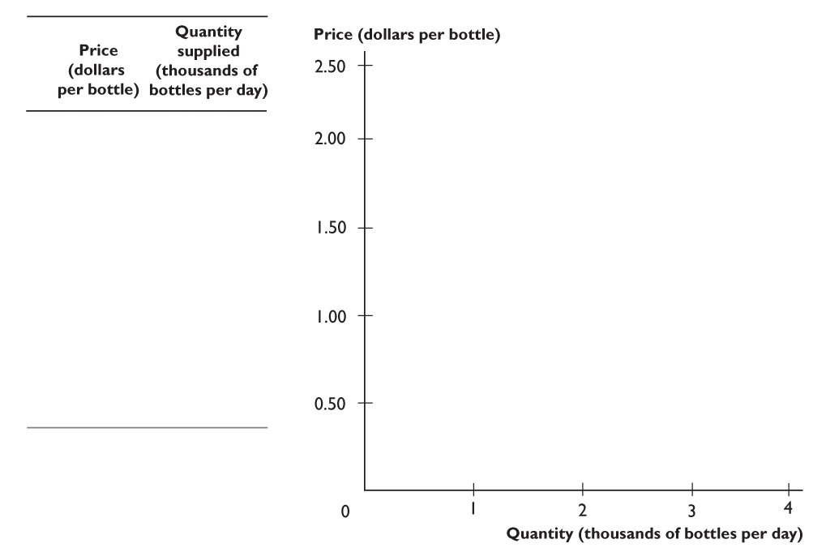
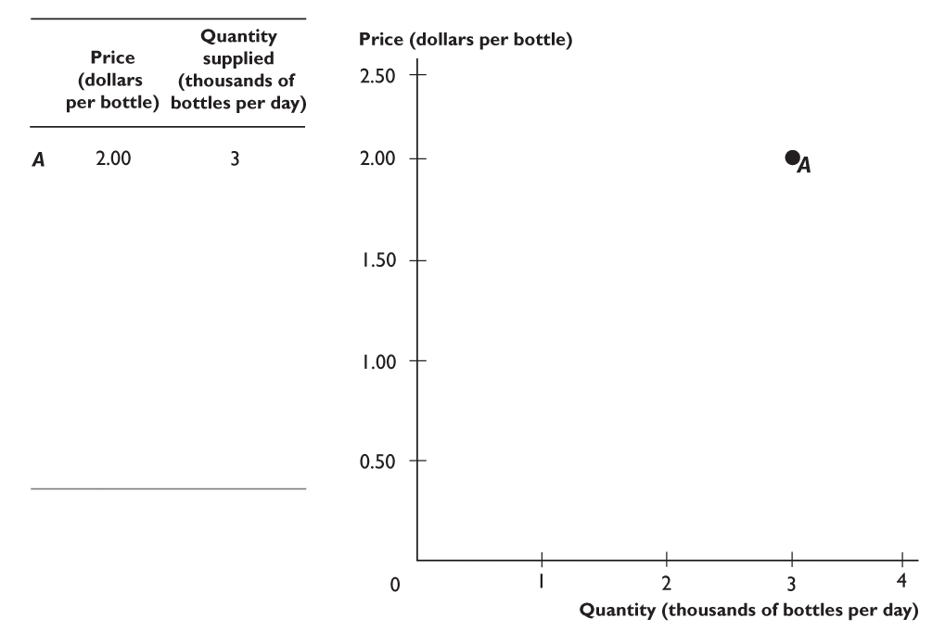
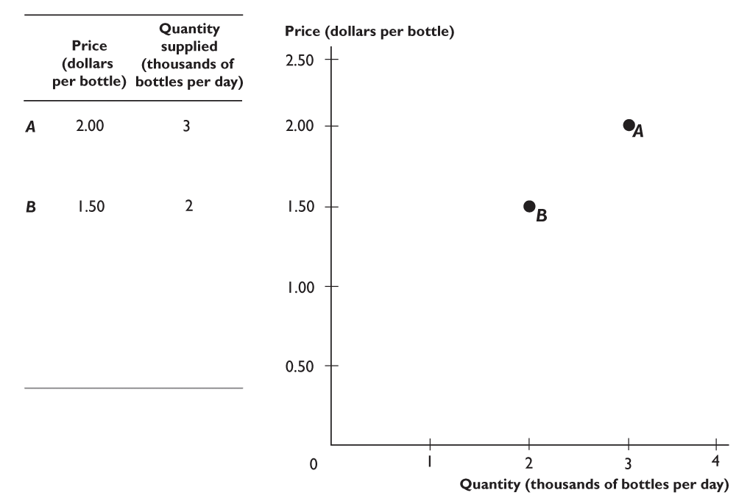
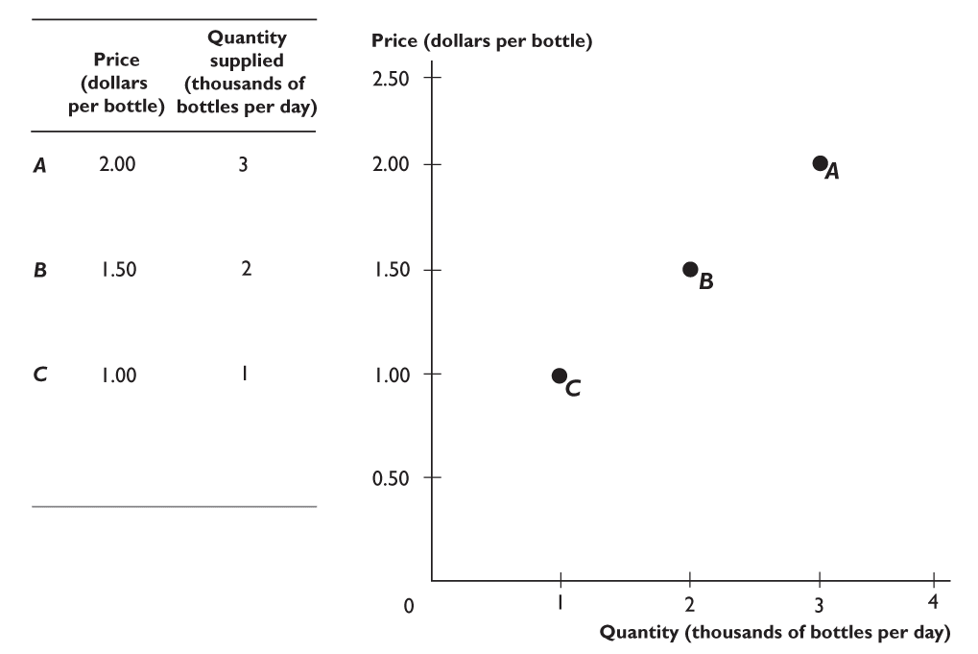
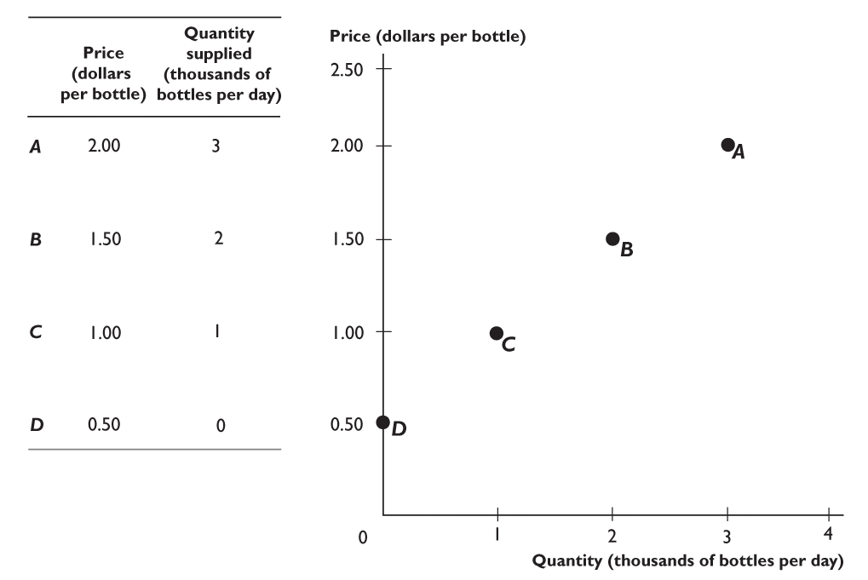
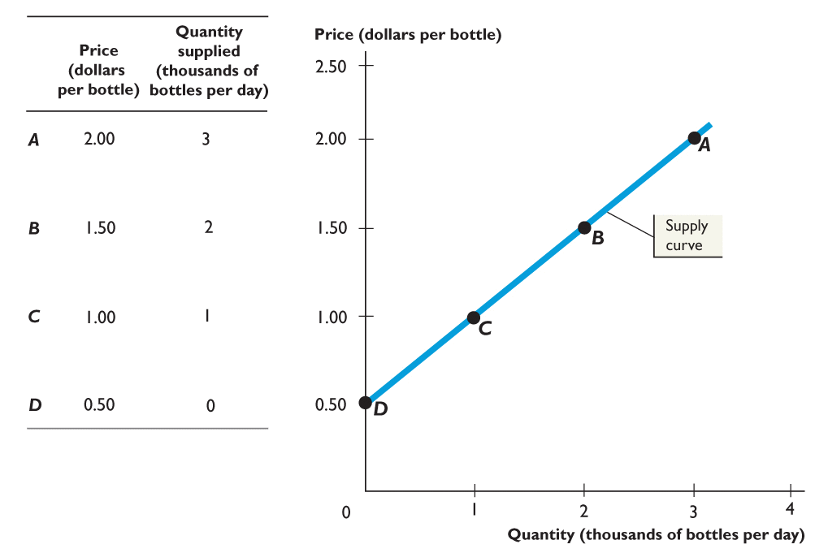
SUPPLY

Slide 18
SUPPLY
Individual Supply and Market Supply
  Market supply is the sum of the supplies of all sellers in a market.
  The market supply curve is the horizontal sum of the supply curves of all the sellers in the market.

Slide 19
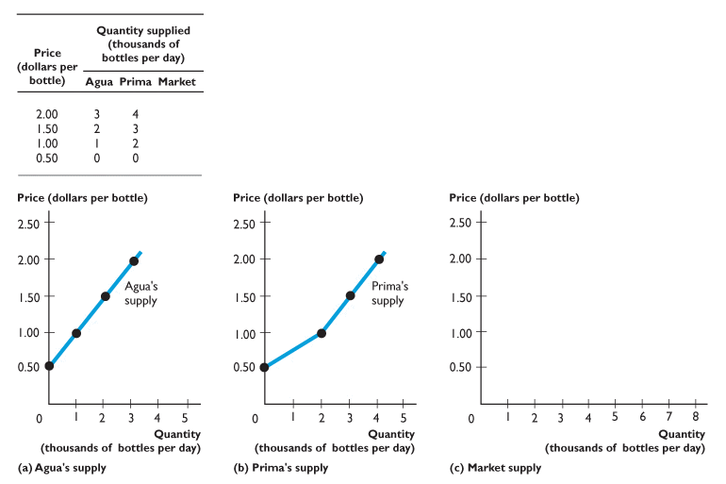
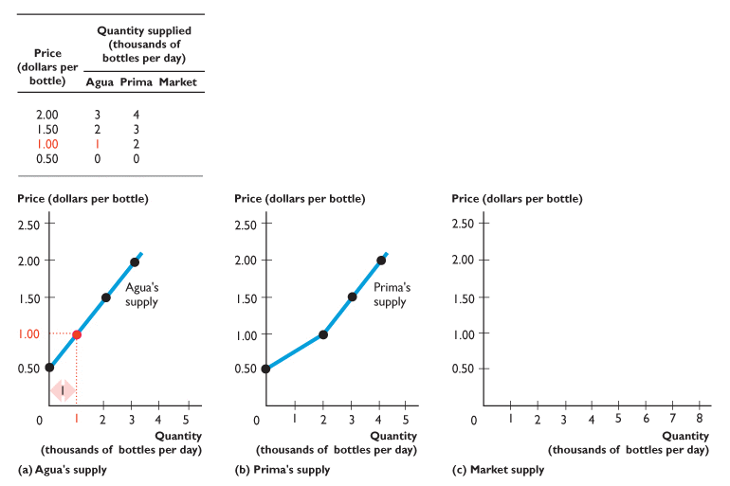
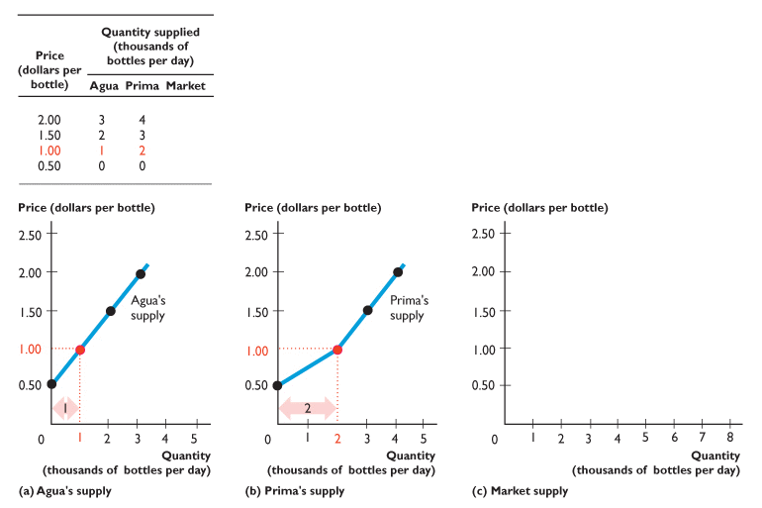
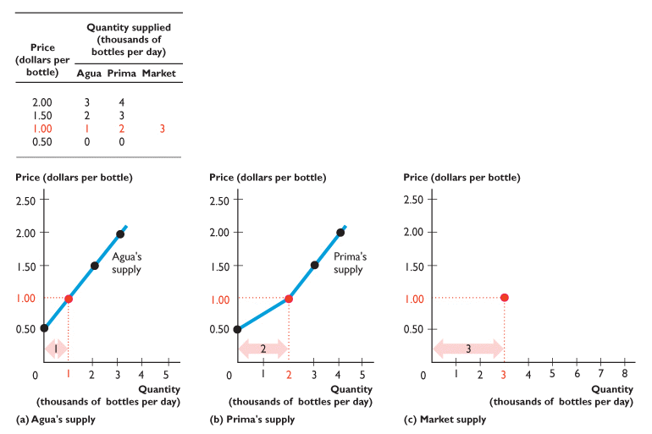

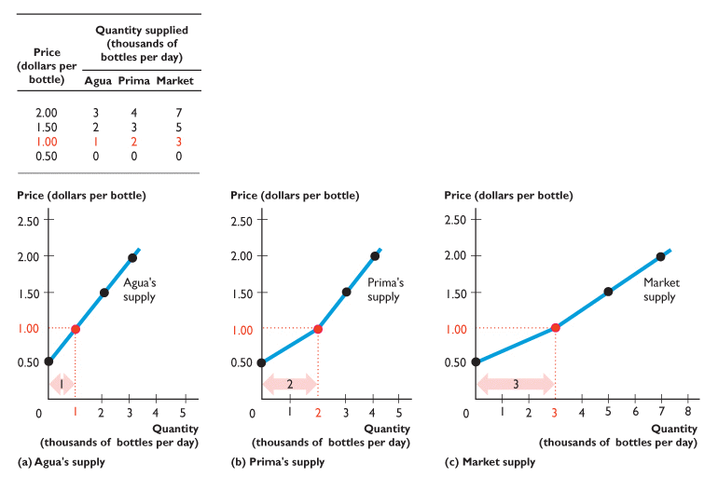
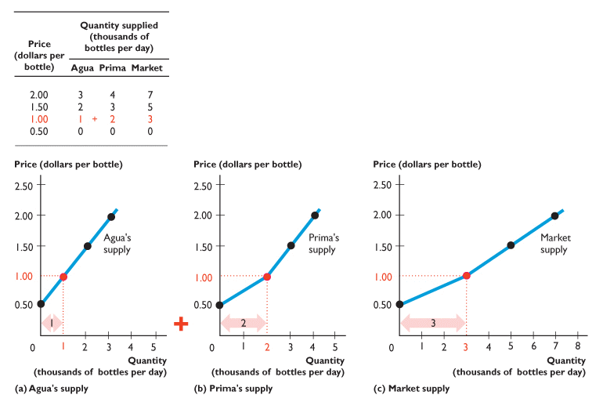
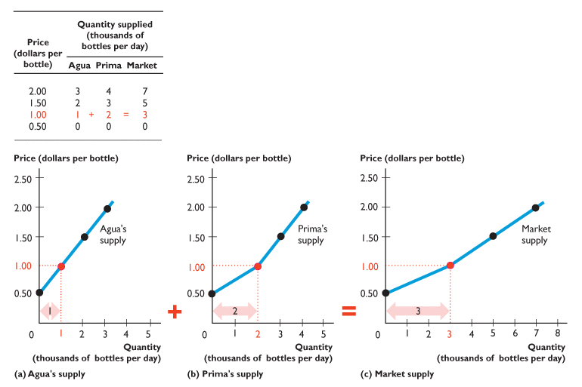
SUPPLY

Slide 20
SUPPLY
Changes in Supply
  A change in supply is a change in the quantity that suppliers plan to sell when any influence on selling plans other than the price of the good changes.
  A change in supply means that there is a new supply schedule and a new supply curve.

Slide 21
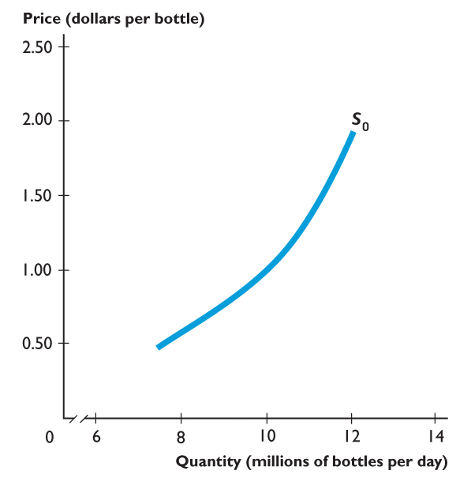
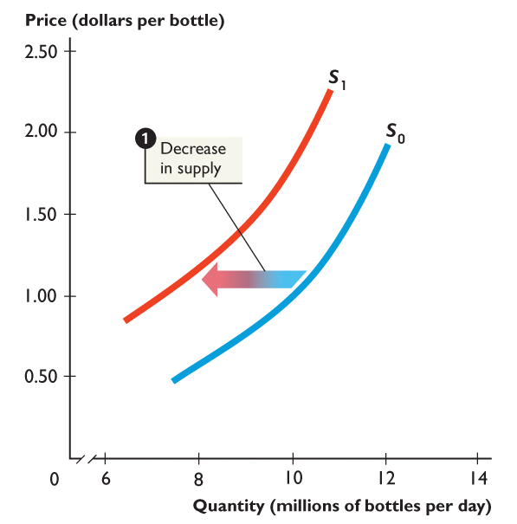
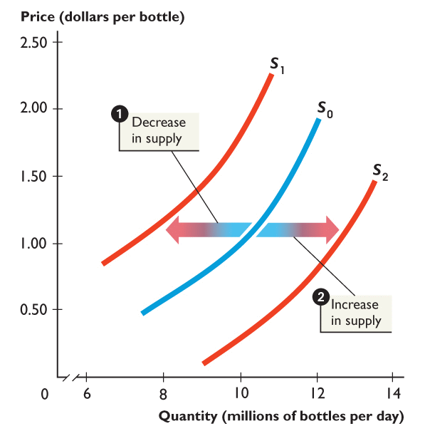
Figure 4.7 shows changes in supply.
1. When supply decreases, the supply curve shifts leftward from S₀ to S₁.
2. When supply increases, the supply curve shifts rightward from S₀ to S₂.

Slide 23
MARKET EQUILIBRIUM
Market equilibrium occurs when the quantity demanded equals the quantity supplied.
At market equilibrium, buyers’ and sellers’ plans are consistent.
Equilibrium price is the price at which the quantity demanded equals the quantity supplied.
Equilibrium quantity is the quantity bought and sold at the equilibrium price.

Slide 24
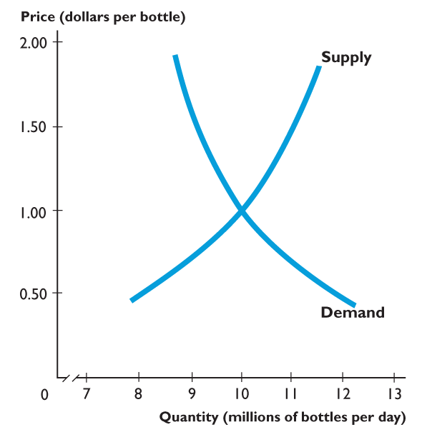
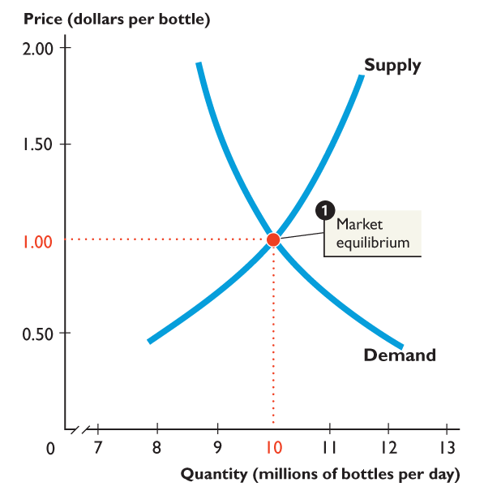
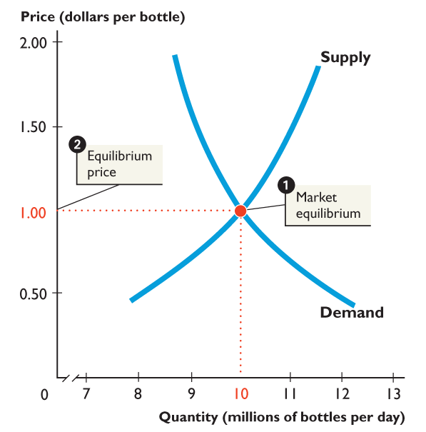
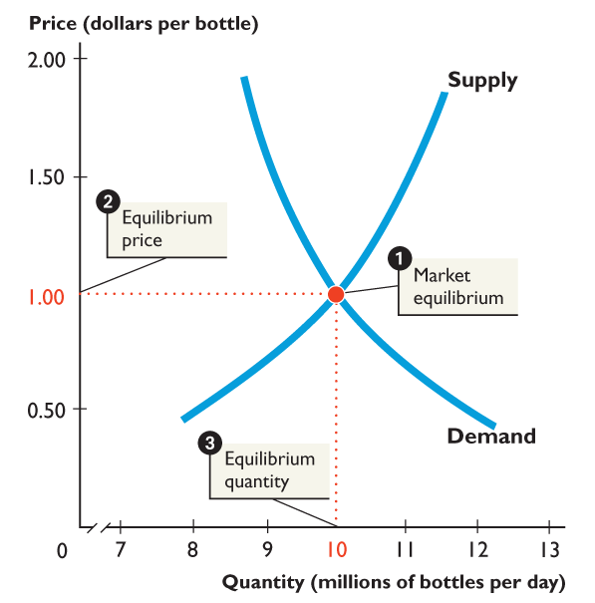
MARKET EQUILIBRIUM
Figure 2 shows the
equilibrium price and
equilibrium quantity.
1. Market equilibrium at the intersection of the demand curve and the supply curve.
2. The equilibrium price is $1 a bottle.
3. The equilibrium quantity is 10 million bottles a day.

Slide 25
MARKET EQUILIBRIUM
Price: A Market’s Automatic Regulator
  Law of market forces
    When there is a shortage, the price rises.
    When there is a surplus, the price falls.
  Shortage occurs when the quantity demanded exceeds the quantity supplied.
  Surplus occurs when the quantity supplied exceeds the quantity demanded.

Slide 26
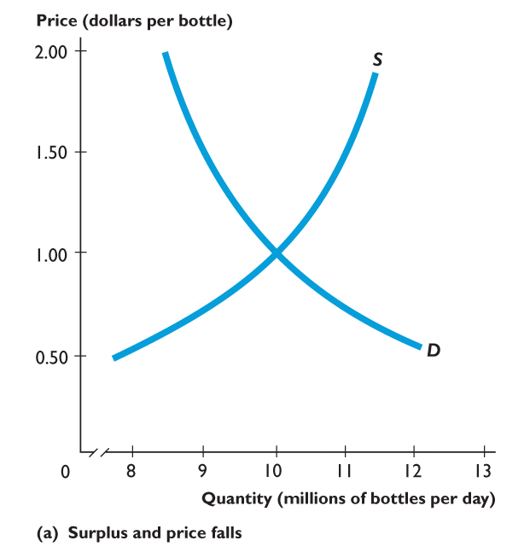
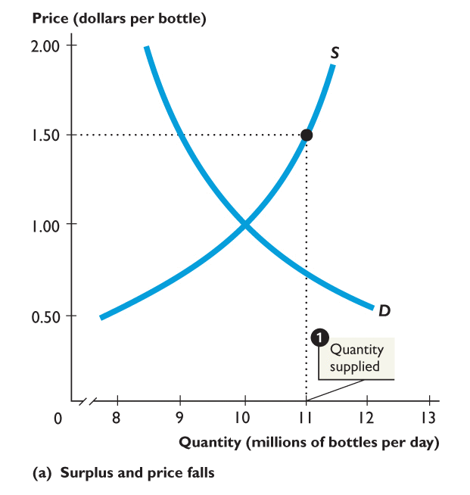
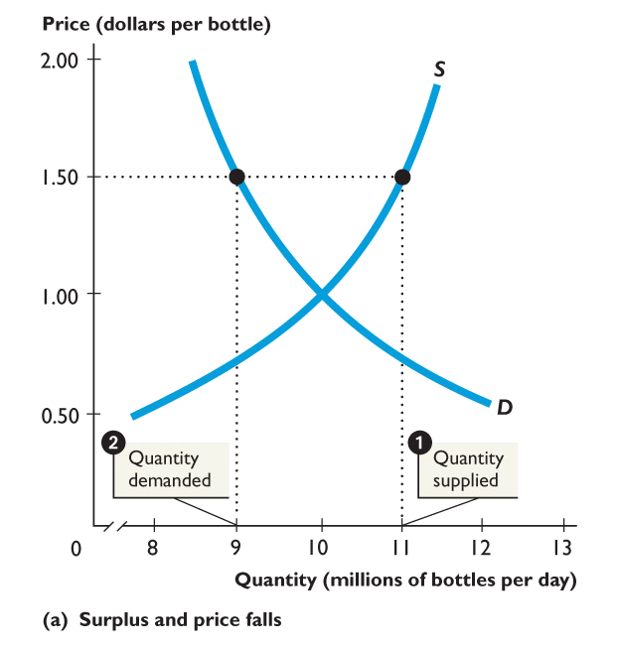
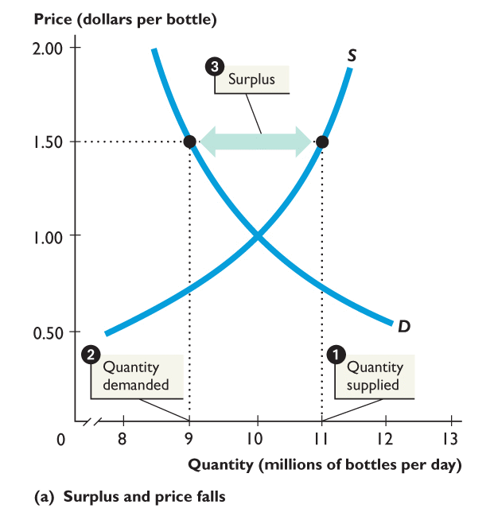
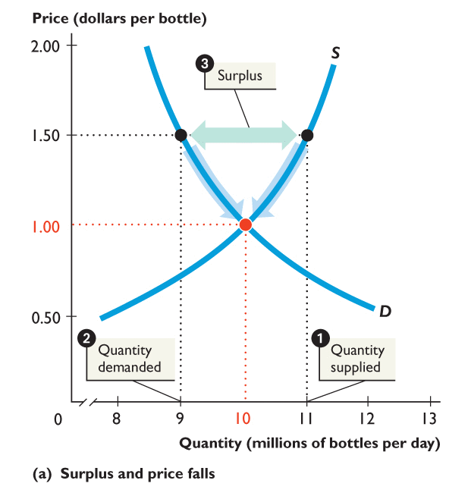
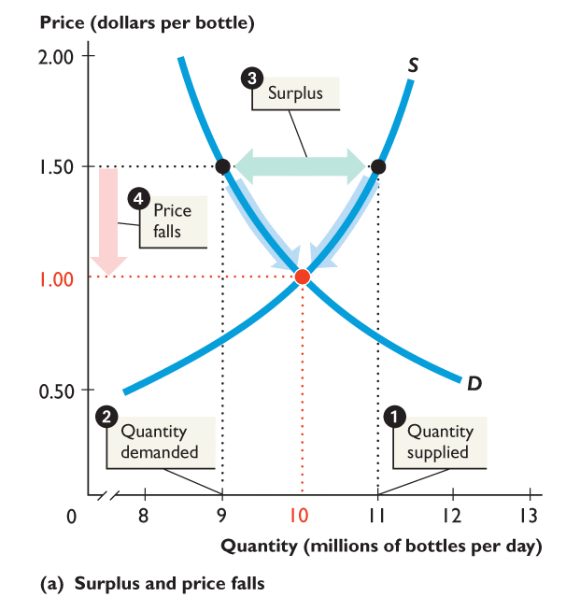
MARKET EQUILIBRIUM
Figure 3 achieves market equilibrium.
At $1.50 a bottle:
1. Quantity supplied is 11 million bottles.
2. Quantity demanded is 9 million bottles.
3. There is a surplus of 2 million bottles.
4. Price falls until the surplus is eliminated and the market is in equilibrium.

Slide 28
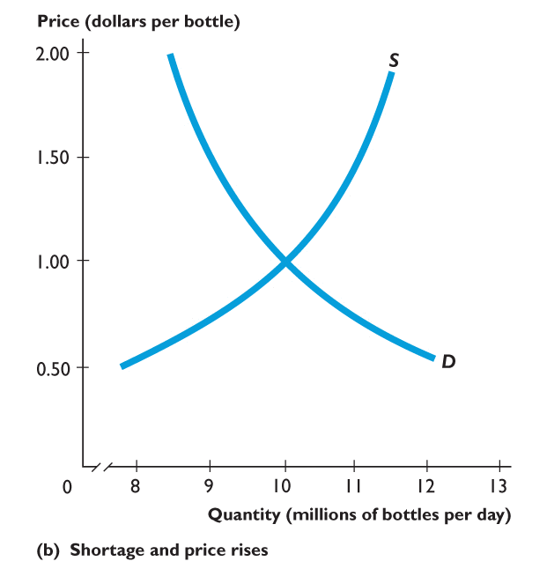
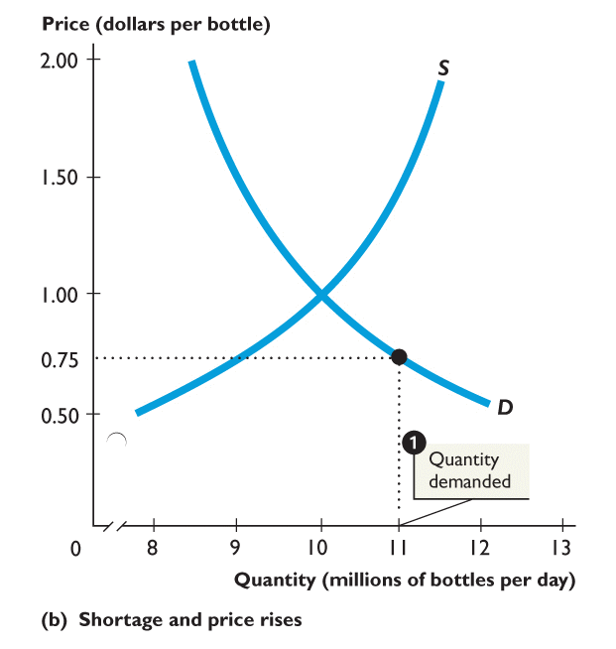
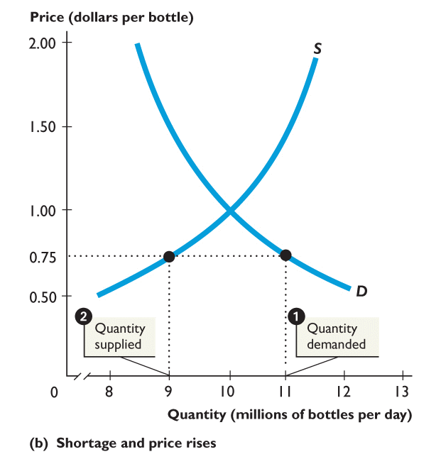
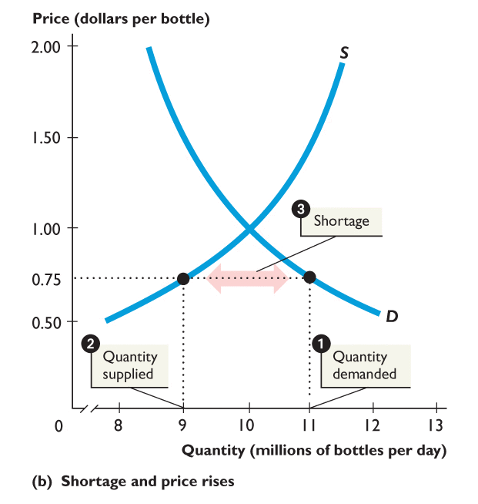
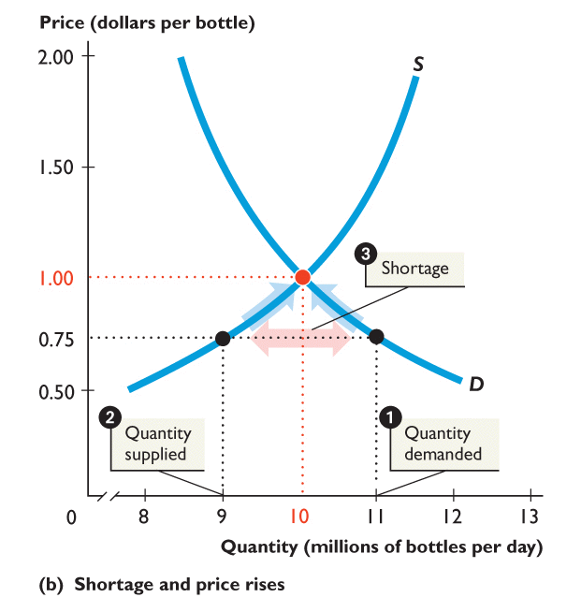
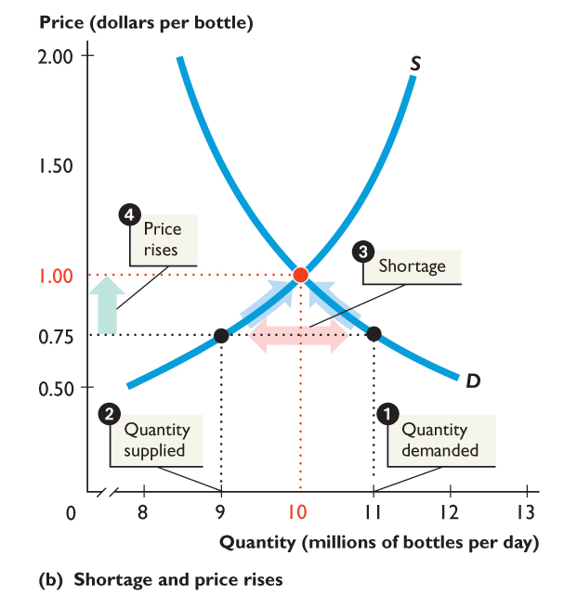
MARKET EQUILIBRIUM
Figure 4 achieves market equilibrium.
At 75 cents a bottle:
1. Quantity demanded is 11 million bottles.
2. Quantity supplied is 9 million bottles.
3. There is a shortage of 2 million bottles.
4. Price rises until the shortage is eliminated and the market is in equilibrium.

Slide 30
DETERMINANTS OF SUPPLY AND DEMAND
Supply and demand analysis is useful not only for the normative insight it offers into questions of public policy but also for a rich variety of descriptive purposes.
Most important, it predicts how equilibrium prices and quantities will respond to changes in market forces. Because supply and demand curves intersect to determine equilibrium prices and quantities, anything that shifts these curves will alter equilibrium values in a predictable way.

Slide 31
Factors the Shift the Demand Curve
Incomes
Tastes
Price of Substitutes and Complements
Expectations
Population

Slide 32
Factors the Shift the Demand Curve
Incomes
  Normal goods: the quantity demanded at any price rises with income.
  Inferior goods: the quantity demanded at any price falls with income.
Tastes
Tastes vary across people and over time. In Western societies, culture instills a taste for sitting on padded furniture, whereas in many Eastern societies, people are conditioned to favor sitting cross-legged on the floor. The demand for armchairs thus tends to be larger in the West than in the East.

Slide 33
Price of Substitutes and Complements
Complements - an increase in the price of one good decreases demand for the other good.
Substitutes - an increase in the price of one will tend to increase the demand for the other.
Complementary Goods Examples: Substitute Goods Examples:
Tennis Balls and Tennis Racket 1. McDonald’s — KFC and Burger King.
Mobile Phones and Sim Cards 2. Coke — Pepsi.
Petrol and Cars 3. iPhone — Samsung Galaxy.
PlayStation and Games 4. Pizza Hut — Domino’s
Movies and Popcorn 5. Playstation — Xbox.
Pencils and Notebooks 6. Butter — margarine.

Slide 34
Expectations
Expectations about future income and price levels also affect current purchase decisions.
For example, someone who expects higher future income is likely to spend more today than an otherwise identical person who expects lower future income. (After all, with higher expected future income, the need to save diminishes.)
Similarly, people will often accelerate their current purchases of goods whose prices are expected to rise in the months to come.

Slide 35
Population
In general, the number of people who buy a product grows as the number of potential buyers grows. Thus, in cities with growing populations, the demand for housing increases from year to year, whereas it tends to fall in cities with declining populations.

Slide 36
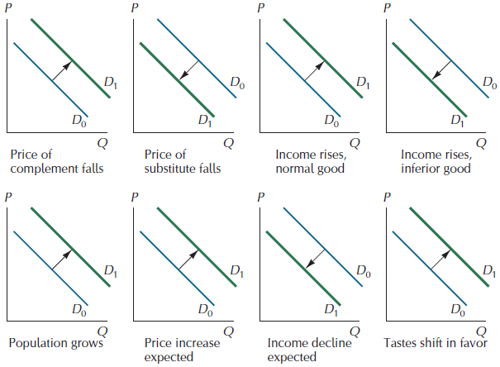
Factors that Shift Demand Curves

Slide 37


Slide 38
DETERMINANTS OF SUPPLY
Factors the Shift the Supply Curve
Technology
Factor Prices
The Number of Suppliers
Expectations
Weather

Slide 39
Technology
The amount suppliers are willing to offer at any price depends primarily on their costs of production. These costs, in turn, are closely linked to technology. For instance, the discovery of a more efficient lobster trap will reduce the cost of harvesting lobsters, which results in a rightward shift in the supply schedule.
Factor Prices
A supplier’s costs also depend on the payment it must make to its factors of production: labor, capital, and so on. If the price of lobster boats rises, or if the wage paid to lobstermen goes up, the supply schedule for lobsters shifts to the left.

Slide 40
The Number of Suppliers
The more firms that can supply a good, the greater will be the quantity supplied of it at any given price. The supply schedule of personal computers has shifted sharply to the right as more and more companies have begun producing them.
Expectations
Suppliers too take expected changes in prices into account in their current production decisions. For example, if ranchers expect beef prices to rise sharply in the future because of an epidemic affecting young cattle, they are likely to withhold current supplies of mature livestock to take advantage of the higher future prices.
Weather
For some products, particularly agricultural ones, nature has significant effects on the supply schedule. In years of drought, for example, the supply schedule for many foodstuffs shifts to the left.

Slide 41

Factors that Shift Supply Schedules

Slide 42
CHANGES IN DEMAND VERSUS
CHANGES IN THE QUANTITY DEMANDED
When economists use the expression change in demand, they mean a shift in the entire demand curve. Thus, when the average income level of buyers changes, the demand curve shifts—there is a change in demand.
When we say change in the quantity demanded, we mean a movement along the demand curve. When the price of a good falls, for example, the result is an increase in the quantity demanded, not an increase in demand.
Analogous interpretations attach to the expressions change in supply and change in the quantity supplied.

Slide 43
Predicting Changes in Price and Quantity
An increase in demand → an increase in both the equilibrium price and quantity.
A decrease in demand → a decrease in both the equilibrium price and quantity.
An increase in supply → a decrease in the equilibrium price and an increase in the equilibrium quantity.
A decrease in supply → an increase in the equilibrium price and a decrease in the equilibrium quantity.

Slide 44
PRICE CEILINGS
  A price ceiling is a government regulation that places an upper limit on the price at which a particular good, service, or factor of production may be traded.
  An example is a price ceiling on housing rents.
  Trading above the price ceiling is illegal.

Slide 45
PRICE CEILINGS
A Rent Ceiling
  A rent ceiling is a regulation that makes it illegal to charge more than a specified rent for housing.
  The effect of a rent ceiling depends on whether it is imposed at a level above or below the market equilibrium rent.

Slide 46




PRICE CEILINGS
Figure 5 shows a housing market.
1. At the market equilibrium
2. The equilibrium rent is $550 a month and
3. The equilibrium quantity is 4,000 units of housing.
If a rent ceiling is set above $550 a month, nothing will change.

Slide 48






Figure 6 shows how a rent ceiling creates a shortage.
A rent ceiling is imposed at $400 a month, which is below the market equilibrium rent.
1. The quantity of housing supplied decreases to 3,000 units.
2. The quantity of housing demanded increases to 6,000 units.
3. A shortage of 3,000 units arises.

Slide 50
  When a rent ceiling creates a housing shortage, two developments occur:
    A black market
    Increased search activity
  A black market is an illegal market that operates alongside a government-regulated market.
  Search activity is the time spent looking for someone with whom to do business.

Slide 51





Figure 7 shows how a rent ceiling creates a black market and housing search.
With a rent ceiling of $400 a month:
1. 3,000 units of housing are available.
2. Someone is willing to pay $625 a month for the 3,000th unit of housing.

Slide 52


Slide 53
PRICE CEILINGS
3. Black market rents might be as high as $625 a month and resources get used up in costly search activity.

Slide 54
Are Rent Ceilings Efficient?
  With a rent ceiling, the outcome is inefficient.
  Marginal benefit exceeds marginal cost.
  Total surplus—the sum of producer surplus and consumer surplus—shrinks and a deadweight loss arises.
  People who can’t find housing and landlords who can’t offer housing at a lower rent lose.

Slide 55




Figure (a) shows an efficient housing market.
1. The market is efficient with marginal benefit equal to marginal cost.
2. Consumer surplus plus ...
3. Producer surplus is as large as possible.

Slide 57





Figure (b) shows the inefficiency of a rent ceiling.
A rent ceiling restricts the quantity supplied and marginal benefit exceeds marginal cost.
1. Consumer surplus reduces.
2. Producer surplus reduces.

Slide 58



Slide 59
PRICE CEILINGS
3. A deadweight loss arises.
4. Other resources are lost in search activity and evading and enforcing the rent ceiling law.
Resource use is inefficient.

Slide 60
PRICE FLOORS
A price floor is a government regulation that places a lower limit on the price at which a particular good, service, or factor of production may be traded.
Price floors are sometimes called “price supports,” because they support a price by preventing it from falling below a certain level.

Slide 61
A price floor is the lowest legal price a commodity can be sold at. Price floors are used by the government to prevent prices from being too low.
The most common price floor is the minimum wage--the minimum price that can be payed for labor. Price floors are also used often in agriculture to try to protect farmers.
For a price floor to be effective, it must be set above the equilibrium price. If it's not above equilibrium, then the market won't sell below equilibrium and the price floor will be irrelevant.

Slide 62


Slide 63




PRICE FLOORS
Figure shows a market for fast-food servers.
1. The demand for and supply of fast-food servers determine the market equilibrium.
2. The equilibrium wage rate is $5 an hour.
3. The equilibrium quantity is 5,000 servers.

Slide 65
PRICE FLOORS
The Minimum Wage
A minimum wage law is a government regulation that makes hiring labor for less than a specified wage illegal.
  Firms can pay a wage rate above the minimum wage but they may not pay a wage rate below the minimum wage.
  The effect of a minimum wage depends on whether it is set above or below the market equilibrium wage rate.

Slide 66






PRICE FLOORS
Figure 9 shows how a minimum wage creates unemployment.
A minimum wage is set above the equilibrium wage.
1. The quantity demanded decreases to 3,000 workers.
2. The quantity supplied increases to 7,000 people.
3. 4,000 people are unemployed.

Slide 67
Of the 4,000 people unemployed, 2,000 have been fired and another 2,000 would like to work at $7 an hour.
The 3,000 jobs must somehow be allocated to the 7,000 people who would like to work.
This allocation is achieved by
Increased search activity
Illegal hiring

Slide 68





PRICE FLOORS
Figure shows how a minimum wage increases job search.
1. At the minimum wage rate of $7 an hour, 3,000 jobs are available.
2. Someone is willing to take the 3,000th job for $3 an hour.

Slide 69

PRICE FLOORS
3. Illegal wage rates might range from just below $7 an hour to $3 an hour.
People are willing to spend time on job search that is worth the equivalent of lowering their wage rate by $4 an hour.

Slide 71
Is the Minimum Wage Efficient?
  The firms’ surplus and workers’ surplus shrink, and a deadweight loss arises.
  Firms that cut back employment and people who can’t find jobs at the higher wage rate lose.
  The total loss exceeds the deadweight loss because resources get used in costly job-search activity.

Slide 72




PRICE FLOORS
  Figure (a) shows an efficient labor market.
  1. At the market equilibrium, the marginal benefit of labor to firms equals the marginal cost of working.
  2. The sum of the firms’ and workers’ surpluses is as large as possible.

Slide 74





PRICE FLOORS
  Figure (b) shows an inefficient labor market with a minimum wage.
  The minimum wage restricts the quantity demanded.
  1. The firms’ surplus shrinks.
  2. The workers’ surplus shrinks.

Slide 75



Slide 76
PRICE FLOORS
  3. A deadweight loss arises.
  4. Other resources are used up in job-search activity.
  The outcome is inefficient.

Slide 77
The Algebra of Supply and Demand
For computing numerical values, it is more convenient to find equilibrium prices and quantities algebraically
  The supply schedule is: P= 2 + 3Q^{s}
  Its demand schedule is: P = 10 – Q^{d}
  In equilibrium we know that Q^{s =} Q^{d}, denoting this common value as Q*, we arrive at: 2 + 3Q* = 10 – Q*
  Which gives Q* = 2, substituting this back into either the supply or demand equation gives the equilibrium price, P* = 8

Slide 78

Figure 2.12: Graphs of the Supply and Demand Equations

Slide 79


Tax Burdens

Slide 80

A Tax of T=10 Levied on the Seller Shifts the Supply Schedule Upward by T Units

Slide 81

Equilibrium Prices and Quantities When a Tax of T = 10 is Levied on the Seller

Slide 82

The Effect of a Tax of T = 10 Levied on the Buyer

Slide 83


Equilibrium Prices and Quantities after Imposition of a Tax of a Tax of T = 10 Paid by the Buyer

Slide 84
A Tax on the Buyer Leads to the Same Outcome as a Tax on the Seller

Slide 85



