Slide 1
Chapter 3
Rational Consumer Choice

Slide 2
Rational choice theory begins with the assumption that consumers enter the marketplace with well-defined preferences. Taking prices as given, their task is to allocate their incomes to best serve these preferences. Two steps are required to carry out this task.
Step 1 is to describe the various combinations of goods the consumer is able to buy. These combinations depend on both her income level and the prices of the goods.
Step 2 then is to select from among the feasible combinations the particular one that she prefers to all others.

Slide 3
Analysis of step 2 requires some means of describing her preferences, in particular, a summary of her ranking of the desirability of all feasible combinations.
Formal development of these two elements of the theory will occupy our attention throughout this chapter. Because the first element—describing the set of possibilities—is much less abstract than the second, let us begin with it.

Slide 4
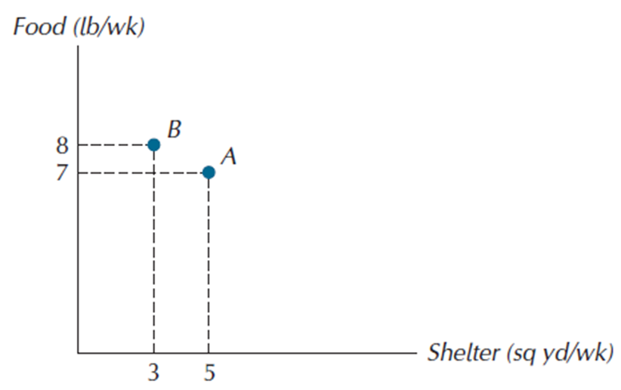
THE OPPORTUNITY SET OR BUDGET CONSTRAINT
For simplicity, we start by considering a world with only two goods, shelter and food. A bundle of goods is the term used to describe a particular combination of shelter, measured in square yards per week, and food, measured in pounds per week. In Figure 3.1, one bundle (bundle A) might consist of 5 sq yd/wk of shelter and 7 lb/wk of food, while another (bundle B) consists of 3 sq yd/wk of shelter and 8 lb/wk of food. We use (5, 7) to denote bundle A and (3, 8) to denote bundle B. By convention, the first number of the pair in any bundle represents the good measured along the horizontal axis.

Slide 5
Figure 3.1: Two Bundles of Goods
A bundle is a specific
combination of goods. Bundle A has 5 units of shelter and 7 units of food. Bundle B has 3 units of shelter and 8 units of food.

Slide 6
Note that the units on both axes are flows, which means amounts per unit of time—pounds per week, square yards per week.
Consumption is always measured as a flow. It is important to keep track of the time dimension because without it there would be no way to evaluate whether a given quantity of consumption was large or small.
budget constraint: the set of all bundles that exactly exhaust the
consumer’s income at given prices. Also called the budget line.

Slide 7
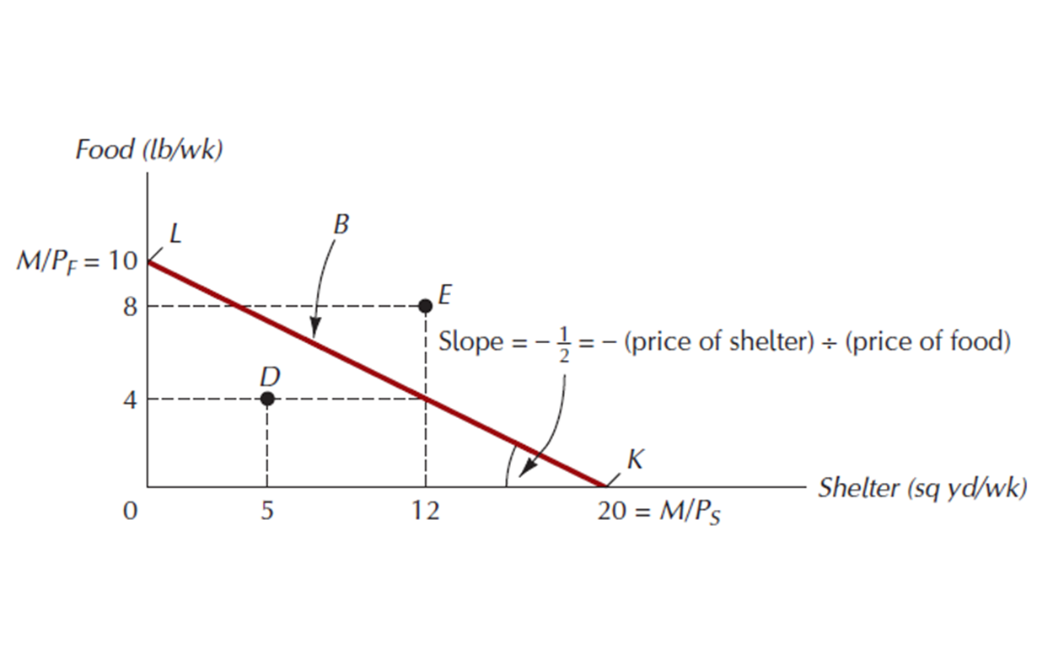
Line B describes the set of all bundles the consumer can purchase for given values of income and prices.
Its slope is the negative of the price of shelter divided by the price of food. In absolute value, this slope is the opportunity cost of an additional unit of shelter—the number of units of food that must be sacrificed in order to
purchase one additional unit of shelter at market prices.

Slide 8
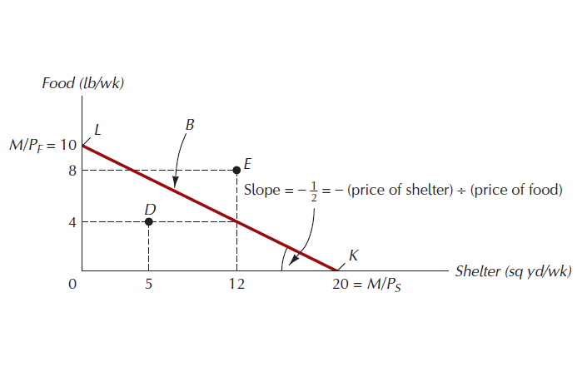
Figure 3.2: The Budget Constraint, or Budget Line

Slide 9
Affordable vs. Unaffordable
Affordable set, or feasible set: bundles on or below the budget constraint; bundles for which the required expenditure at given prices is less than or equal to the income available.
Unaffordable set, or unfeasible set: bundles that lie outside the budget constraint.

Slide 10
The Budget Constraint
Assume only two goods available: X and Y
Consumers take as given:
Price of X: P_{X}
Price of Y: P_{Y}
Income: I
Total expenditure on basket: P_{X} . X + P_{Y} . Y
The Basket is affordable if total expenditure does not exceed total income:
P_{X} . X + P_{Y} . Y ≤ I

Slide 11
Definition: The Budget Constraint defines the set of baskets that the consumer may purchase given the income available.
P_{X} . X + P_{Y} . Y ≤ I

Slide 12
Other Definitions:
The Budget Set is the set of baskets that are affordable to the consumer
The Budget Line is the set of baskets that are just affordable:
P_{X} . X + P_{Y} . Y = I
=> Y = I — P_{X} . X
P_{Y} P_{Y}

Slide 13
Example:
Suppose I = € 10 P_{X} = € 1 P_{Y} = € 2
Budget line: 1. X + 2 . Y = 10
or: Y = 10 — 1 . X
2 2

Slide 14
Y
•
A
I/P_{Y}= 5
B
•
X
I/P_{X} = 10

Slide 15
Y
•
A
I/P_{Y}= 5
B
•
X
I/P_{X} = 10

Slide 16
Y
Budget line = BL₁
•
A
I/P_{Y}= 5
B
•
X
I/P_{X} = 10

Slide 17
Y
Budget line = BL₁
•
A
I/P_{Y}= 5
-P_{X}/P_{Y} = -1/2
B
•
X
I/P_{X} = 10

Slide 18
Point A: one only consumes y
Point B: one only consumes x.
Point D: consumes a mixture
Point C: consumes a mixture while not spending the entire budget
Point E: unobtainable unless prices or income change
Y
Budget line = BL₁
•
A
I/P_{Y}= 5
-P_{X}/P_{Y} = -1/2
•
C
B
•
X
I/P_{X} = 10

Slide 19
Budget Constraints
Clothing
(units
per week)
Pc = $2 P_{f} = $1 I = $80
(I/P_{C}) = 40
A
Budget Line F + 2C = $80
B
30
10
D
20
20
E
10
G
Food
(units per week)
0
20
40
60
80 = (I/P_{F})
Notes:
54
42

Slide 20
Shifts in the Budget Constraint
The budget line will change if any of its components change:
Income (shift of the budget line)
Prices of x and/or y (rotation of the budget line)

Slide 21
Budget Shifts Due to Price and Income Changes
If the price of ONLY one good changes…
The slope of the budget constraint changes.
If the price of both goods change by the same proportion…
The budget constraint shifts parallel to the original one.
If income changes ….
The budget constraint shifts parallel to the original one.

Slide 22
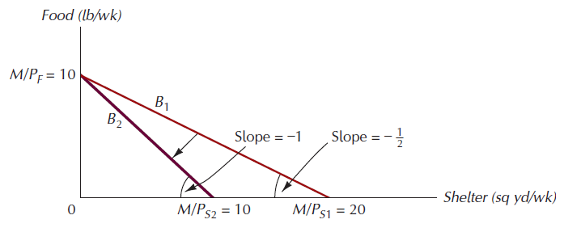
Figure 3.3: The Effect of a Rise in the Price of Shelter
When shelter goes up in
price, the vertical intercept of the budget constraint remains the same. The original budget constraint rotates inward about this Shelter (sq yd/wk) intercept.

Slide 23
Budget Constraints: Changes in Income and Prices
Clothing
(units
per week)
An increase in P_{F}
to $2.00 changes
the slope of the
budget line and
rotates it inward
pivoting from the
other good’s intercept.
A decrease in the
price of food to
$.50 changes
the slope of the
budget line and
rotates it outward.
40
L₃
L₁
L₂
(P_{F} = 1)
(P_{F} = 1/2)
(P_{F} = 2)
Food
(units per week)
40
80
120
160
Notes:
65
42

Slide 24
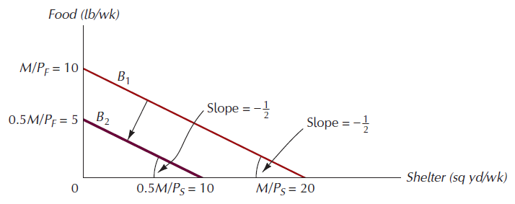
Figure 3.4: The Effect of Cutting Income by Half
Both horizontal and vertical intercepts fall by half. The new budget constraint has the same slope as the old but is closer to the origin.

Slide 25
Budget Constraints: Changes in Income and Prices
Clothing
(units
per week)
An increase in
income shifts
the budget line
outward (holding
prices constant)
80
60
A decrease in
income shifts
the budget line
inward
40
20
L₃
(I =
$40)
L₁
L₂
(I = $80)
(I = $160)
Food
(units per week)
0
40
80
120
160
Notes:
61
42

Slide 26
Suppose I = € 10 PX = € 1 PY = € 2
Budget line: 1. X + 2 . Y = 10
Change in Income: Shift of the Budget Line
Suppose I = € 12 P_{X} = € 1 P_{Y} = € 2
=> Budget line: X + 2Y = 12
If the income rises, the budget set expands, and both intercepts shift out
Since prices have not changed, the slope of the budget line does not change

Slide 27
Y
Example: Shift of a budget line
I = € 12
P_{X} = € 1
P_{Y} = € 2
Y = 6 - X/2 …. BL₂
5
BL₁
10
X

Slide 28
Y
Example: Shift of a budget line
I = € 12
P_{X} = € 1
P_{Y} = € 2
Y = 6 - X/2 …. BL₂
6
5
BL₂
BL₁
10
12
X

Slide 29
Suppose I = € 10 PX = € 1 PY = € 2
Budget line: 1. X + 2 . Y = 10
Change in Price: Rotation of the Budget Line
Suppose I = € 10 P_{X} = € 1 P_{Y} = € 3
=> Budget line: X + 3Y = 10
If the price of Y rises, the budget line gets flatter, and the vertical intercept shifts in
Since neither income nor the price of X have changed, the horizontal intercept does not change

Slide 30
Example: Rotation of a budget line
Y
I = € 10
P_{X} = € 1
P_{Y} = € 3
Y = 3.33 - X/3 …. BL₂
5
BL₁
10
X

Slide 31
Example: Rotation of a budget line
Y
I = € 10
P_{X} = € 1
P_{Y} = € 3
Y = 3.33 - X/3 …. BL₂
5
BL₁
3.33
BL₂
10
X

Slide 32
Price Changes: If the two goods increase in price, but the ratio of the two prices is unchanged, the slope will not change. However, the budget line will shift inward to a point parallel to the original budget line.
Price Changes: If the two goods decrease in price, but the ratio of the two prices is unchanged, the slope will not change. However, the budget line will shift outward to a point parallel to the original budget line.

Slide 33
Consumer Choice
Consumers choose a combination of goods that maximizes their satisfaction, given the limited budget available to them.
The maximizing market basket must satisfy two conditions:
1) It must be located on the budget line.
2) It must give the consumer the most preferred combination of goods and services.
Notes:
68

Slide 34
Preferences
Consumers have preferences that they can use to compare different goods bundles
The preferences may be over goods bundles consumed by oneself or over goods bundles consumed by someone else
For example, a parent may have preferences over various bundles of food and clothing bought by the parent but consumed by a child

Slide 35
Preference Ordering
Preference ordering: a ranking of all possible consumption bundles in order of preference.
Differ widely among consumers
Four simple properties of preference ordering

Slide 36
Properties of Preference Orderings
Completeness: the consumer is able to rank all possible combinations of goods and services.
More-Is-Better: other things equal, more of a good is preferred to less.
Transitivity: for any three bundles A, B, and C, if he prefers A to B and prefers B to C, then he always prefers A to C.
Convexity: mixtures of goods are preferable to extremes.

Slide 37
Consumer Preferences
Consumer preferences can be represented graphically using indifference curves
Indifference curves represent all combinations of market baskets that the person is indifferent to
A person will be equally satisfied with either choice
Notes:
13

Slide 38
Indifference Curves
Indifference curve: a set of bundles among which the consumer is indifferent.
Indifference map: a representative sample of the set of a consumer’s indifference curves, used as a graphical summary of her preference ordering.

Slide 39
Properties of Indifference Curves
Indifference curves …
Are everywhere.
Any bundle has an indifference curve passing through it.
Are Downward-sloping.
This comes from the “more-is-better” assumption.
Cannot cross.
Become less steep as we move downward and to the right along them.
This property is implied by the convexity property of preferences.

Slide 40
An Indifference Curve
An indifference curve is a set of consumption bundles that the consumer prefers equally
K is inferior and L is superior to the bundles on the indifference curve
Origin

Slide 41
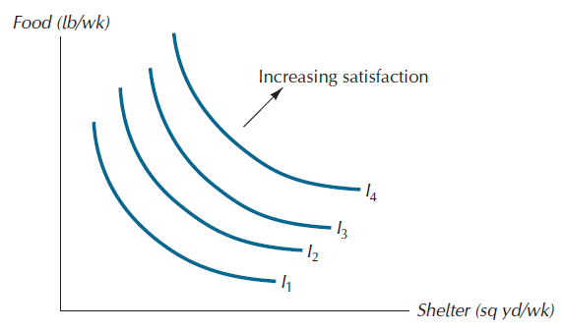
Figure 3.10: Part of an Indifference Map

Slide 42
Properties of Indifference Maps
Bundles on indifference curves farther from the origin are preferred to those on indifference curves closer to the origin.
There is an indifference curve through every possible bundle.
Indifference curves cannot cross.
Indifference curves slope downward.

Slide 43
Impossible Indifference Curves
Lisa is indifferent between e and a, and also between e and b…
so by transitivity she should also be indifferent between a and b…
but this is impossible, since b must be preferred to a given it has more of both goods.
itos per semester
r
, Bur
B
e
b
a
I
1
I
0
Z
, Pizzas per semester

Slide 44
Impossible Indifference Curves
Lisa is indifferent between b and a since both points are in the same indifference curve…
But this contradicts the “more is better” assumption. Can you tell why?
Yes, b has more of both and hence it should be preferred over a.
itos per semester
b
r
, Bur
B
a
I
Z
, Pizzas per semester

Slide 45
Impossible Indifference Curves

Slide 46
Substitution Between Goods
Economic decisions involve trade-offs
Indifference curves provide information on the amount of one good that the consumer is willing to give up to gain a unit of another good

Slide 47
Rates of Substitution
Consider moving along an indifference curve, from one bundle to another
This is the same as taking away units of one good and compensating the consumer for the loss by adding units of another good
Slope of the indifference curve shows how much of the second good is needed to make up for a loss of the first good

Slide 48
Marginal rate of substitution (MRS):
Marginal rate of substitution (MRS): the rate at which the consumer is willing to exchange the good measured along the vertical axis for the good measured along the horizontal axis.
Equal to the absolute value of the slope of the indifference curve.

Slide 49
Rates of Substitution
Look at the move from bundle A to C
Consumer loses 1 soup (ΔS = -1); gains 2 bread (ΔB = +2)
A and C are equally desirable
Slope of indifference curve = ΔB/ΔS = -2
Consumer is willing to substitute for soup with bread at 2 ounces per pint
4-49

Slide 50
Marginal Rate of Substitution
The marginal rate of substitution for X with Y, MRS_{XY}, is the rate at which a consumer must adjust Y to maintain the same level of well-being when X changes by a tiny amount, from a given starting point
Tells us how much Y a consumer needs to compensate for losing a little bit of X, per unit of X
Tells us the maximum amount of Y a consumer would be willing to pay per additional unit of X
That is, MRS_{XY} is the consumer’s willingness to pay Y for a unit of X
4-50

Slide 51
Diminishing Marginal Rate of Substitution
Clothing
16
A
MRS = 6
14
12
-6
10
B
1
8
-4
MRS = 2
D
6
1
-2
E
4
G
1
-1
2
1
Food
1
2
3
4
5
Notes:
32

Slide 52
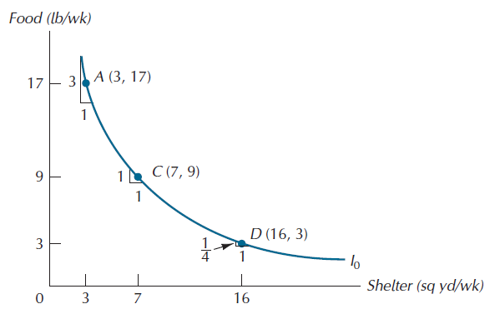
Diminishing Marginal Rate of Substitution

Slide 53
Marginal Rate of Substitution
Indifference curves are convex
As more of one good is consumed, a consumer would prefer to give up fewer units of a second good to get additional units of the first one
Consumers generally prefer a balanced market basket
Notes:
34

Slide 54
Marginal Rate of Substitution
The MRS decreases as we move down the indifference curve
Along an indifference curve there is a diminishing marginal rate of substitution.
The MRS went from 6 to 4 to 1
Notes:
33

Slide 55
Marginal Rate of Substitution
Indifference curves with different shapes imply a different willingness to substitute
Two polar cases are of interest
Perfect substitutes
Perfect complements

Slide 56
Marginal Rate of Substitution
Perfect Substitutes
Two goods are perfect substitutes when the marginal rate of substitution of one good for the other is constant
Example: a person might consider apple juice and orange juice perfect substitutes
They would always trade 1 glass of OJ for 1 glass of Apple Juice
Notes:
35

Slide 57
Consumer Preferences
Apple
Juice
(glasses)
4
Perfect
Substitutes
3
2
1
Orange Juice
(glasses)
0
1
2
3
4
Notes:
38

Slide 58
Consumer Preferences
Perfect Complements
Two goods are perfect complements when the indifference curves for the goods are shaped as right angles
Example: If you have 1 left shoe and 1 right shoe, you are indifferent between having more left shoes only
Must have one right for one left
Notes:
36

Slide 59
Consumer Preferences
Left
Shoes
Perfect
Complements
4
3
2
1
0
1
2
3
4
Right Shoes
Notes:
40

Slide 60
Perfect complements
Example: Left shoes, right shoes
{7 left shoes, 5 right shoes}
is just as good as
{5 left shoes, 5 right shoes}
Notes:
60

Slide 61
Consumer Preferences
We have assumed all our commodities are “goods”
There are commodities we don’t want more of - bads
Things for which less is preferred to more
Example
Air pollution

Slide 62
The Best Feasible Bundle
Consumer’s Goal: to choose the best affordable bundle.
The same as reaching the highest indifference curve she can, given her budget constraint.
For convex indifference curves..
the best bundle will always lie at the point of tangency.

Slide 63
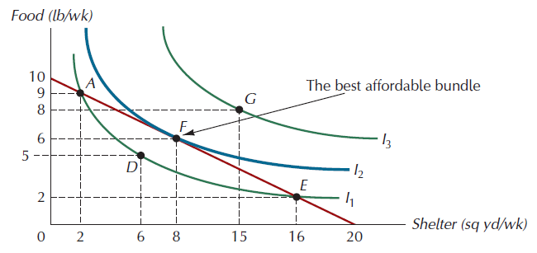
Figure 3.15: The Best Affordable Bundle

Slide 64
Utility
Recall that under the completeness and transitivity assumptions, the ranking principle is true:
the consumer can rank all bundles according to her preference
Therefore, the consumer can assign a number to each bundle such that the numbers assigned to the bundles represent the consumer’s preferences
The number assigned to a bundle is called its utility

Slide 65
Utility functions
If the utility numbers assigned by a consumer to the various consumption bundles can be represented by a mathematical formula, that formula is called a utility function
Example:
Consider two goods, food and clothing and let the quantities consumed be F and C.
Then, the formula U(F,C) = F × C can be used to assign a number to any bundle. (For example, if F = 11 and C = 3, then U = 33.)
And if the assigned numbers agree with the consumer’s preference ranking, then the formula is a utility function.

Slide 66
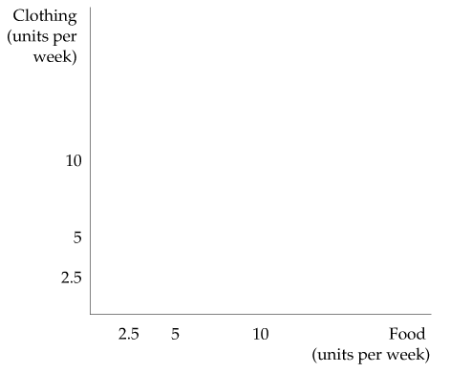
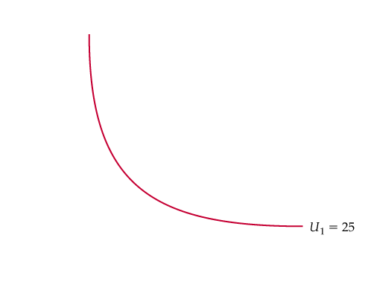
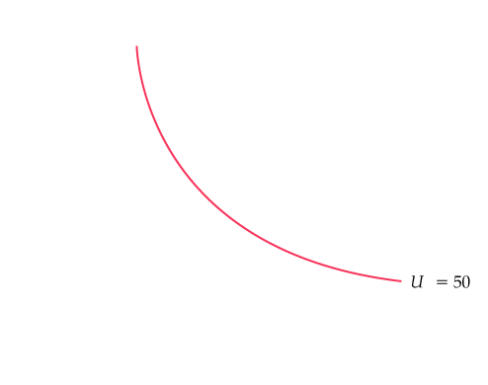
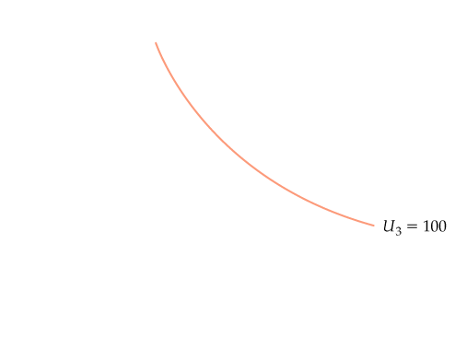
CONSUMER PREFERENCES
Utility and Utility Functions
● utility Numerical score representing the satisfaction that a consumer gets from a given market basket.
● utility function Formula that assigns a level of utility to individual market baskets.
Utility Functions and Indifference Curves
A utility function can be represented by a set of indifference curves, each with a numerical indicator.
This figure shows three indifference curves (with utility levels of 25, 50, and 100, respectively) associated with the utility function:
u(F,C) = FC

Slide 67
Indifference Curves for the Utility Function U = F × S

Slide 68
Marginal Utility
Marginal utility is the increase in a consumer’s utility resulting from the addition of a very small amount of some good, per unit of the good
4-68

Slide 69
MU and MRS
Consider changes in consumption, ΔX and ΔY, that leave utility unchanged
A small change in X, ΔX, causes utility to change by MU_{X}ΔX
Small change in Y, ΔY, causes utility to change by MU_{Y}ΔY
If we stay on same indifference curve, then MU_{X}ΔX + MU_{Y}ΔY = 0. Therefore,
4-69

Slide 70
Utility and Marginal Utility
(a) Utility
, Utils
350
Utility function,
U
(10,
Z
)
As Lisa consumes more pizza, holding her consumption of burritos constant at 10, her total utility, U, increases…
and her marginal utility of pizza, MU_{Z}, decreases (though it remains positive).
Marginal utility is the slope of the utility function as we hold the quantity of the other good constant.
U
250
ΔU = 20
230
ΔZ = 1
0
1
2
3
4
5
6
7
8
9
10
(b) Marginal Utility
Z
, Pizzas per semester
130
, Marginal utility of pizza
Z
MU
20
MU
Z
0
1
2
3
4
5
6
7
8
9
10
Z
, Pizzas per semester

Slide 71
Consumer Choice
Assumptions:
Consumers only choose non-negative quantities
"Rational” choice: The consumer chooses the basket that maximizes his satisfaction given the constraint that his budget imposes.
Consumer’s Problem:
Max U(X,Y) subject to: P_{X} . X + P_{Y} . Y ≤ I
X,Y

Slide 72
Consumer Choice
There are two types of equilibrium:
Interior Solution:
Consumer chooses a positive quantity of both goods
Corner Solution:
Consumer chooses not to consume one of the goods.

Slide 73
Interior Solution
Graphical interpretation:
The optimal consumption basket is at a point where the indifference curve is just tangent to the budget line.
=> MRS_{X,Y} = P_{X}
P_{Y}

Slide 74
Interior Solution
Economic interpretation:
The rate at which the consumer would be willing to exchange X for Y has to be the same as the rate at which they are exchanged in the marketplace
=> MRS_{X,Y} = P_{X}
P_{Y}

Slide 75
Interior Solution
Y
BL
0
X

Slide 76
Interior Solution
Y
IC₁
BL
0
X

Slide 77
Interior Solution
Y
IC₃
IC₁
BL
0
X

Slide 78
Interior Solution
Y
Optimal choice (interior solution) at point A
•
A
IC₃
IC₂
IC₁
BL
0
X

Slide 79
Interior Solution
To find algebraically the quantities of X and Y in the optimal basket, we have to solve a system of two equations for two unknowns:
1. MRS_{X,Y} = P_{X}
P_{Y}
2. P_{X} . X + P_{Y} . Y = I

Slide 80
Example:
Suppose U(X,Y) = XY
I = € 1000
P_{X} = € 50
P_{Y} = € 100
Which is the optimal choice for the consumer?

Slide 81
MRS_{X,Y} = MU_{X} = Y
MU_{Y} X
P_{X} = 50 = 1
P_{Y} 100 2
So X = 2Y

Slide 82
Budget line: P_{X} . X + P_{Y} . Y = I
=> 50 X + 100 Y = 1000
Then: 50 (2Y) + 100 Y = 1000
200 Y = 1000
=> Y* = 5
=> X* = 10

Slide 83
Example: Interior Consumer Optimum
Y
50X + 100Y = 1000
•
5
U* = XY = 50
0
X
10

Slide 84
Interior Solution
The tangency condition can also be written as:
MU_{X} = MU_{Y}
P_{X} P_{Y}
Interpretation: At the optimal basket, the marginal utility per euro spent on each commodity is the same.
“Each good gives equal bang for the buck”
Marginal reasoning to maximize

Slide 85
Example
Vincent “fingers” McGiny enjoys two things: skittles (s) and bubble gum (b). His MU_{s}=2b and MU_{b}=3s. A pack of skittles costs $2 while bubble gum costs $1.
If Fingers has $20, what should he to do maximize his utility?

Slide 86
Optimization Steps
P_{s}S+P_{b}B=I
2S+B=20
2) MU_{s}/MU_{b}=P_{s}/P_{b}
2B/3S=2/1
2B=6S
B=3S

Slide 87
Optimization Steps
2S+B=20
2S+3S=20
5S=20
S=4
B=3S
B=3(4)=12

Slide 88
Optimization Steps
4) Fingers buys 12 bubble gum and 4 packs of skittles in order to maximize his utility.
Optional Budget Check:
2S+B=20
2(4)+12=20
20=20

Slide 89
Corner Solution
Definition: A corner solution occurs when the optimal bundle contains none of one of the goods.
The tangency condition may not hold at a corner solution.

Slide 90
Corner Solution
How do you know whether the optimal bundle is interior or at a corner?
Graph the indifference curves
Check to see whether tangency condition ever holds at positive quantities of X and Y

Slide 91
Example: Perfect Substitutes
Suppose U(X,Y) = X + Y
I = € 1000
P_{X} = € 50
P_{Y} = € 100
Which is the optimal choice for the consumer?

Slide 92
MRS_{X,Y} = MU_{X} = 1
MU_{Y}
P_{X} = 50 = 1
P_{Y} 100 2
So the tangency condition is not satisfied

Slide 93
Example: Corner Solution – Perfect Substitutes
Y
BL: 50X + 100Y = 1000
10
0
X
20

Slide 94
Example: Corner Solution – Perfect Substitutes
Y
BL
U = X+Y
10
0
X
20

Slide 95
Example: Corner Solution – Perfect Substitutes
Y
10
0
X
20

Slide 96
Example: Corner Solution – Perfect Substitutes
Y
10
•
A
0
X
20

Slide 97
Suppose now: U(X,Y) = X + Y
I = € 1000
P_{X} = € 100
P_{Y} = € 50
Which is the optimal choice for the consumer?

Slide 98
Example: Corner Solution – Perfect Substitutes
Y
BL: 100X + 50Y = 1000
20
0
X
10

Slide 99
Example: Corner Solution – Perfect Substitutes
Y
BL
B
20
•
0
X
10

Slide 100
Example
Two goods available: Cats and Dogs:
I = $200
P_{c} = $100
P_{d} = $50
Utility is such that:
MU_{c}=d
MU_{d}=5+c

Slide 101
Optimization Steps
P_{c}c+P_{d}d=I
100c+50d=200
2) MU_{c}/MU_{d}=P_{c}/P_{d}
d/(5+c)=100/50
50d=500+100c
d=10+2c

Slide 102
Optimization Steps
100c+50d=200
100c+50(10+2c)=200
200c=-300
c=-3/2, therefore c=0
100(0)+50d=200
d=4

Slide 103
Optimization Steps
4) Buying 4 dogs and no cats will maximize your utility:
Optional Budget Check:
100c+50d=200
100(0)+50(4)=200
200=200

Slide 104
Perfect Complements
In the case of perfect complements, utility is maximized when goods are consumed in a set ratio, which simplifies our calculations:
Example: Let U(X,Y) = min(X,Y). Let I = $1000, Px = $50 and PY = $200. What is the optimal consumption basket?
We know that to maximize utility x=y therefore:
50x+200y=1000
50x+200x=1000
4=x=y

Slide 105
U= min(X,Y).
U= min(4,4) =4
Utility is maximized at 4 when x and y are equal to 4.
Budget line: Y = $5 - X/4

Slide 106
Minimizing Expenditure
Thus far, we have considered utility maximization:
-Given one’s budget constraint, maximize utility (ie: buying the best lunch affordable)
Sometimes one wishes to achieve a level of utility for the least cost possible – cost minimization
-Given one’s required utility, what is the least one can spend? (ie: buying the cheapest lunch that will fill you up)

Slide 107
Duality
The mirror image of the original (primal) utility optimization problem is called the expenditure minimization problem.
Min P_{x}X + P_{y}Y
(X,Y) subject to: U(X,Y) = U*
where: U* is a target level of utility.

Slide 108
Minimization Steps
1) Calculate the point of tangency (as per maximization)
2) Use the point of tangency and the UTILITY constraint to solve for the minimizing x and y
3) Calculate expenditure and conclude.

Slide 109
Minimization Example
Vincent “Hawaii” McGiny is a cheap mobster who enjoys the ham and pinapples on his Hawaiian pizzas. Every dinner he aims to achieve a utility of 18 by eating a slice of pizza which gives him utility of U=ham*pineapple. (MU_{h}=p, MU_{p}=h)
If a slice of ham costs 10 cents and a piece of pineapple costs 20 cents, minimize Hawaii's expenditure

Slide 110
Minimization Steps
1) MU_{h}/MU_{p}=P_{h}/P_{p}
p/h=10/20
20p=10h
2p=h

Slide 111
Minimization Steps
2) U=hp
18=2p(p)
9=p²
3=p
U=hp
18=h3
6=h

Slide 112
Minimization Steps
3) I=P_{h}h+P_{p}P
I=0.1(6)+0.2(3)
I=1.20
Hawaii’s minimum expenditure for a slice of pizza is $1.20 if he wants a utility of 18.
Optional Check: U=ph
18=3(6)
18=18

Slide 113
Optimization Comparison
Utility Maximization
Expend. Minimization
Given prices and utility formulas
Given prices and utility formulas
Given EXPENDITURE
Given UTILITY
Solve tangency condition
Solve tangency condition
Substitute into budget constraint
Substitute into utility formula
Solve for UTILITY
Solve for EXPENDITURE

