Slide 1
Chapter 4
Individual and Market Demand

Slide 2
The Effect of Changes in Price
Price-consumption curve (PCC): for a good X is the set of optimal bundles traced on an indifference map as the price of X varies (holding income and the price of Y constant).
The price consumption curve is the curve that results from connecting tangents of indifference curves and budget lines (optimal bundles) when income and the price of good y are fixed, and the price of x changes.

Slide 3
Effect of a Price Change
Clothing
(units per
month)
Assume:
I = $20
P_{C} = $2
P_{F} = $2, $1, $.50
10
6
A
5
U₁
D
B
Three separate
indifference curves
are tangent to
each budget line.
4
U₃
U₂
Food (units
per month)
4
12
20
Notes:
4

Slide 4
Effect of a Price Change
Clothing
(units per
month)
The price-consumption
curve traces out the
utility maximizing
market basket for the
various prices for food.
6
A
Price-Consumption Curve
5
U₁
D
B
4
U₃
U₂
Food (units
per month)
4
12
20
Notes:
4

Slide 5
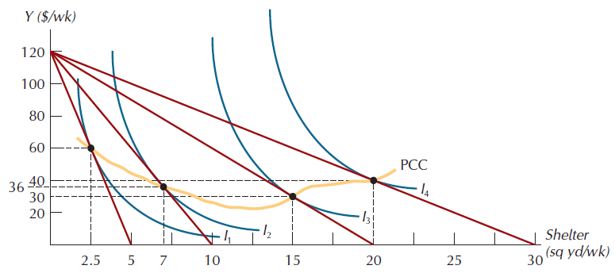
The Price-Consumption Curve

Slide 6
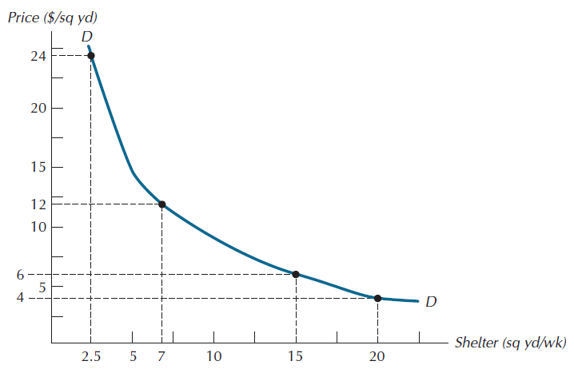
An Individual Consumer’s Demand Curve

Slide 7
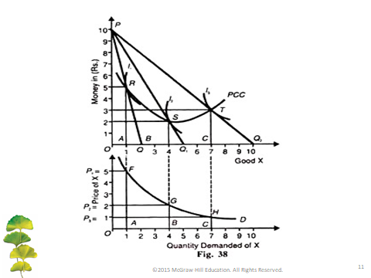
The derivation of demand curve from the PCC
Assumptions:
The money to be spent by consumer is given and constant.
The price of good X falls.
Prices of other related goods do not change.
Consumer’s tastes and preferences remain constant.

Slide 8
Deriving the Demand Curve
Algebraically, we can derive an individual’s demand using the following equations:
P_{x}x + P_{y}y = I (budget constraint) (1)
MU_{x}/P_{x} = MU_{y}/P_{y} (tangency point) (2)
1) Solve (2) for y
2) Substitute y from (2) into (1)
3) Solve for x

Slide 9
General Example:
Suppose that U(x,y) = xy. MU_{x} = y and MU_{y} = x. The prices of x and y are P_{x} and P_{y}, respectively and income = I.
x/P_{y} = y/P_{x}
y = xP_{x}/P_{y}
2) P_{x}x + P_{y}(P_{x}/P_{y})x = I
P_{x}x + P_{x}x = I
3) x= I/2Px

Slide 10
Specific Demand Example
Let U=xy, therefore MU_{x}=y and MU_{y}=x
Let income=12, P_{y}=1.
Graph demand as P_{x} increases from $1 to $2 to $3.
Step 1: P_{x}x+P_{y}y=I
P_{x}x+y=12
Step 2: MU_{x}/MU_{y}=P_{x}/P_{y}
y/x=P_{x}
y=P_{x}x

Slide 11
Demand Example
Step 1: P_{x}x+y=12
Step 2: y=P_{x}x
Step 3: P_{x}x+P_{x}x=12
x=6/P_{x}
X(1)=6
X(2)=3
X(3)=2

Slide 12
P_{X}
Demand Example
Maximizing at each point, we arrive at the following demand curve:
•
P_{X} = 3
•
P_{X} = 2
U increasing
•
P_{X} = 1
X
2 3 6

Slide 13
The Effects of Changes in Income
Income-consumption curve (ICC): for a good X is the set of optimal bundles traced on an indifference map as income varies (holding the prices of X and Y constant).
Definition: The income-consumption curve of good X is the set of optimal baskets for every possible income level. Assumes all other variables remain constant.

Slide 14
Y (units)
Income-Consumption Curve
I=40
U₁
0
10
X (units)

Slide 15
Y (units)
Income-Consumption Curve
I=68
I=40
U₁
U₂
0
10 18
X (units)

Slide 16
Y (units)
Income-Consumption Curve
I=92
I=68
I=40
U₃
U₁
U₂
0
10 18 24
X (units)

Slide 17
Y (units)
Income-Consumption Curve
I=92
Income consumption curve
I=68
I=40
U₃
U₁
U₂
0
10 18 24
X (units)

Slide 18
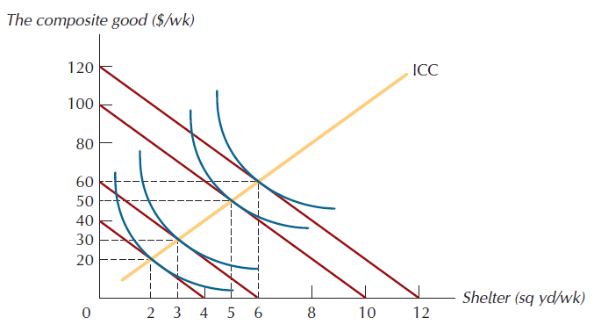
An Income-Consumption Curve

Slide 19
Individual Demand when Income Changes
Note:
The points on the income-consumption curve can be graphed as points on a shifting demand curve.

Slide 20
Y (units)
Income-Consumption Curve
Income consumption curve
I=40
U₁
0
X (units)
10
P_{X}
$2
I=40
10
X (units)

Slide 21
Y (units)
Income-Consumption Curve
I=68
Income consumption curve
I=40
U₂
U₁
0
X (units)
10 18
P_{X}
$2
I=40
I=68
10 18
X (units)

Slide 22
Y (units)
Income-Consumption Curve
I=92
I=68
U₃
Income consumption curve
I=40
U₂
U₁
0
X (units)
10 18 24
P_{X}
$2
I=68
I=92
I=40
10 18 24
X (units)

Slide 23
The Engel Curve
The income-consumption curve for good X can also be written as the quantity consumed of good X for any income level.
This is the individual’s Engel curve for good X.

Slide 24
I (€)
The Engel Curve
40
0
X (units)
10

Slide 25
I (€)
The Engel Curve
68
40
0
X (units)
10 18

Slide 26
I (€)
The Engel Curve
92
68
40
0
X (units)
10 18 24

Slide 27
I (€)
The Engel Curve
Engel Curve
92
68
40
0
X (units)
10 18 24

Slide 28
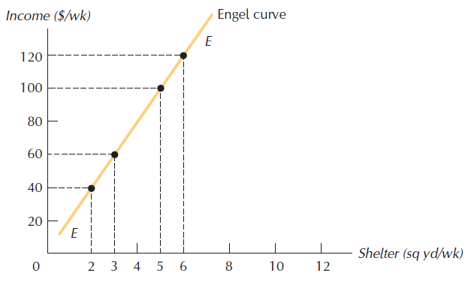
An Individual Consumer’s Engel Curve

Slide 29
The Engel Curve
Note:
When the slope of the income-consumption curve is positive, then the slope of the Engel curve is also positive.

Slide 30
The Effects of Changes in Income
Normal good: one whose quantity demanded rises as income rises. If the income consumption curve shows that the consumer purchases more of good X as her income rises, good X is a normal good. Equivalently, if the slope of the Engel curve is positive, the good is a normal good.
Inferior good: one whose quantity demanded falls as income rises. If the income consumption curve shows that the consumer purchases less of good X as her income rises, good X is a inferior good. Equivalently, if the slope of the Engel curve is negative, the good is a inferior good.
Note: A good can be normal over some ranges of income, and inferior over others.

Slide 31
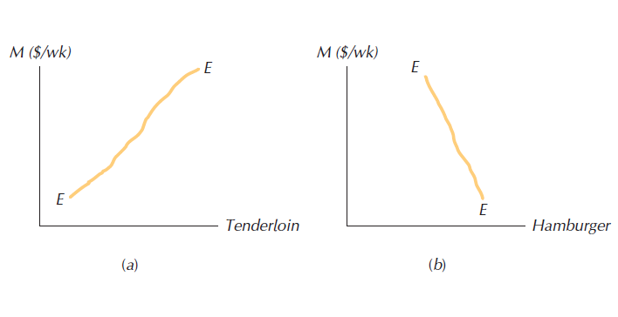
The Engel Curve for Normal and Inferior Goods

Slide 32
Y (units)
Example: Backward Bending Engel Curve
I=200
U₁
•
0
13
X (units)
I (€)
•
200
13
X (units)

Slide 33
Y (units)
Example: Backward Bending Engel Curve
I=300
I=200
U₂
U₁
•
•
0
13 18
X (units)
I (€)
•
300
•
200
13 18
X (units)

Slide 34
Y (units)
I=400
Example: Backward Bending Engel Curve
I=300
U₃
•
I=200
U₂
U₁
•
•
0
13 16 18
X (units)
I (€)
•
400
•
300
•
200
13 16 18
X (units)

Slide 35
Y (units)
I=400
Example: Backward Bending Engel Curve
I=300
U₃
•
Income consumption curve
I=200
U₂
U₁
•
•
0
13 16 18
X (units)
I (€)
•
400
•
300
Engel Curve
•
200
13 16 18
X (units)

Slide 36
Income and Substitution Effects of a Price Change
Substitution effect: that component of the total effect of a price change that results from the associated change in the relative attractiveness of other goods.
Income effect: that component of the total effect of a price change that results from the associated change in real purchasing power.
Total effect: the sum of the substitution and income effects.

Slide 37
Income Effect
Definition: When the price of good X falls, purchasing power rises. This is called the income effect of a change in price.
It assumes all else remain constant
The income effect may be:
Positive (normal good)
Negative (inferior good).

Slide 38
Substitution Effect
Definition: When the price of good X falls, good X becomes cheaper relative to good Y. This change in relative prices alone causes the consumer to adjust his consumption basket. This effect is called the substitution effect.
It assumes all else remain constant
The substitution effect is always negative

Slide 39
Income & Substitution Effects
Usually, a move along a demand curve will be composed of both effects.
Let’s analyze both effects for the cases of:
Normal good
Inferior good

Slide 40
Y
Example: Normal Good: Income and Substitution Effects
(Explain The Total Effect of a Price Decrease)
BL₁ has slope
-P_{X1}/P_{Y}
A
•
U₁
0
X_{A}
X

Slide 41
Y
Example: Normal Good: Income and Substitution Effects
A
BL₂ has slope
-P_{X2}/P_{Y}
•
C
•
U₂
U₁
0
X_{A} X_{C}
X

Slide 42
Y
Example: Normal Good: Income and Substitution Effects
A
•
C
•
BL_{d} has slope
-P_{X2}/P_{Y}
•
B
U₂
U₁
0
X_{A} X_{B} X_{C}
X

Slide 43
Y
Example: Normal Good: Income and Substitution Effects
Substitution Effect: X_{B}-X_{A}
A
•
C
•
•
B
U₂
U₁
0
X_{A} X_{B} X_{C}
X

Slide 44
Y
Example: Normal Good: Income and Substitution Effects
Substitution Effect: X_{B}-X_{A}
Income Effect: X_{C}-X_{B}
A
•
C
•
•
B
U₂
U₁
0
X_{A} X_{B} X_{C}
X

Slide 45
Y
Example: Normal Good: Income and Substitution Effects
Substitution Effect: X_{B}-X_{A}
Income Effect: X_{C}-X_{B}
Overall Effect: X_{C}-X_{A}
A
•
C
•
•
B
U₂
U₁
0
X_{A} X_{B} X_{C}
X

Slide 47
Y
Example: Inferior Good: Income and Substitution Effects
BL₁ has slope
-P_{X1}/P_{Y}
A
•
U₁
0
X_{A}
X

Slide 48
Y
Example: Inferior Good: Income and Substitution Effects
•
C
A
BL₂ has slope
-P_{X2}/P_{Y}
•
U₂
U₁
0
X_{A} X_{C}
X

Slide 49
Y
Example: Inferior Good: Income and Substitution Effects
•
C
A
•
BL_{d} has slope
-P_{X2}/P_{Y}
•
B
U₂
U₁
0
X_{A} X_{C} X_{B}
X

Slide 50
Y
Example: Inferior Good: Income and Substitution Effects
Substitution Effect: X_{B}-X_{A}
•
C
A
•
•
B
U₂
U₁
0
X_{A} X_{C} X_{B}
X

Slide 51
Y
Example: Inferior Good: Income and Substitution Effects
Substitution Effect: X_{B}-X_{A}
Income Effect: X_{C}-X_{B}
•
C
A
•
•
B
U₂
U₁
0
X_{A} X_{C} X_{B}
X

Slide 52
Y
Example: Inferior Good: Income and Substitution Effects
Substitution Effect: X_{B}-X_{A}
Income Effect: X_{C}-X_{B}
Overall Effect: X_{C}-X_{A}
•
C
A
•
•
B
U₂
U₁
0
X_{A} X_{C} X_{B}
X

Slide 54
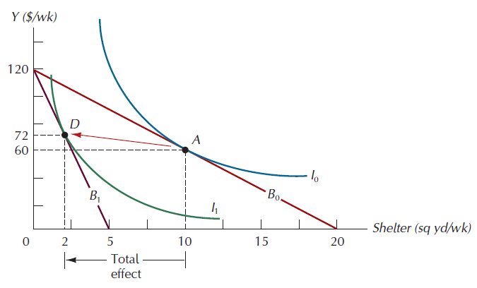
The Total Effect of a Price Increase

Slide 55
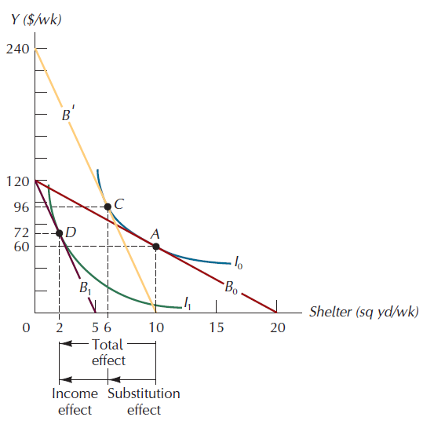
The Substitution and Income Effects of a Price Change

Slide 56
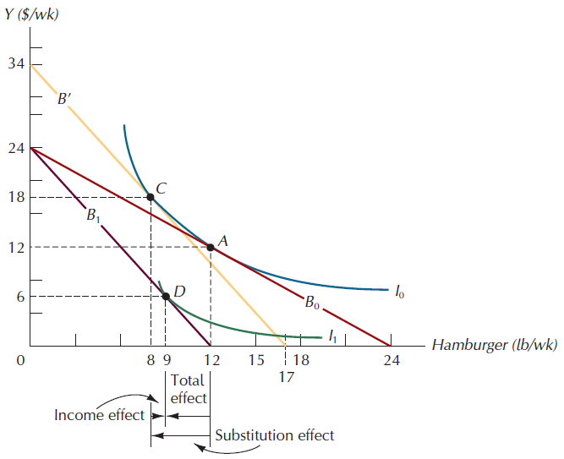
Income and Substitution Effects for an Inferior Good

Slide 57
Giffen Goods
Giffen good: one for which the quantity demanded rises as its price rises.
The Giffen good must be an inferior good
Theoretically, it is possible that, for an inferior good, the income effect dominates the substitution effect
A Giffen good is a good that is so inferior, that the net effect of a decrease in the price of that good, all else constant, is a decrease in consumption of that good.

Slide 58
Y
Example: Giffen Good: Income and Substitution Effects
BL₁ has slope
-P_{X1}/P_{Y}
A
•
U₁
0
X_{A}
X

Slide 59
Y
Example: Giffen Good: Income and Substitution Effects
•
C
U₂
A
BL₂ has slope
-P_{X2}/P_{Y}
•
U₁
0
X_{C} X_{A}
X

Slide 60
Y
Example: Giffen Good: Income and Substitution Effects
•
C
U₂
A
•
BL_{d} has slope
-P_{X2}/P_{Y}
•
B
U₁
0
X_{C} X_{A} X_{B}
X

Slide 61
Y
Example: Giffen Good: Income and Substitution Effects
Substitution Effect: X_{B}-X_{A}
Income Effect: X_{C}-X_{B}
Overall Effect: X_{C}-X_{A}
•
C
U₂
A
•
•
B
U₁
0
X_{C} X_{A} X_{B}
X

Slide 62
Giffen Good
Notes:
For Giffen goods, demand does not slope down.
For the income effect to be large enough to offset the substitution effect, the good would have to represent a very large proportion of the budget.

Slide 63
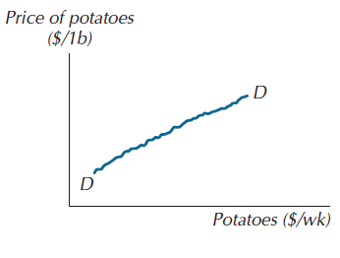
The Demand Curve for a Giffen Good

Slide 64
Example: Finding Income and Substitution Effects
Suppose a Quasilinear Utility:
U(X,Y) = 2X^{0.5} + Y
=> MU_{X} = 1/X^{0.5} MU_{Y} = 1
P_{Y} = € 1
I = € 10

Slide 65
Suppose P_{X} = € 0.50
Tangency condition:
MU_{X} = P_{X} ➔ _1_ = 0.5 ➔ X_{A} = 4
MU_{Y} P_{Y} X^{0.5}
Budget constraint:
P_{X} . X + P_{Y} . Y = I ➔ Y_{A} = 8
Utility level:
U* = 2 (4)^{0.5} + 8 = 12

Slide 66
Suppose P_{X} = € 0.20
Tangency condition:
MU_{X} = P_{X} ➔ _1_ = 0.2 ➔ X_{C} = 25
MU_{Y} P_{Y} X^{0.5}
Budget constraint:
P_{X} . X + P_{Y} . Y = I ➔ Y_{C} = 5
Utility level:
U* = 2 (25)^{0.5} + 5 = 15

Slide 67
3. What are the substitution and income effects that result from the decline in P_{X}?
Find the basket B that gives a utility level of U = 12 at prices P_{X} = € 0.20 and P_{Y} = € 1

Slide 68
Y
Substitution Effect: X_{B}-X_{A}
Income Effect: X_{C}-X_{B}
Overall Effect: X_{C}-X_{A}
A
•
C
•
•
B
U₂=15
U₁=12
0
X_{A}=4 X_{B} X_{C}=25
X

Slide 69
Tangency condition:
MU_{X} = P_{X} ➔ _1_ = 0.2 ➔ X_{B} = 25
MU_{Y} P_{Y} X^{0.5}
Utility constraint:
U* = 2 (25)^{0.5} + Y = 12 ➔ Y_{B} = 2
Then:
Substitution Effect: X_{B} - X_{A} = 25 - 4 = 21
Income Effect: X_{C} - X_{B} = 25 - 25 = 0

Slide 70
Market Demand Curves
Market demand curve: the horizontal summation of the individual demand curves. In other words, the market demand is obtained by adding the quantities demanded by the individuals at each price and plotting this total quantity for all possible prices.
.

Slide 71
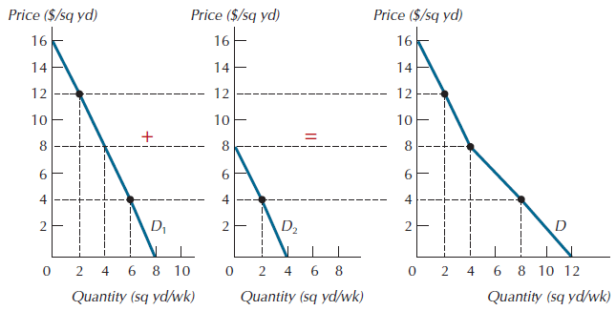
Generating Market Demand from Individual Demands

Slide 72
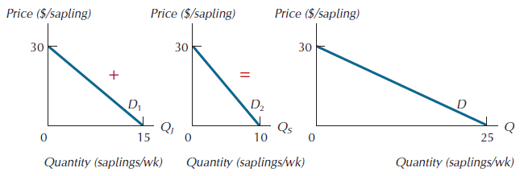
The Market Demand Curve for Beech Saplings

Slide 73
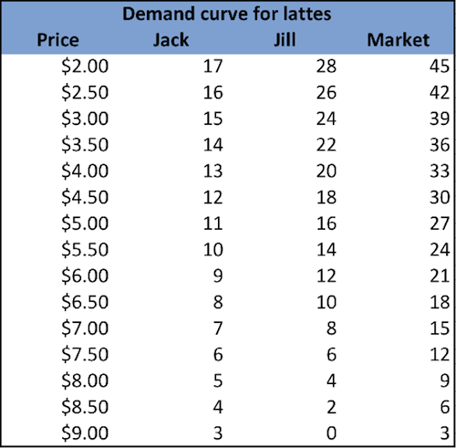

Slide 74
From Individual to Market Demand: Determining the Market Demand Curve
Price Individual A Individual B Individual C Market
($) (units) (units) (units) (units)
1 6 10 16 32
2 4 8 13 25
3 2 6 10 18
4 0 4 7 11
5 0 2 4 6

Slide 75
Summing to Obtain a Market Demand Curve
Price
5
The market demand
curve is obtained by
summing the consumer’s
demand curves
4
3
Market Demand
2
1
D_{A}
D_{B}
D_{C}
0
5
10
15
20
25
30
Quantity

Slide 76
Elasticity measures
What are they?
Responsiveness measures
Why introduce them?
Demand and supply responsiveness clearly matters for lots of market analyses.
Why not just look at slope?
Want to compare across markets: inter market
Want to compare within markets: intra market
slope can be misleading
want a unit free measure

Slide 77
Why Economists Use Elasticity
An elasticity is a unit-free measure.
By comparing markets using elasticities it does not matter how we measure the price or the quantity in the two markets.
Elasticities allow economists to quantify the differences among markets without standardizing the units of measurement.

Slide 78
What is an Elasticity?
Measurement of the percentage change in one variable that results from a 1% change in another variable.
Can come up with many elasticities.
We will introduce four.
three from the demand function
one from the supply function
Notes:
Follows your lecture 5 discussion.

Slide 79
Price Elasticity of Demand
Price elasticity of demand: how sensitive is the quantity demanded to a change in the price of the good.
Price elasticity of demand measures the percentage change in the quantity demanded resulting from a 1% change in price.

Slide 81
Examples:
When the price of gasoline rises by 1% the quantity demanded falls by 0.2%, so gasoline demand is not very price sensitive.
Price elasticity of demand is -0.2 .
When the price of gold earring rises by 1% the quantity demanded falls by 2.6%, so earring demand is very price sensitive.
Price elasticity of demand is -2.6 .
Notes:
Some examples.

Slide 82
The Elasticity of Demand
Price elasticity of demand
Elastic demand
Quantity demanded responds substantially to changes in the price
Inelastic demand
Quantity demanded responds only slightly to changes in the price

Slide 83
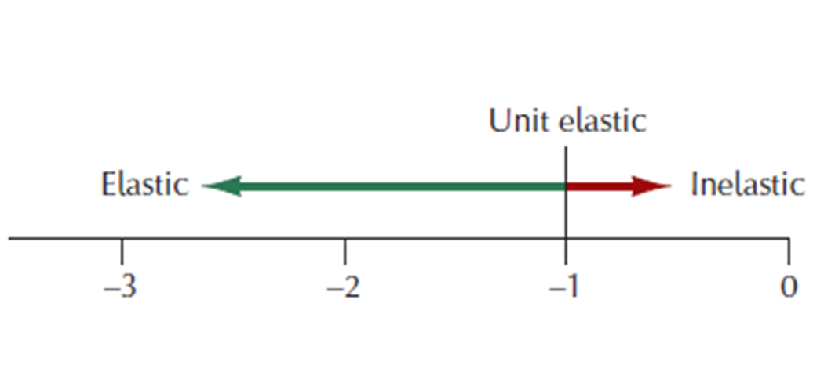
Three Categories of Price Elasticity
Elastic → € < -1
Inelastic → € > -1
Unit elastic → € = 1

Slide 84
The price elasticity of demand is always negative. Economists usually refer to the price elasticity of demand by its absolute value (ignore the negative sign).
Unit elastic
Inelastic
Elastic
0
1
2
3
4
5
6
Unit elastic: price elasticity equal to 1
Inelastic: price elasticity less than 1
Elastic: price elasticity greater than 1

Slide 85
Arc Formula for Elasticity - General
Although the exact formula for calculating an elasticity is useful for theory, in practice economists usually calculate an approximation called the arc elasticity.
You are really approximating the elasticity between two points.
Need two points to perform the calculation.
Notes:
I need to teach them this formula. Sorry.

Slide 86
Arc Formula for Price Elasticity of Demand
Get two points of the demand curve: Points A and B.
Consider P^{A} and X^{A} and P^{B} and X^{B} from the demand relationship.
Note: we’ll take absolute value
Notes:
I need to teach them this formula. Sorry.

Slide 87
OR
Two points: (Q1, P1) and (Q2, P2)

Slide 88
Point Formula for Price Elasticity of Demand
The exact formula for calculating an elasticity at the point A on the demand curve.
Note: we’ll take absolute value
Notes:
I need to teach them this formula. Sorry.

Slide 89
The Elasticity of Demand
Determinants of price elasticity of demand
Budget share: the larger the share → more elastic
Availability of close substitutes (Substitution possibilities):
Goods with close substitutes
More elastic demand
Necessities vs. luxuries (Direction of income effect)
Necessities – inelastic demand
Luxuries – elastic demand
a normal good will have a higher price elasticity than an inferior good.
Definition of the market
Narrowly defined markets – more elastic demand
Time horizon
More elastic over longer time horizons

Slide 90
Some Technical Definitions For Extreme Elasticity Values
Economists use the terms “perfectly elastic” and “perfectly inelastic” to describe extreme values of price elasticities.
Perfectly elastic means the quantity demanded is as price sensitive as possible.
Perfectly inelastic means that the quantity demanded has no price sensitivity at all.

Slide 91
Perfectly Elastic Demand
We say that demand is perfectly elastic when a 1% change in the price would result in an infinite change in quantity demanded.
Price
Perfectly Elastic Demand (elasticity = ∞)
Quantity
Notes:
Your discussion from your lecture 6

Slide 92
Perfectly Inelastic Demand
We say that demand is perfectly inelastic when a 1% change in the price would result in no change in quantity demanded.
Price
Perfectly Inelastic Demand (elasticity = 0)
Quantity
Notes:
ditto.

Slide 93
The price elasticity of demand (a, b)
Perfectly inelastic demand:
Elasticity = 0
(b) Inelastic demand:
Elasticity < 1
Price
Price
1. an
Demand
1. an
Demand
An
increase
in price…
A 22%
increase
in price…
2. … leads to
an 11% decrease
in quantity
demanded
$5
$5
4
4
2. …leaves
the quantity
demanded
unchanged
0
100
0
90
100
Quantity
Quantity
The price elasticity of demand determines whether the demand curve is steep or flat.
Note that all percentage changes are calculated using the midpoint method.

Slide 94
The price elasticity of demand (c)
(c) Unit elastic demand:
Elasticity = 1
Price
Demand
1. an
$5
A 22%
increase
in price…
4
2. … leads to
A 22% decrease
in quantity
demanded
0
80
100
Quantity
The price elasticity of demand determines whether the demand curve is steep or flat.
Note that all percentage changes are calculated using the midpoint method.

Slide 95
The price elasticity of demand (d, e)
(d) Elastic demand:
Elasticity > 1
(e) Perfectly elastic demand:
Elasticity equals infinity
Price
Price
1. an
A 22%
increase
in price…
1. an
1. At any price
above $4, quantity
demanded is zero
2. At exactly $4,
consumers will
buy any quantity
$5
4
Demand
$4
Demand
2. … leads to
a 67% decrease
in quantity
demanded
3. At any price
below $4, quantity
demanded is infinite
0
50
100
0
Quantity
Quantity
The price elasticity of demand determines whether the demand curve is steep or flat.
Note that all percentage changes are calculated using the midpoint method.

Slide 96
Using Demand Elasticity: Total Expenditures
Do the total expenditures on a product go up or down when the price increases?
The price increase means more spent for each unit.
But, quantity demanded declines as price rises.
So, we must measure the measure the price elasticity of demand to answer the question.
Notes:
Set-up slide

Slide 97
The Elasticity of Demand
Total revenue
Amount paid by buyers
Received by sellers of a good
Computed as: price of the good times the quantity sold (P ˣ Q)

Slide 98
Total revenue
Price
1. an
$4
P ˣ Q=$400
(revenue)
Demand
P
0
100
Quantity
Q
The total amount paid by buyers, and received as revenue by sellers, equals the area of the box under the demand curve, P × Q. Here, at a price of $4, the quantity demanded is 100, and total revenue is $400.

Slide 99
The Elasticity of Demand
Total revenue and price elasticity of demand
Inelastic demand
Increase in price
Increase in total revenue
Elastic demand
Increase in price
Decrease in total revenue

Slide 100
How total revenue changes when price changes (a)
(a) The Case of Inelastic Demand
Price
Price
1. an
1. an
$3
Revenue=$240
$1
Demand
Demand
Revenue=$100
0
100
Quantity
0
80
Quantity
The impact of a price change on total revenue (the product of price and quantity) depends on the elasticity of demand. In panel (a), the demand curve is inelastic. In this case, an increase in the price leads to a decrease in quantity demanded that is proportionately smaller, so total revenue increases. Here an increase in the price from $1 to $3 causes the quantity demanded to fall from 100 to 80. Total revenue rises from $100 to $240

Slide 101
How total revenue changes when price changes (b)
(b) The Case of Elastic Demand
Price
Price
1. an
1. an
$5
$4
Revenue
=$200
Revenue=$100
Demand
Demand
0
50
Quantity
0
20
Quantity
The impact of a price change on total revenue (the product of price and quantity) depends on the elasticity of demand. In panel (b), the demand curve is elastic. In this case, an increase in the price leads to a decrease in quantity demanded that is proportionately larger, so total revenue decreases. Here an increase in the price from $4 to $5 causes the quantity demanded to fall from 50 to 20. Total revenue falls from $200 to $100.
.

Slide 102
The Elasticity of Demand
When demand is inelastic
Price and total revenue move in the same direction
When demand is elastic
Price and total revenue move in opposite directions
If demand is unit elastic
Total revenue remains constant when the price changes

Slide 103
Total revenue, price changes and the price elasticity of demand
©McGraw-Hill Education, 2014

Slide 104
The Elasticity of Demand
Elasticity and total revenue along a linear demand curve
Linear demand curve
Constant slope
Different elasticities
Points with low price & high quantity
Inelastic
Points with high price & low quantity
Elastic

Slide 105
Elasticity of a linear demand curve (graph)
Price
1. an
$7
Elasticity
is larger
than 1
6
5
4
Elasticity
is smaller
than 1
3
2
Demand
1
0
2
4
6
8
10
12
14
Quantity
The slope of a linear demand curve is constant, but its elasticity is not. The demand schedule in the table was used to calculate the price elasticity of demand by the midpoint method. At points with a low price and high quantity, the demand curve is inelastic. At points with a high price and low quantity, the demand curve is elastic.

Slide 106
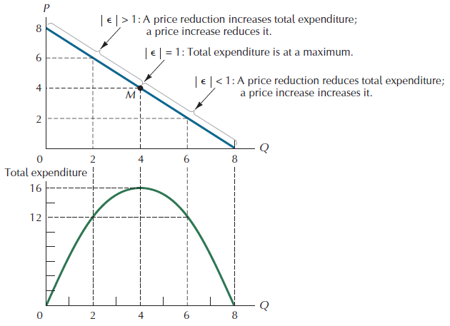
Demand and Total Expenditure

Slide 107
The Elasticity of Demand
Income elasticity of demand
Measure of how much the quantity demanded of a good responds
To a change in consumers’ income
Percentage change in quantity demanded
Divided by the percentage change in income
Normal goods: positive income elasticity
Necessities: smaller income elasticities
Luxuries: large income elasticities
Inferior goods: negative income elasticities

Slide 108
The income elasticity of demand
The income elasticity of demand measures
the sensitivity of quantity demanded to a
change in income and can be defined as:
% change in quantity demanded of a good
% change in consumer income
The income elasticity may be positive or negative.
Notes:
108

Slide 109
Normal and inferior goods
A normal good has a positive income elasticity of demand
an increase in income leads to an increase in the quantity demanded, e.g. dairy produce
An inferior good has a negative income elasticity of demand
an increase in income leads to a fall in quantity demanded, e.g. coal
A luxury good has an income elasticity of demand greater than 1 , e.g. wine
Notes:
109

Slide 111
Characteristics:
Ey > 1, Qd and income are directly related. This is a normal good and it is income elastic.
0< Ey<1, Qd and income are directly related. This is a normal good and it is income inelastic.
Ey < 0, Qd and income are inversely related. This is an inferior good.
Ey approaches 0, Qd stays the same as income changes, indicating a necessity.
Example:
If income increased by 10%, the quantity demanded of a product increases by 5 %. Then the coefficient for the income elasticity of demand for this product is::
Ey = percentage change in Qx / percentage change in Y = (5%) / (10%) = 0.5 > 0, indicating this is a normal good and it is income inelastic.

Slide 112
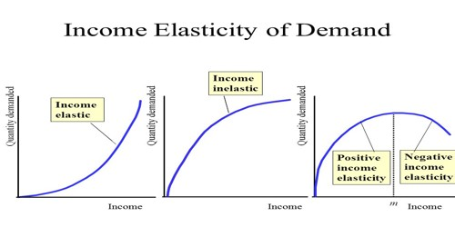

Slide 113
The Elasticity of Demand
Cross-price elasticity of demand
Measure of how much the quantity demanded of one good responds
To a change in the price of another good
Percentage change in quantity demanded of the first good
Divided by the percentage change in price of the second good
Substitutes: Positive cross-price elasticity
Complements: Negative cross-price elasticity

Slide 114
The cross price elasticity of demand
The cross price elasticity of demand for good i
with respect to the price of good j is:
% change in quantity demanded of good i
% change in the price of good j
This may be positive or negative
The cross price elasticity tends to be positive
if two goods are substitutes: e.g. tea and coffee
The cross price elasticity tends to be negative
if two goods are complements e.g. tea and milk.
©McGraw-Hill Companies, 2010
Notes:
114

Slide 116
Examples:
1. If the price of Product A increased by 10%, the quantity demanded of B increases by 15 %. Then the coefficient for the cross elasticity of the A and B is :
Exy = percentage change in Qx / percentage change in Py =
(15%) / (10%) = 1.5 > 0, indicating A and B are substitutes.
2. If the price of Product A increased by 10%, the quantity demanded of B decreases by 15 %. Then the coefficient for the cross elasticity of the A and B is :
Exy = percentage change in Qx / percentage change in Py =
(- 15%) / (10%) = - 1.5 < 0, indicating A and B are complements.

Slide 117
The Elasticity of Supply
Price elasticity of supply
Measure of how much the quantity supplied of a good responds
To a change in the price of that good
Percentage change in quantity supplied
Divided by the percentage change in price
Depends on the flexibility of sellers to change the amount of the good they produce

Slide 118
The Elasticity of Supply
Price elasticity of supply
Elastic supply
Quantity supplied responds substantially to changes in the price
Inelastic supply
Quantity supplied responds only slightly to changes in the price
Determinant of price elasticity of supply
Time period
Supply is more elastic in long run

Slide 119
The Elasticity of Supply
Computing price elasticity of supply
Percentage change in quantity supplied
Divided by percentage change in price
Variety of supply curves
Supply is perfectly inelastic
Elasticity =0
Supply curve – vertical
Supply is perfectly elastic
Elasticity = infinity
Supply curve – horizontal

Slide 120
The Elasticity of Supply
Variety of supply curves
Unit elastic supply
Elasticity =1
Elastic supply
Elasticity >1
Inelastic supply
Elasticity < 1

Slide 121
The price elasticity of supply (a, b)
Perfectly inelastic supply:
Elasticity = 0
(b) Inelastic supply:
Elasticity < 1
Price
Price
1. an
Supply
1. an
Supply
An
increase
in price…
A 22%
increase
in price…
2. … leads to
a 10% increase
in quantity
supplied
$5
$5
4
4
2. …leaves
the quantity
supplied
unchanged
0
100
0
100
110
Quantity
Quantity
The price elasticity of supply determines whether the supply curve is steep or flat.
Note that all percentage changes are calculated using the midpoint method.

Slide 122
The price elasticity of supply (c)
(c) Unit elastic supply: Elasticity =1
Price
1. an
Supply
A 22%
increase
in price…
$5
2. … leads to
a 22% increase
in quantity
supplied
4
0
100
125
Quantity
The price elasticity of supply determines whether the supply curve is steep or flat.
Note that all percentage changes are calculated using the midpoint method.

Slide 123
The price elasticity of supply (d, e)
(d) Elastic supply:
Elasticity > 1
(e) Perfectly elastic supply:
Elasticity equals infinity
Price
Price
1. At any price
above $4, quantity
supplied is infinite
1. an
A 22%
increase
in price…
1. an
Supply
2. At exactly $4,
producers will
supply any quantity
$5
4
$4
Supply
2. … leads to
a 67% increase
in quantity
supplied
3. At any price
below $4, quantity
supplied is zero
0
100
50
0
Quantity
Quantity
The price elasticity of supply determines whether the supply curve is steep or flat.
Note that all percentage changes are calculated using the midpoint method.

Slide 124
E _{i} = % Δ Q_{d} %Δ Income
DEMAND
E_{d =} % change in Q_{d}
% change in P
CROSS
E _{xy} = % Δ Q_{d} of X %Δ Price of Y
INCOME
E_{s =} % change in Q_{s}
% change in P
Supply

