Slide 1
Chapter 5
Applications of Rational Choice and Demand Theories

Slide 2
Consumer Surplus
Consumer surplus: a dollar measure of the extent to which a consumer benefits from participating in a transaction.
In a graph → area between demand curve and price.

Slide 3
Consumer surplus is an economic measure of consumer benefit.
It is calculated by analyzing the difference between what consumers are willing and able to pay for a good or service relative to its market price, or what they actually do spend on the good or service.
A consumer surplus occurs when the consumer is willing to pay more for a given product than the current market price.

Slide 4
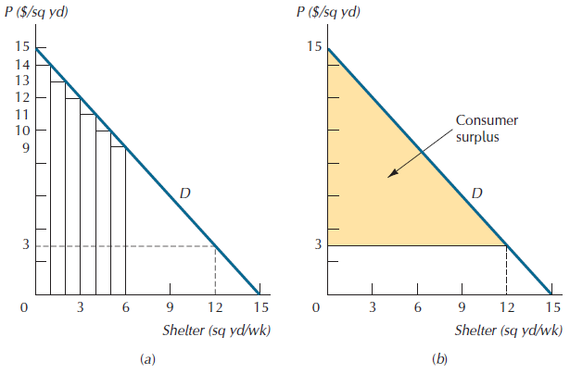
The Demand Curve Measure of Consumer Surplus
D represents an individual’s demand curve for shelter, which sells for a market price of $3/sq yd

Slide 5
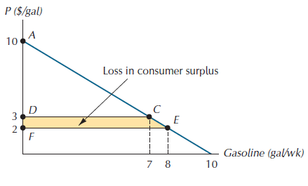
Example
An individual’s demand curve for gasoline is given by P = 10 – Q. If the individual’s weekly income is $1000 and the current price of gasoline is $2/gal, by how much will her consumer surplus decline if an oil import restriction raises price to $3/gal?

Slide 6
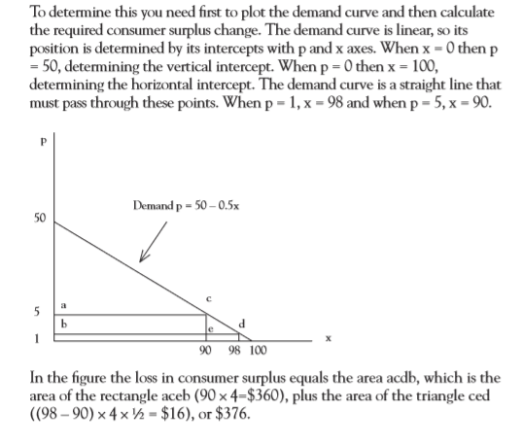
Example
When demand is estimated to be p = 50 – 0.5x, calculate the loss in consumer surplus when a tax drives price from $1 to $5.

Slide 7
Example
Consumer & Producer Surplus If QD = 950 – P and QS = 2P - 160:
a. Solve for the market equilibrium price (P*) and market equilibrium quantity (Q*).
b. Solve for consumer surplus, producer surplus and total surplus.

